Slide 1
SOIL HEALTH U
Water Panel: Conserving Every Last Drop

Slide 2
Water Panel: Conserving Every Last Drop (2:30 PM)
Moderated By:
Wes McCary Tech Projects Coordinator – Kansas Water Office
Panelists:
Katie Durham Manager – Groundwater Management District No. 1
Ryan Brady Farmer/rancher – Quarter Turn, Inc
Pat Janssen Farmer/rancher – Janssen Beef & Grain
Dwane Roth Farmer/Consultant – Garden City Company

Slide 3
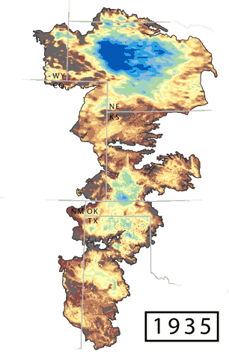
Notes:
Section 1
3

Slide 4
QUESTIONS?

