Slide 1
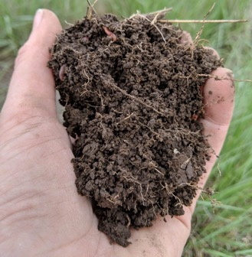
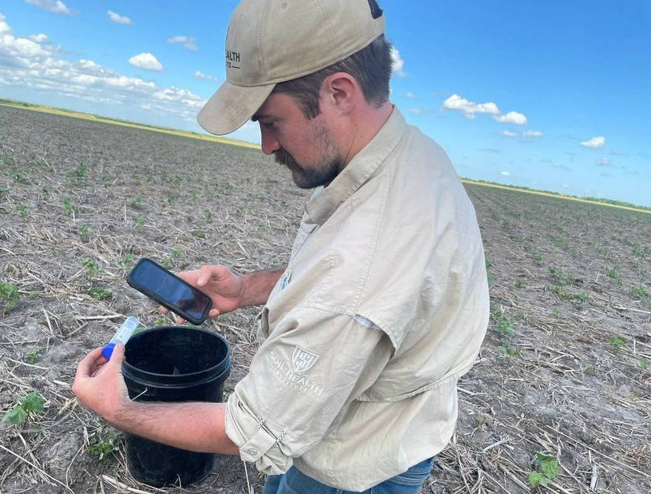
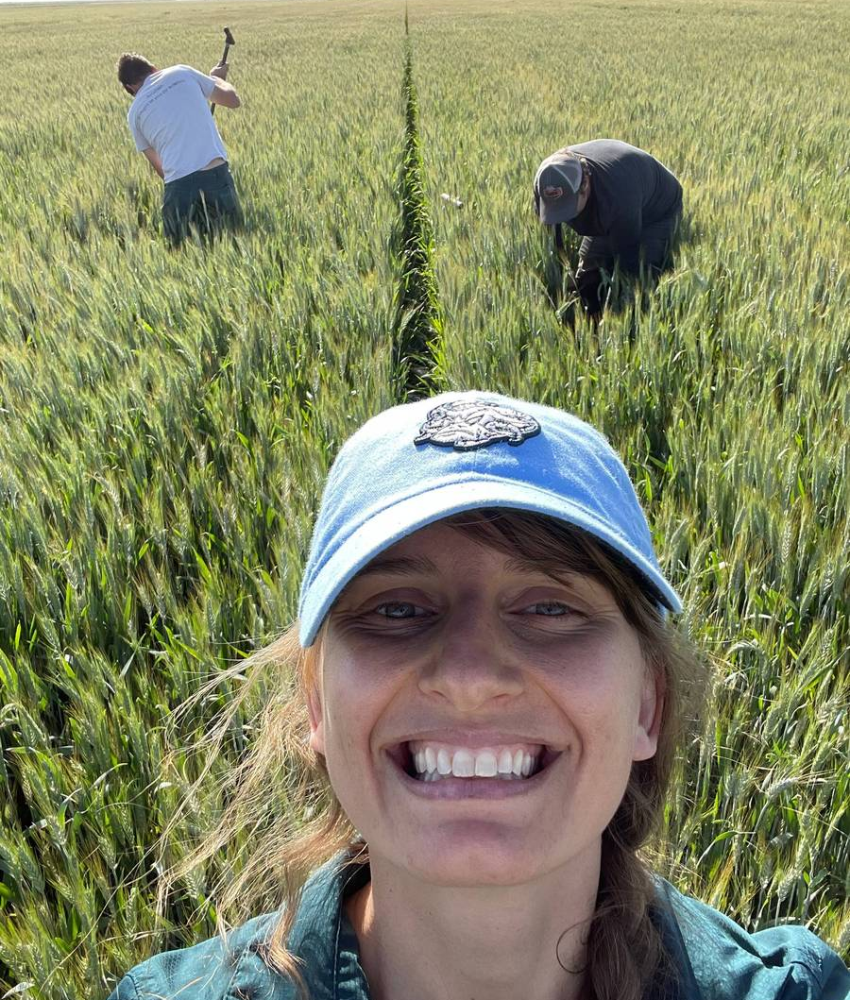
Measuring and assessing Soil Health
Enriching Soil, Enhancing Life
Cristine Morgan, PhD
Chief Scientific Officer

Slide 2
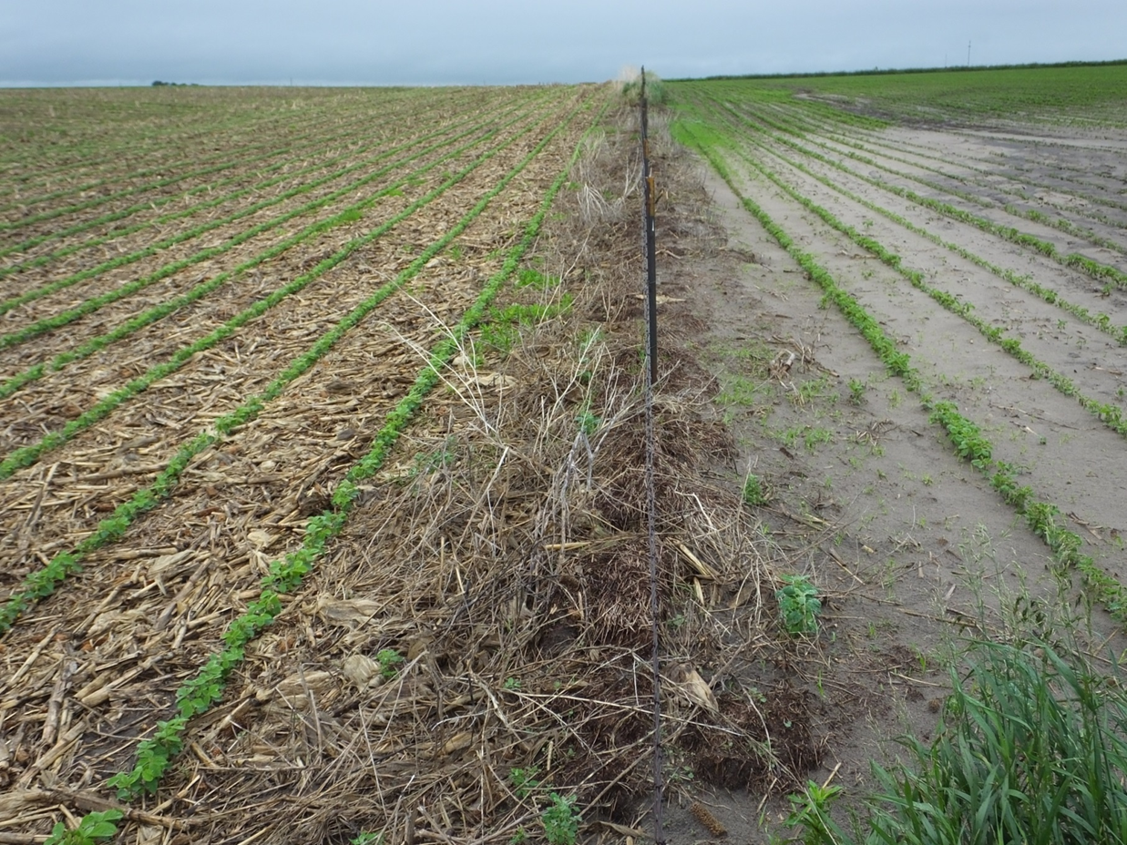
Soil Health
What is Soil Health?

Slide 3
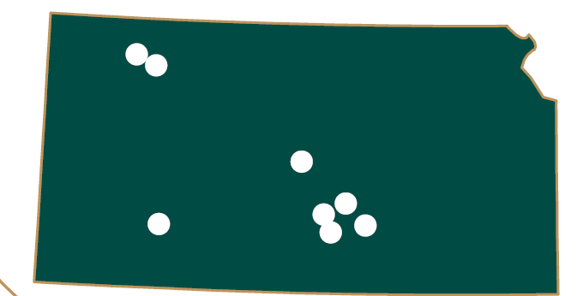
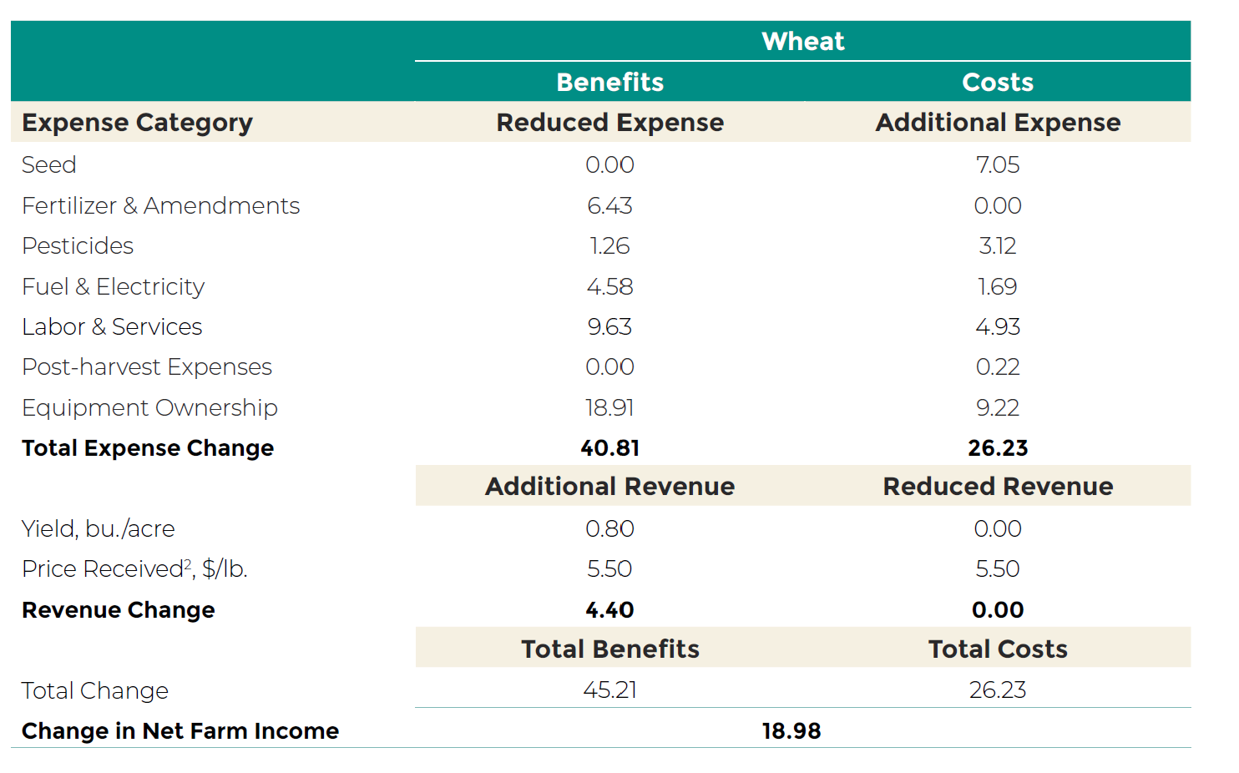

Business Case for Soil Health Mangement
Partial Budget Analyses: 10 farms in KS and ND

Slide 4
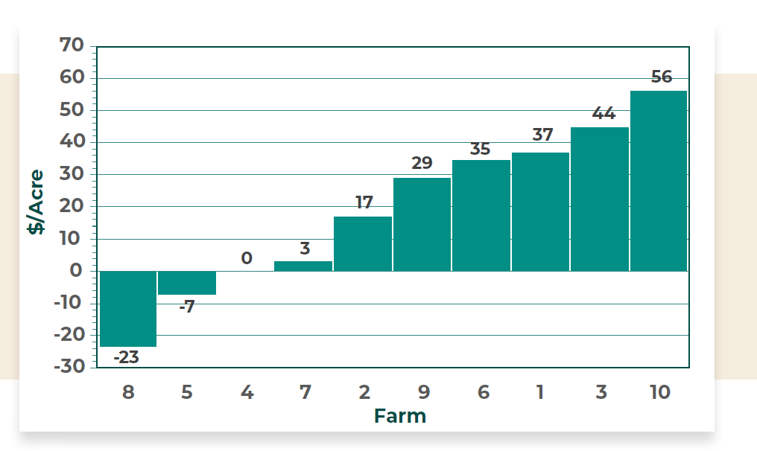
Partial Budget: 10 farms in Kansas and North Dakota
Mean change in net farm income for wheat is $19/acre after adopting SHMS

Slide 5
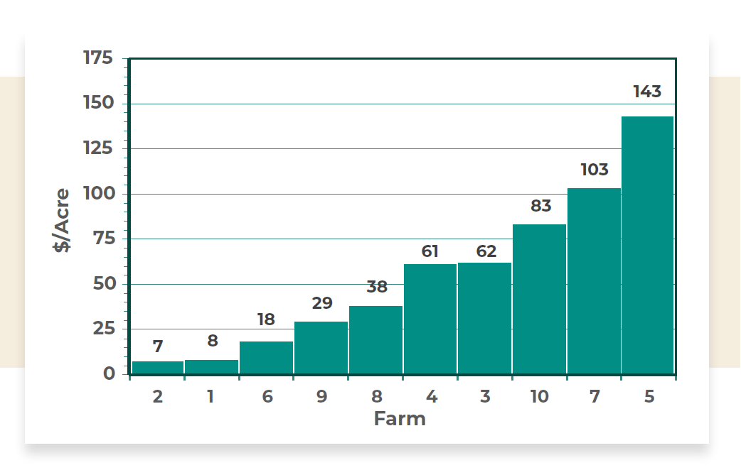
Partial Budget: 10 farms in Kansas and North Dakota
Mean change in net farm across many crops including grazing $55/acre

Slide 6
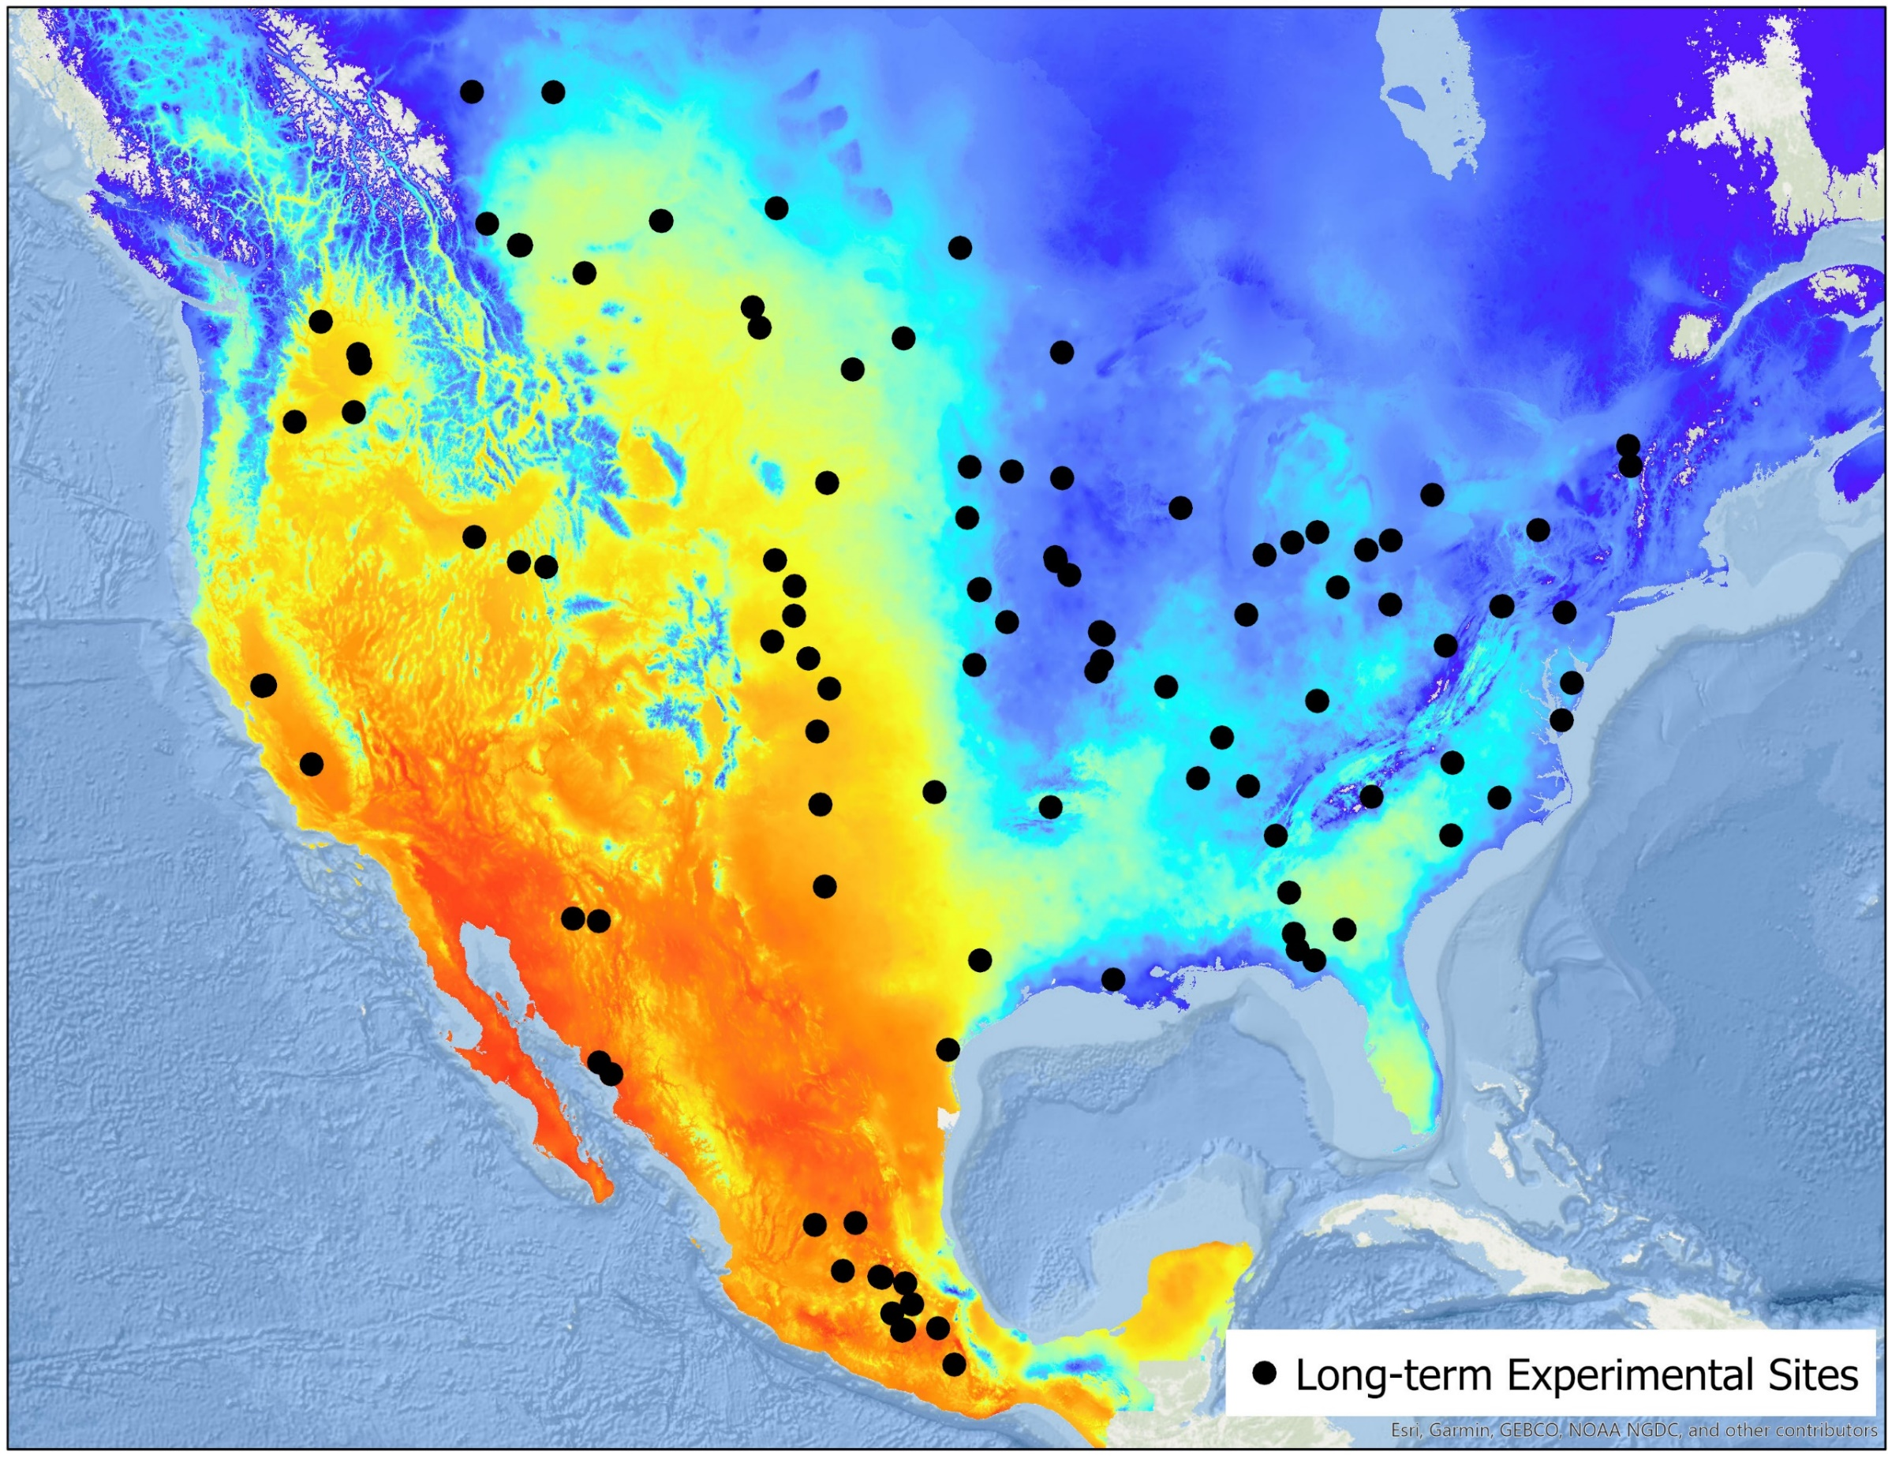


Measuring Soil Health at Scale
North American Project to Evaluate Soil Health Measurements
Identify most effective indicators of soil health
124 long term experimental sites
  Paired treatments- tillage, cover crops, crop rotations
  0-15 cm depth
Over 30 current & exploratory soil health measurements
Notes:
I’d like to start today with a brief background on how we got to this point

Slide 7
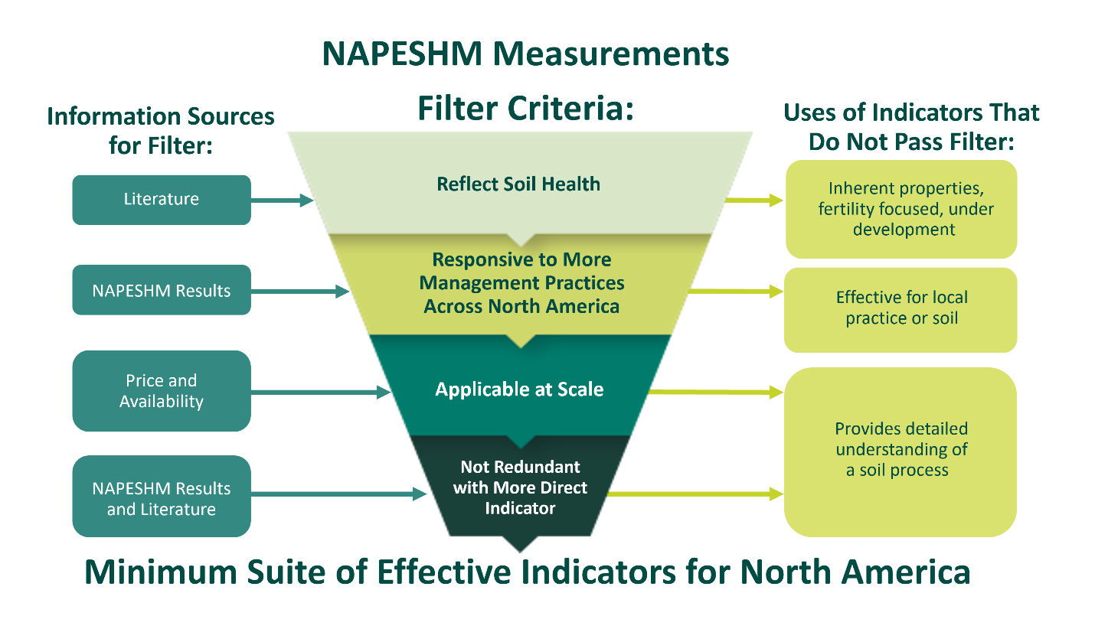
Measuring Soil Health at Scale
Notes:
How did we go from over 30 potential indicators to our minimum suite?
We used a filtering process

Slide 8
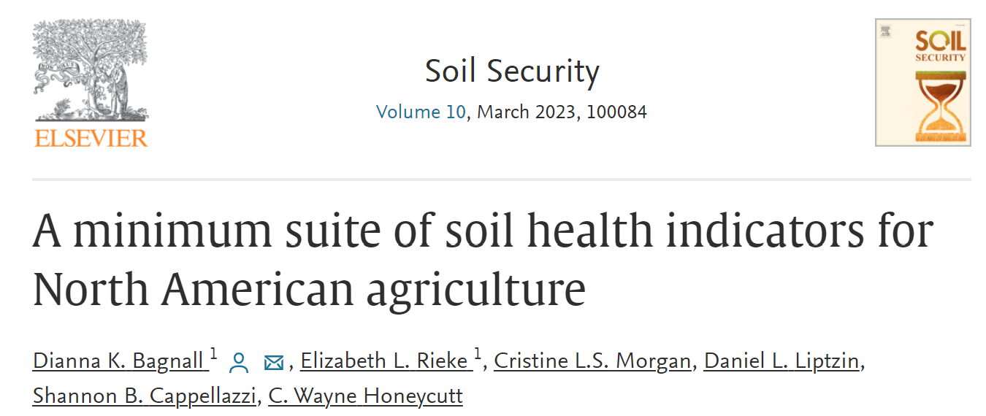
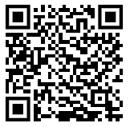
Measuring Soil Health at Scale
Selected Soil Health Indicators:
Soil Organic Carbon Concentration
Carbon Mineralization Potential
Aggregate Stability via Slaking Image Analysis
Predicted Available Water Holding Capacity
Bagnall, D.K., Morgan, C.L.S., Cope, M., … Honeycutt, C.W., 2022. Carbon sensitive pedotransfer functions for plant available water. Soil Sci. Soc. Am. J. https://doi.org/10.1002/saj2.20395
Notes:
This process left us with 3 measurements that together make up 4 indicators

Slide 9
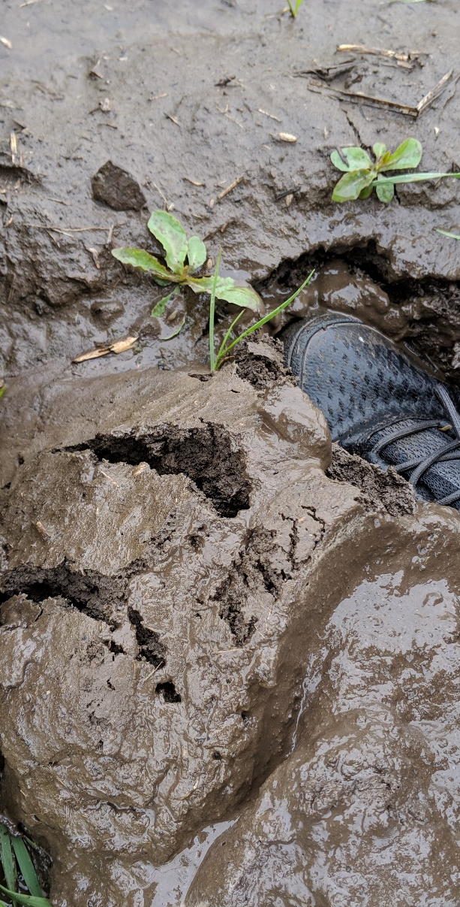
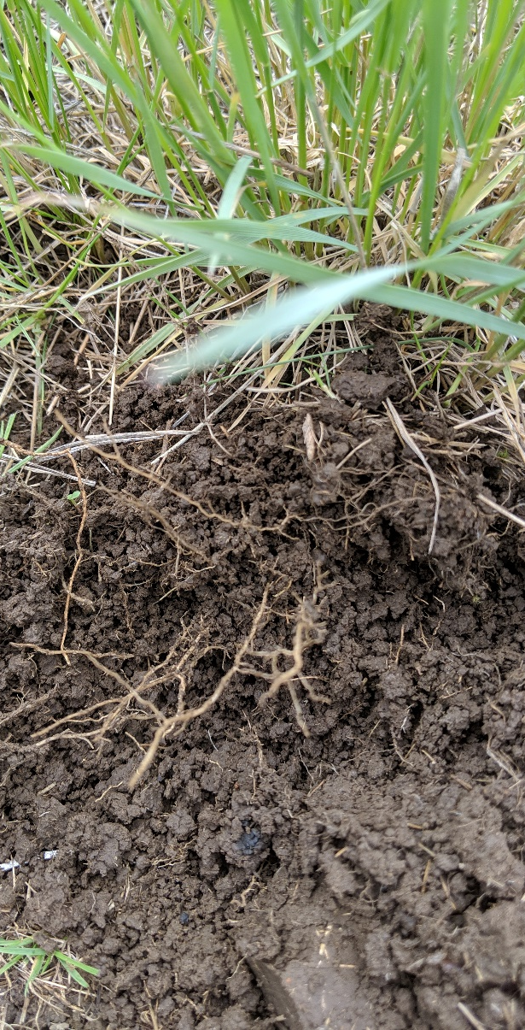
Scaling Soil Health Assessment
Management Systems
Baseline
Soil Health
Reference
Soil Organic Carbon %
0.8 1.7 2.2
C Mineralization Potential
8 45 94
Aggregate Stability
0.21 0.36 0.49
Available Water Holding Capacity
inches per acre -- top 6”
1.21 1.36 1.44
9
Notes:
Dianna added available water on 8/2/22. Available water units are in gallons for an acre to six inch depth. If we want the units in m3 per m3, those would be means of .202, .225, and .234 with sd of .0017, .0051, and .0026. In inches of water per acre to a 6 inch depth, the values would be 1.21, 1.35, and 1.41 inches with SD of .01, .03, and .02 inches. The sites for BAU, SHMS, Target are USOR01, USOR03, and USOR02 and the treatments are BAU) trash till, wheat-fallow, winter wheat, SHMS)winter-wheat_pea;no-till and Target) no farming, perennial grass

Slide 10
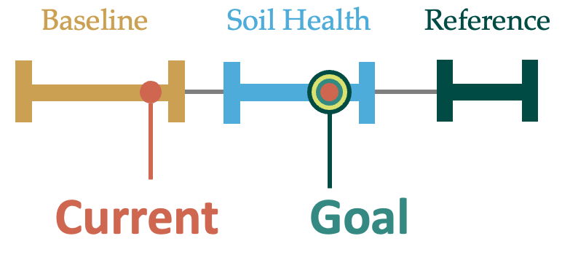
Interpreting Indicators – Soil Health Benchmarks
Benchmarking Soil Health
An interpretable, scalable, locally relevant method for evaluating and monitoring soil health. Goals are set by farmers and their advisors.

Slide 11
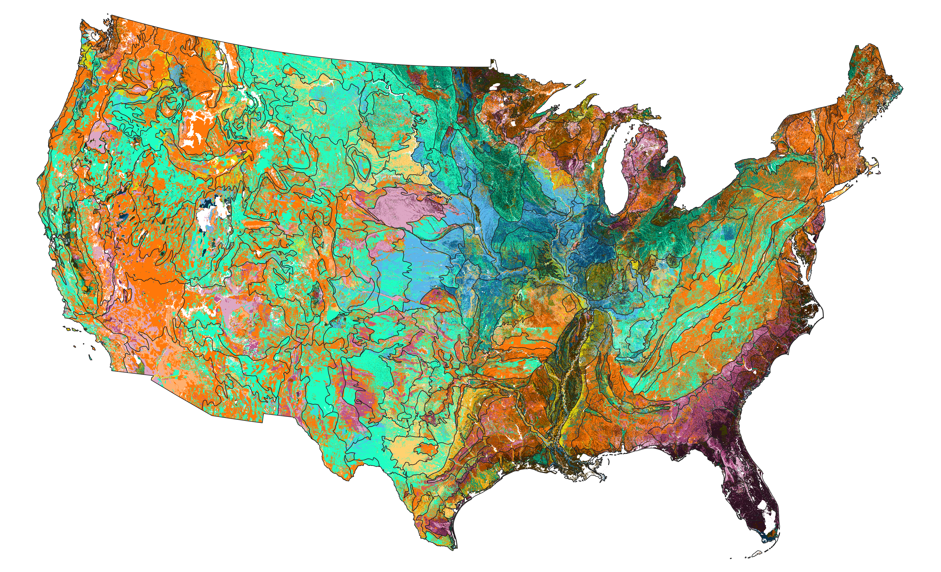
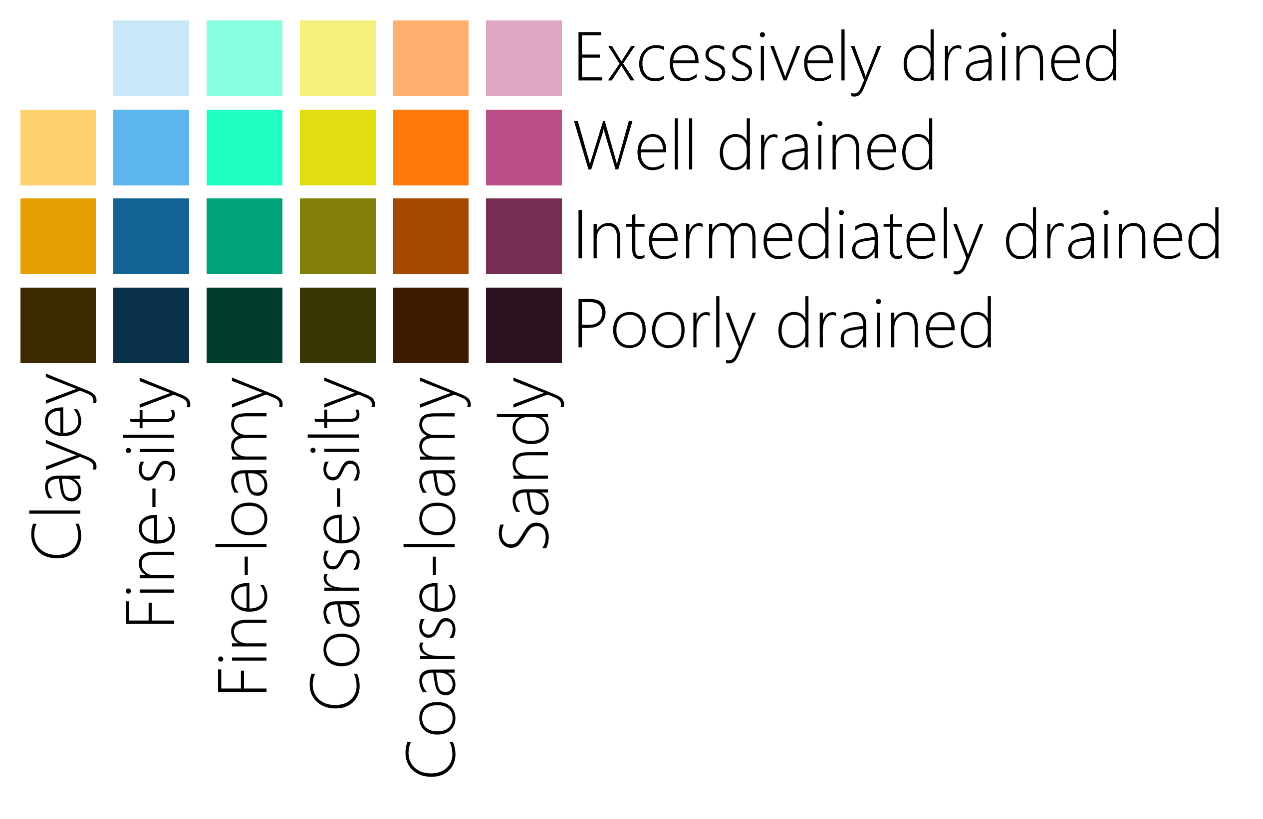
Soil health sampling groups for the conterminous US
Notes:
SSURGO-based soil health sampling groups (topsoil texture x drainage class)

Slide 12
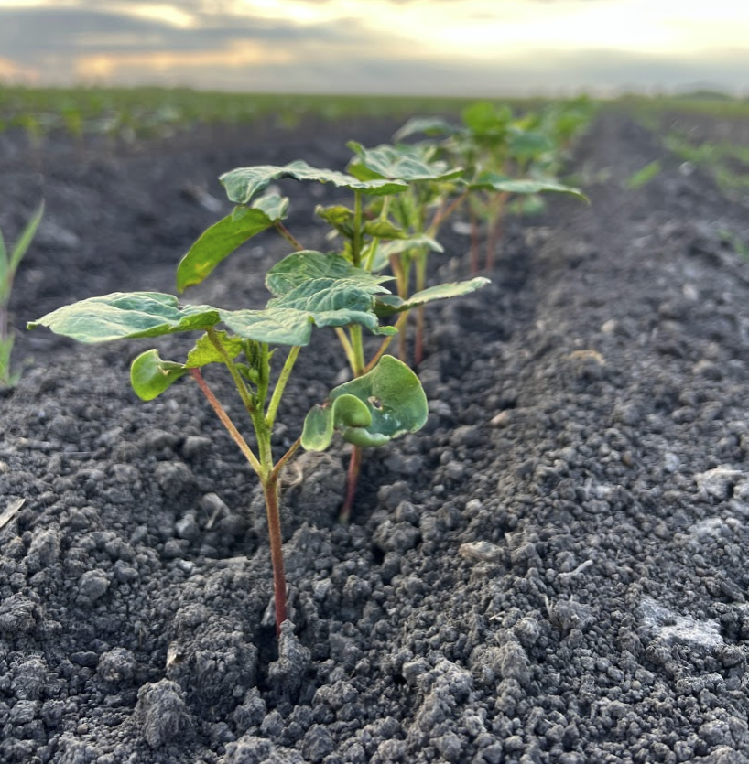
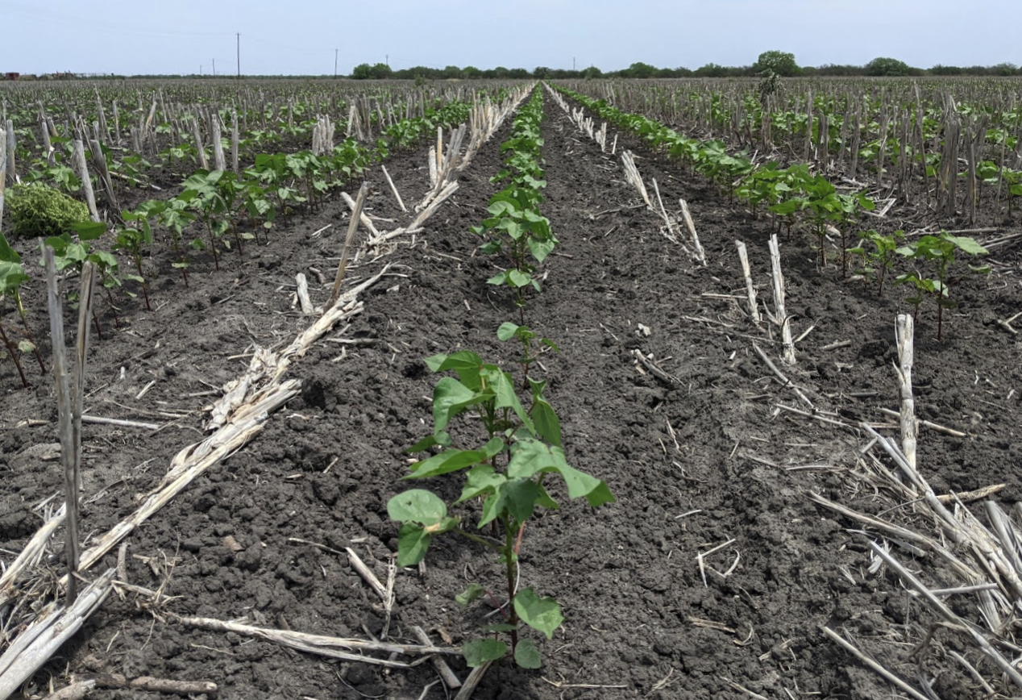
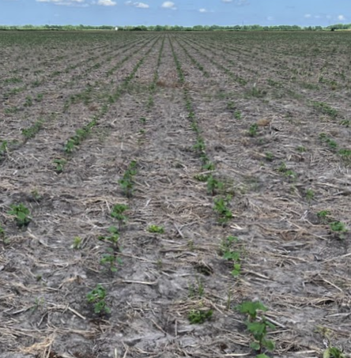
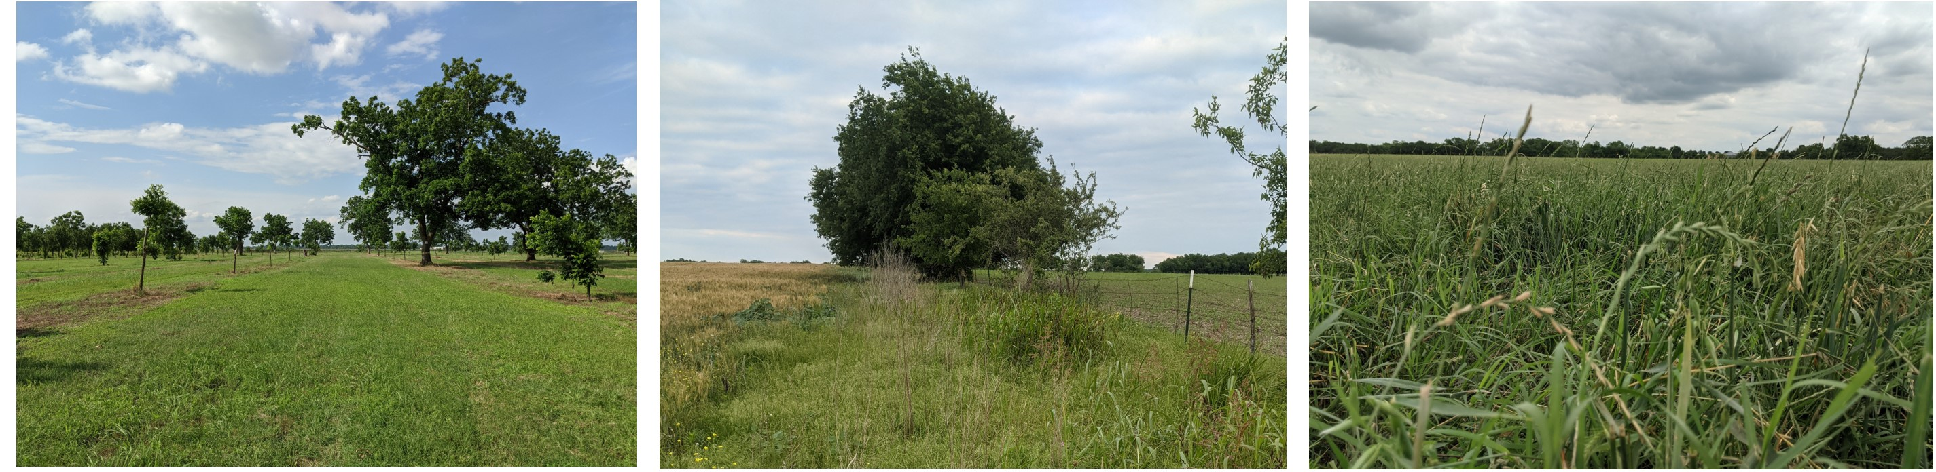
Soil Health: Capability/Connectivity
Benchmarking Soil Health

Slide 13
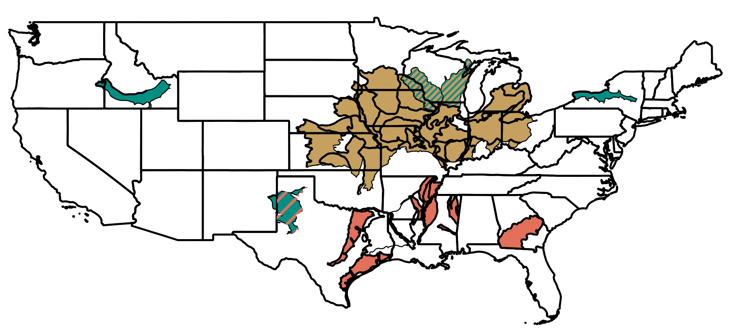
Interpreting Indicators – Soil Health Benchmarks
Constraining Climate by MLRA
Agrosystems
Farms Sampled
Corn & Soybean
239
Dairy Feed
87
Cotton
280

Slide 14
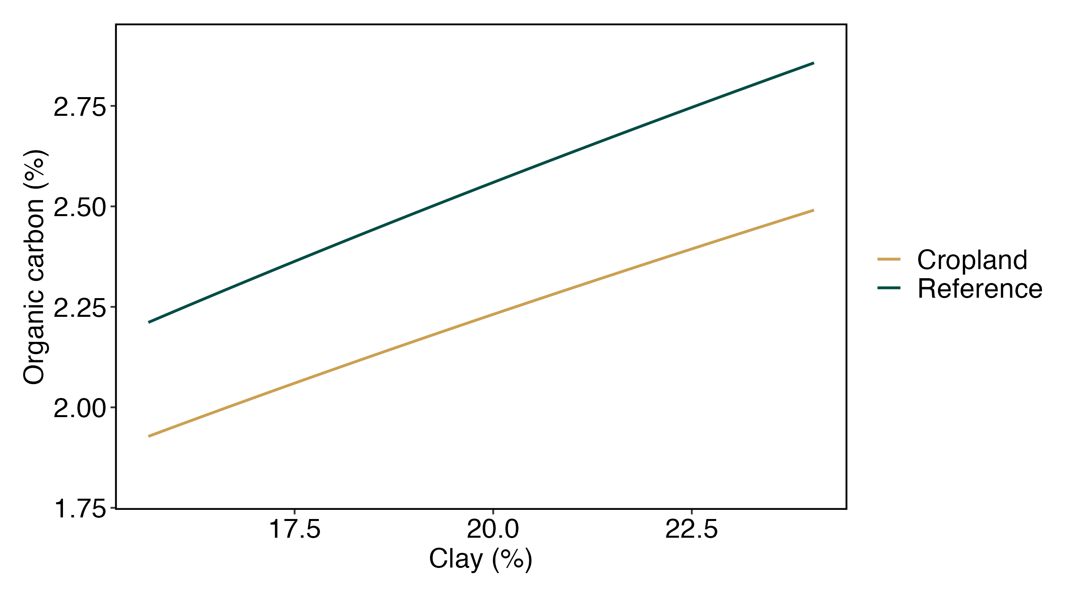

Interpreting Indicators – Soil Health Benchmarks
Regional Interpretation of Management Effects
WI - Driftless
Benchmark
Innovation Space
Average under Row Crops

Slide 15
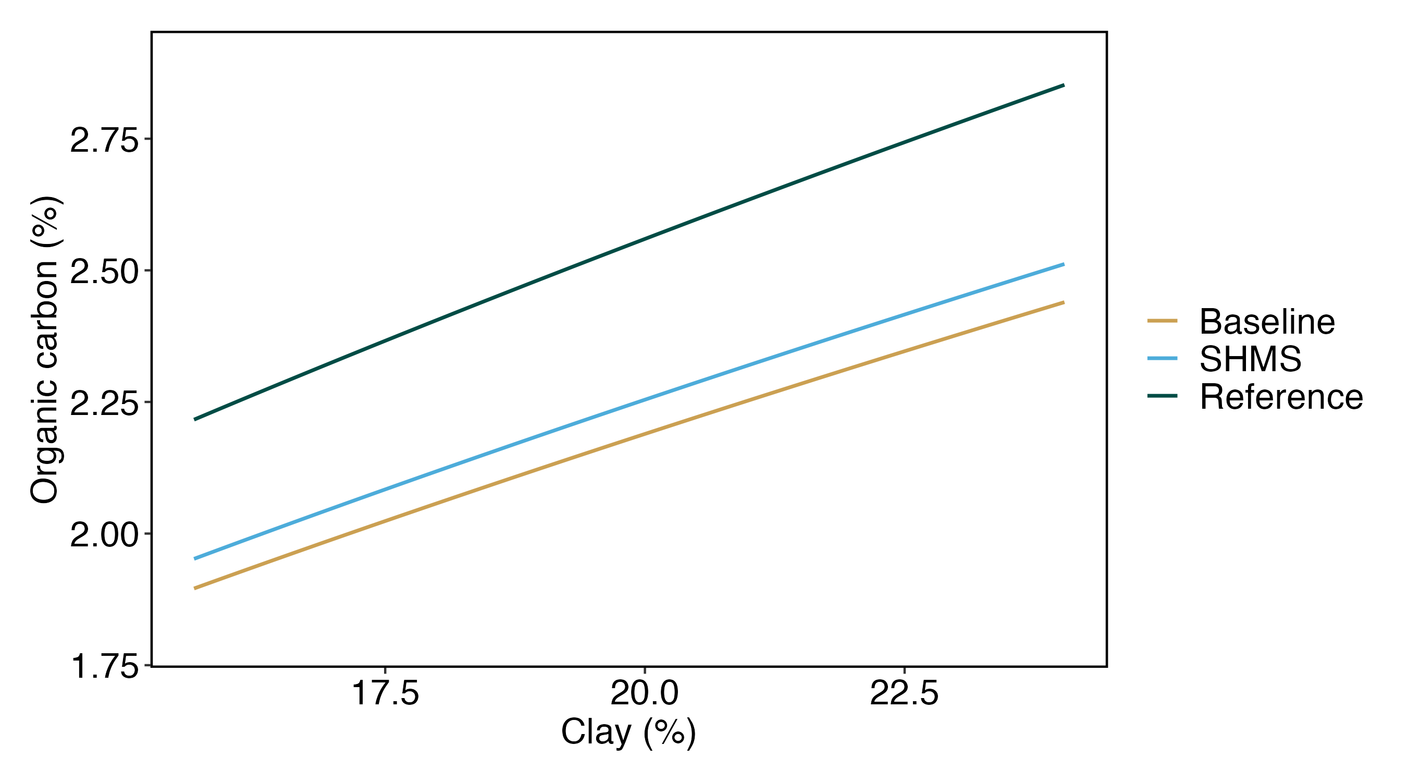
Interpreting Indicators – Soil Health Benchmarks
Regional Effects of Management
WI - Driftless

Slide 16
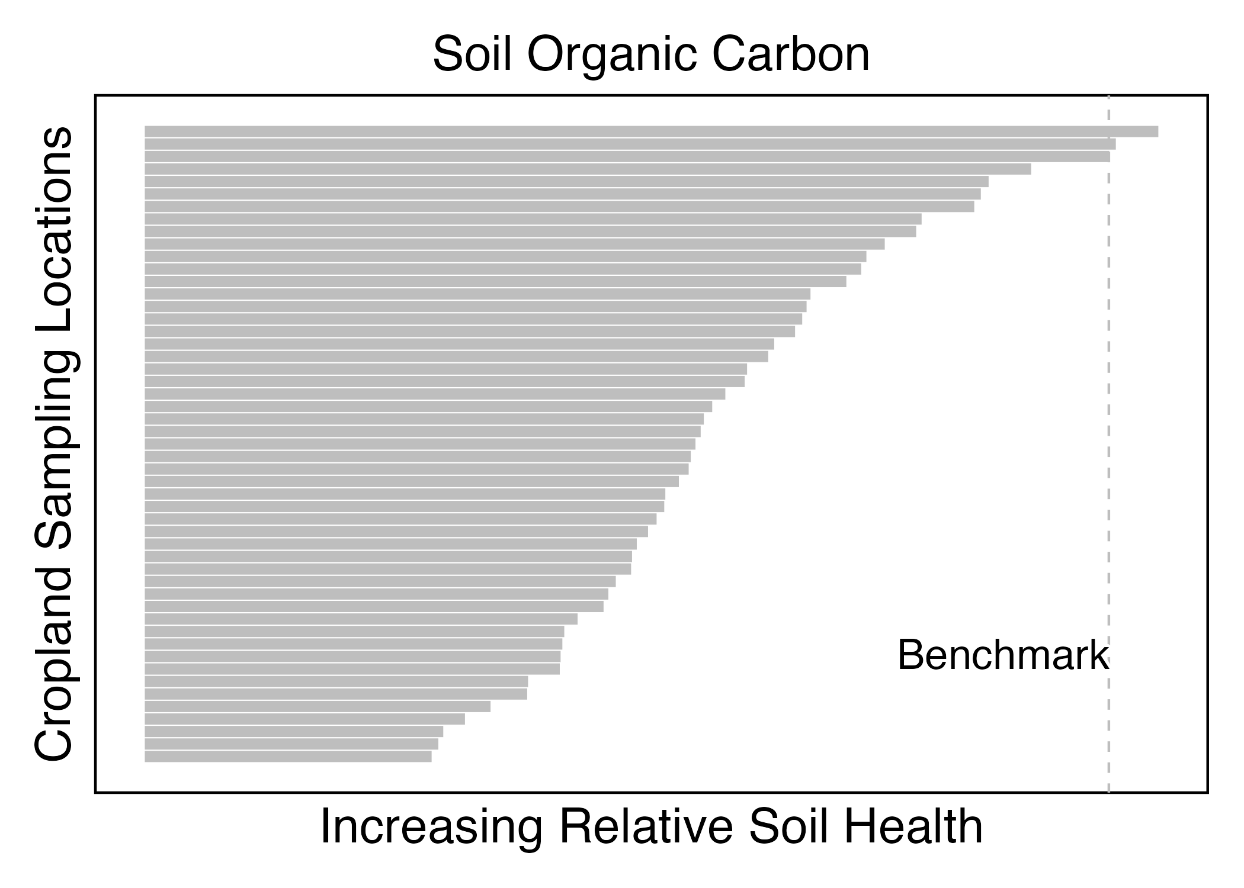
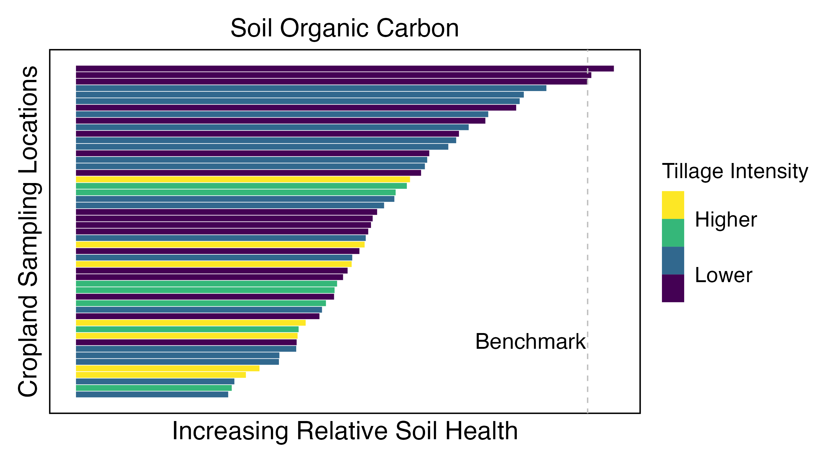
Soil Health Benchmarks
Progress Achieved at the Regional Scale (GA)
Notes:
51 cropland locations with gTIR shown

Slide 17
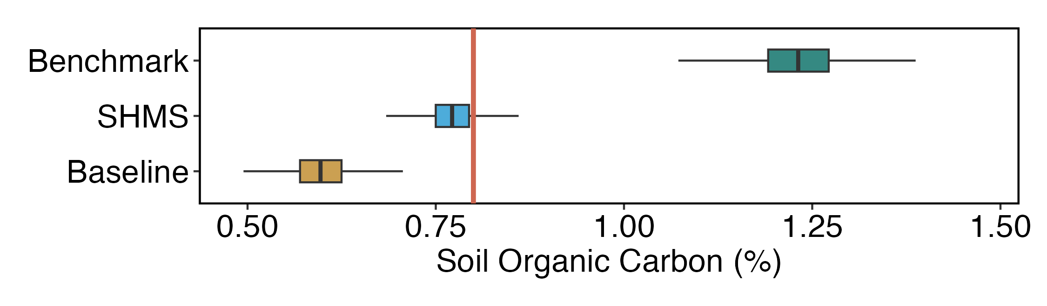
Soil Health Benchmarks
Farmer-Facing Reporting
  Sample with 80% sand and 0.8% SOC
  Expected values of SOC for soils with 80% sand in same region
Notes:
View for individual sample (e.g., representing part of a field) with 80% sand
Boxplots show SOC values expected for each mgmt system (model-predicted means with uncertainties)
Red vertical line shows SOC value for individual sample

Slide 18
Measuring and Assessing Soil Health
Summary
Soil health management systems can help our most productive soils become more profitable
We can measure and monitor soil health affordably (3 accessible measurements)
Achievable soil health varies by soil type, climate, and cropping system
If you treasure it measure it

Slide 19
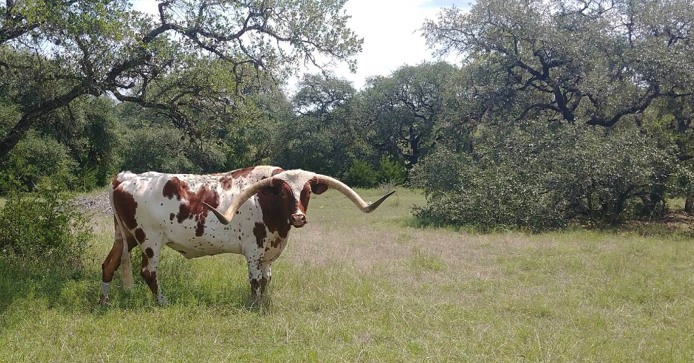
Cmorgan@soilhealthinstitute.org
Notes:
Thank you.
We invite you to visit the SHI website where you will find information on the upcoming Annual Meeting – Aug 1-3 in Albuquerque, and can sign up to receive quarterly newsletters of many things going on in the soil health world.

