Slide 1
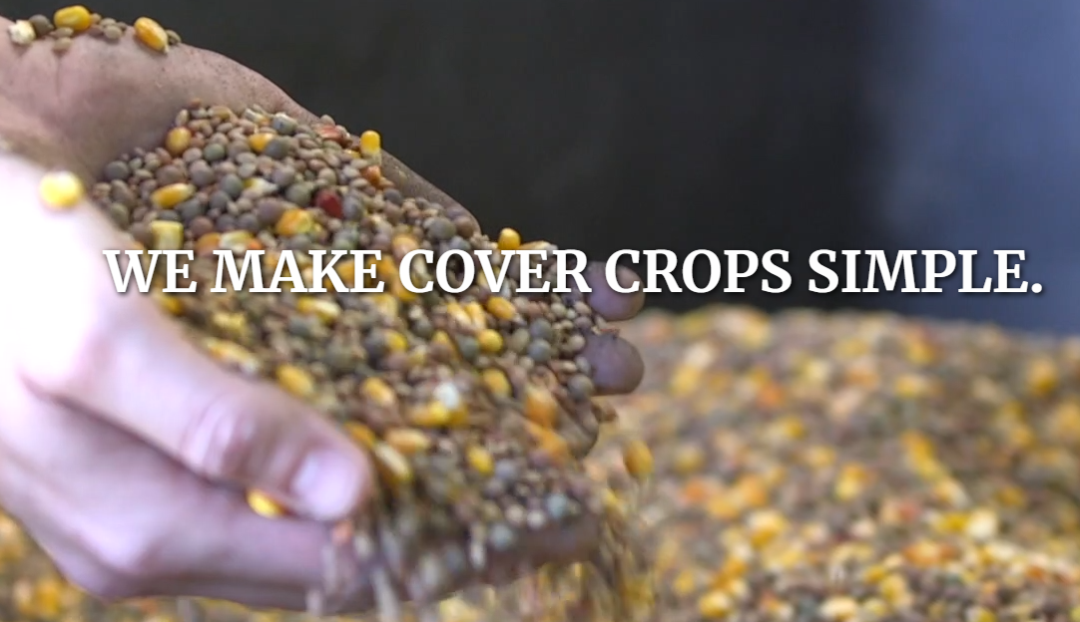
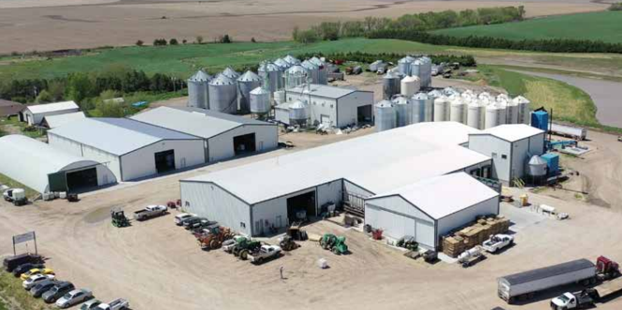
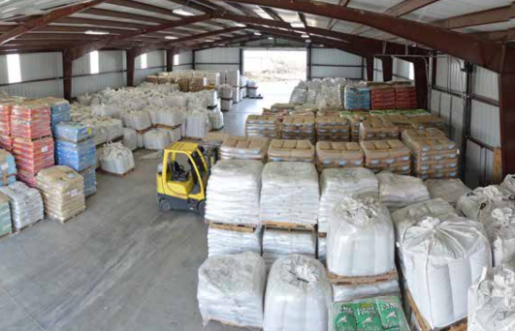
Keith Berns

Slide 2
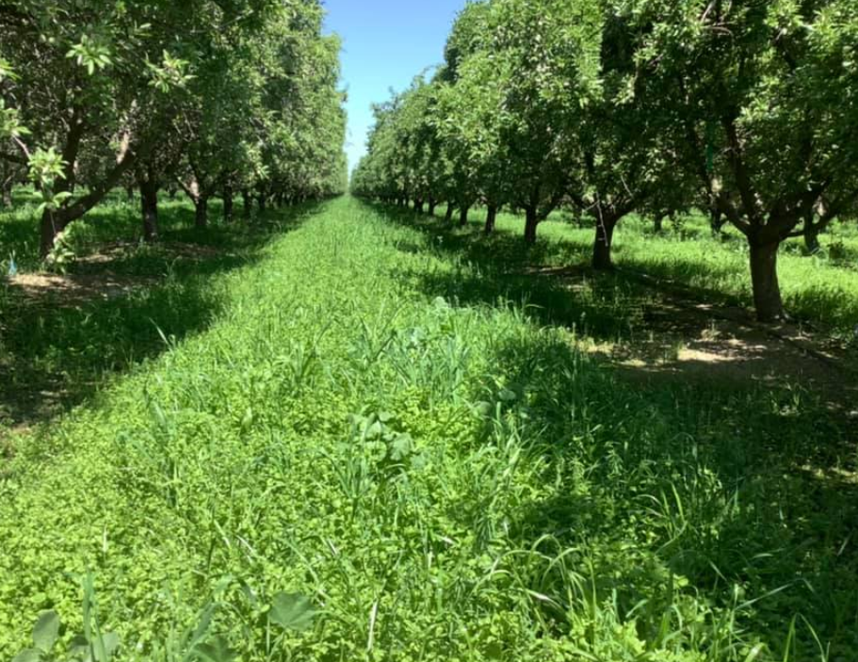
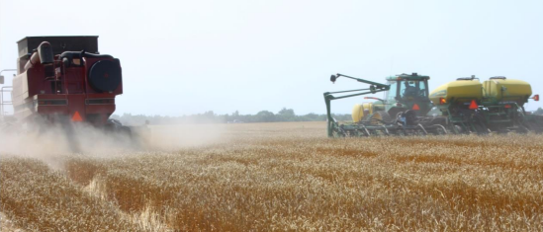
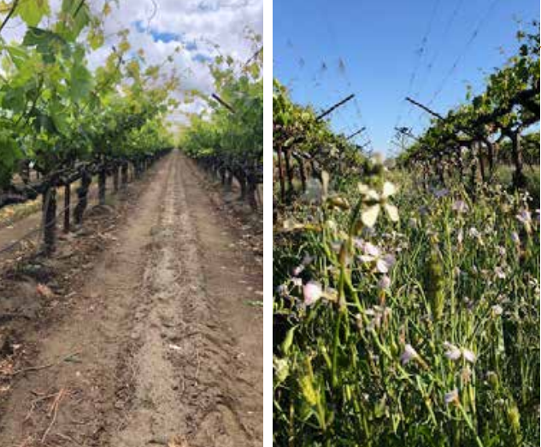
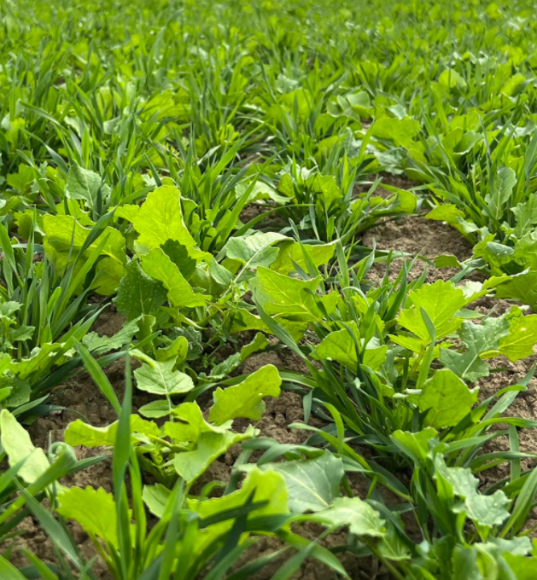
Why Cover Crops?

Slide 3
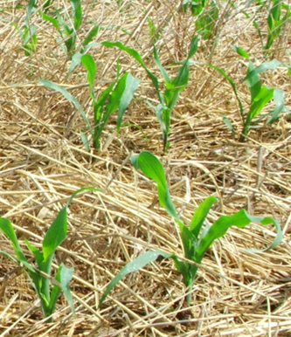
Post Harvest Cover Crops Why?
What are your goals for the cover crop?

Slide 4
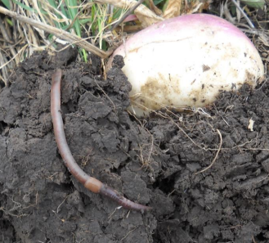
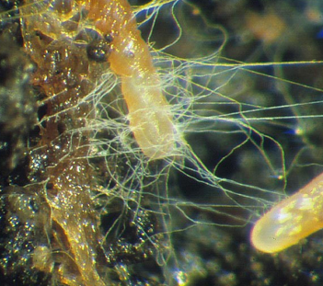
Post Harvest Cover Crops Why?
What are your goals for the cover crop?
Biology boosting

Slide 5
Post Harvest Cover Crops Why?
What are your goals for the cover crop?
Biology boosting
Erosion prevention

Slide 6
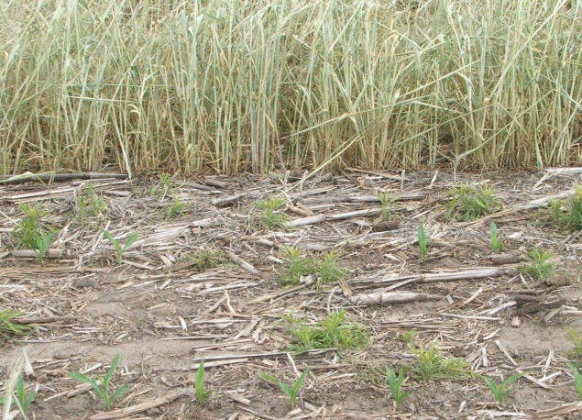
Post Harvest Cover Crops Why?
What are your goals for the cover crop?
Biology boosting
Erosion prevention
Weed control

Slide 7
Post Harvest Cover Crops Why?
What are your goals for the cover crop?
Biology boosting
Erosion prevention
Weed control

Slide 8
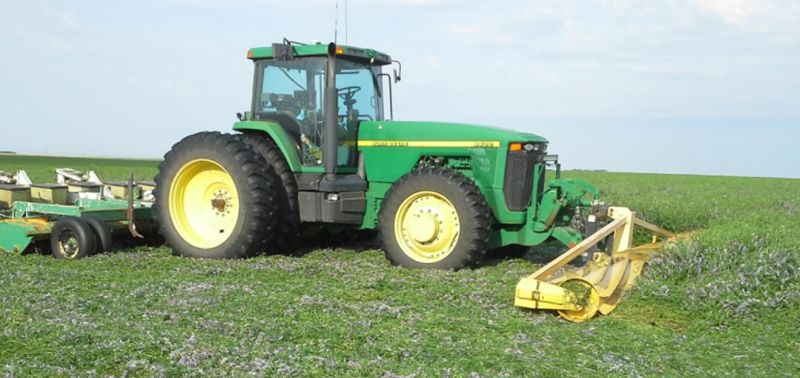
Post Harvest Cover Crops Why?
What are your goals for the cover crop?
Biology boosting
Erosion prevention
Weed control
Nitrogen fixation

Slide 9
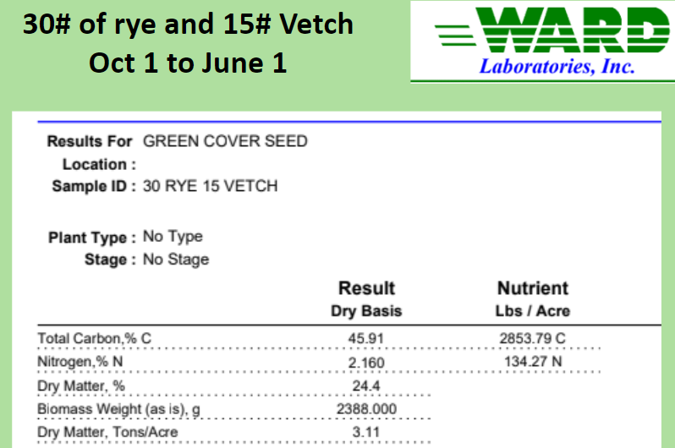
Post Harvest Cover Crops Why?
What are your goals for the cover crop?
Biology boosting
Erosion prevention
Weed control
Nitrogen fixation

Slide 10
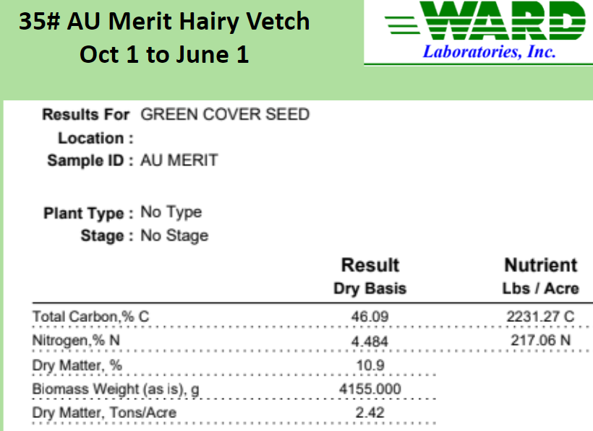
Post Harvest Cover Crops Why?
What are your goals for the cover crop?
Biology boosting
Erosion prevention
Weed control
Nitrogen fixation

Slide 11
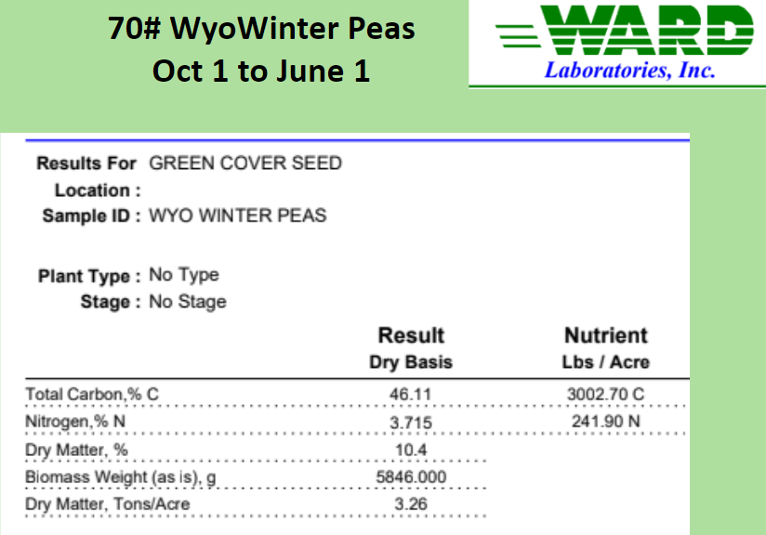
Post Harvest Cover Crops Why?
What are your goals for the cover crop?
Biology boosting
Erosion prevention
Weed control
Nitrogen fixation

Slide 12
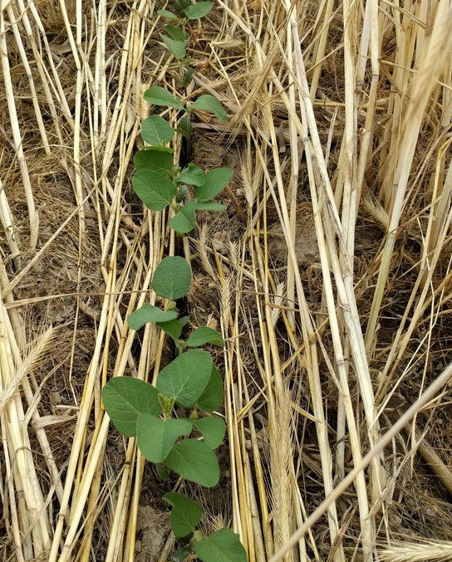
Post Harvest Cover Crops Why?
What are your goals for the cover crop?
Biology boosting
Erosion prevention
Weed control
Nitrogen fixation
Nutrient cycling and availability

Slide 13
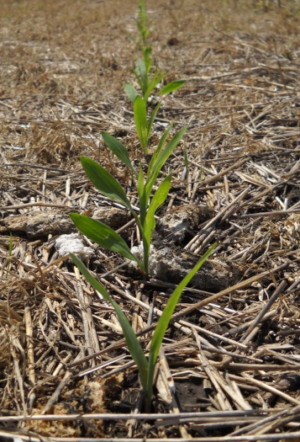
Post Harvest Cover Crops Why?
What are your goals for the cover crop?
Biology boosting
Erosion prevention
Weed control
Nitrogen fixation
Nutrient cycling and availability

Slide 14
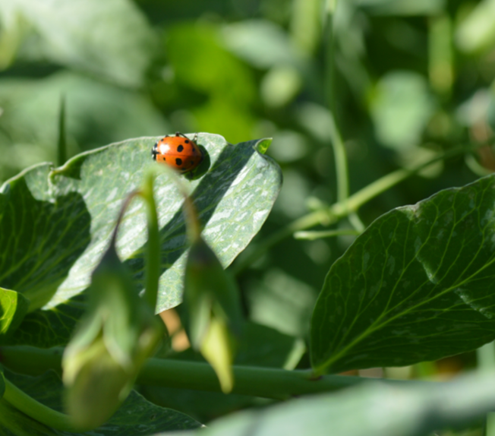
Post Harvest Cover Crops Why?
What are your goals for the cover crop?
Biology boosting
Erosion prevention
Weed control
Nitrogen fixation
Nutrient cycling and availability
Beneficial and pollinator insect habitat and forage

Slide 15
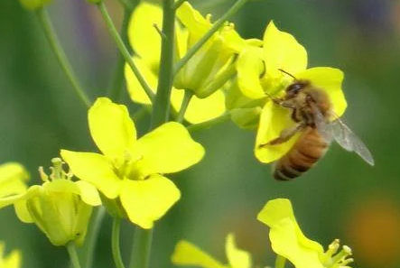
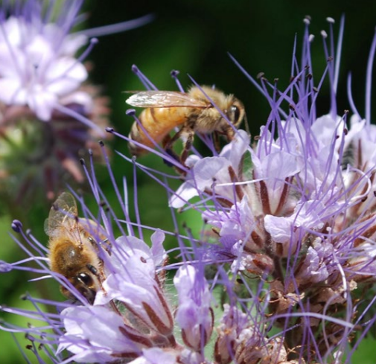
Post Harvest Cover Crops Why?
What are your goals for the cover crop?
Biology boosting
Erosion prevention
Weed control
Nitrogen fixation
Nutrient cycling and availability
Beneficial and pollinator insect habitat and forage

Slide 16
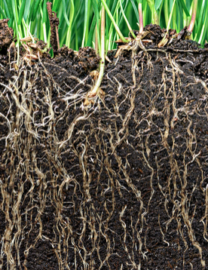
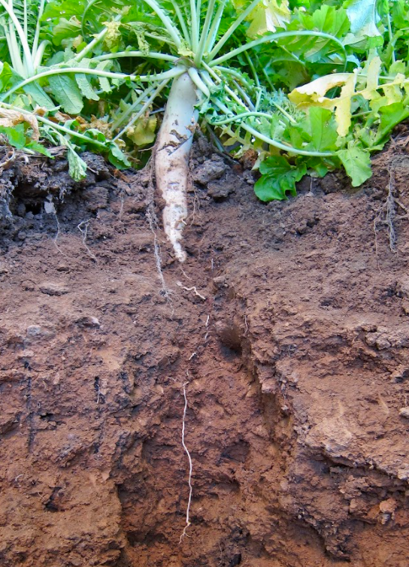
Post Harvest Cover Crops Why?
What are your goals for the cover crop?
Biology boosting
Erosion prevention
Weed control
Nitrogen fixation
Nutrient cycling and availability
Beneficial and pollinator insect habitat and forage
Compaction and infiltration issues

Slide 17
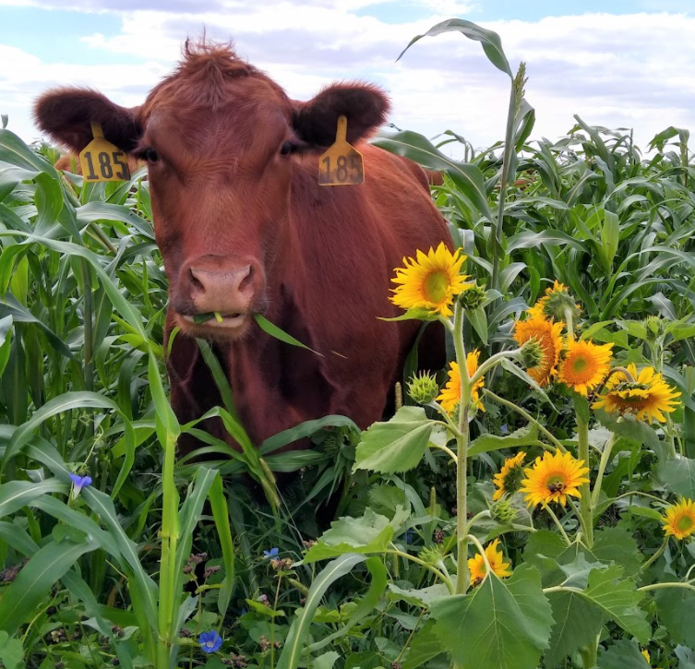
Post Harvest Cover Crops Why?
What are your goals for the cover crop?
Biology boosting
Erosion prevention
Weed control
Nitrogen fixation
Nutrient cycling and availability
Beneficial and pollinator insect habitat and forage
Compaction and infiltration issues
Supplemental Forage

Slide 18
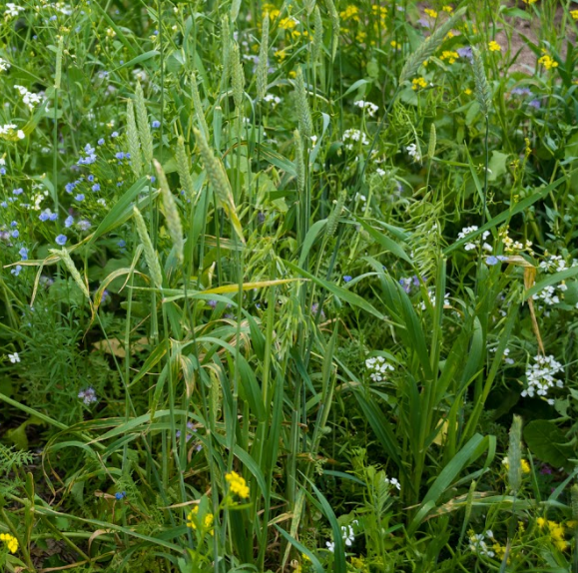
Post Harvest Cover Crops Why?
What are your goals for the cover crop?
Biology boosting
Erosion prevention
Weed control
Nitrogen fixation
Nutrient cycling and availability
Beneficial and pollinator insect habitat and forage
Compaction and infiltration issues
Supplemental Forage

Slide 19
Post Harvest Cover Crops When?
When can you plant the cover crop?
Timing is everything in the fall….
How much “growing” season do you have left?
Do you have and will you use irrigation?
Can you plant “pre” post harvest?
When and how will you terminate it?
Find the most cold-hardy varieties on the market

Slide 20
Post Harvest Cover Crops How?
How will you plant the cover crop?
Drilling or broadcasting?
If broadcasting, how will you help ensure seed to soil contact?
How can you take advantage of every fall day possible if growing season is limited?

Slide 21
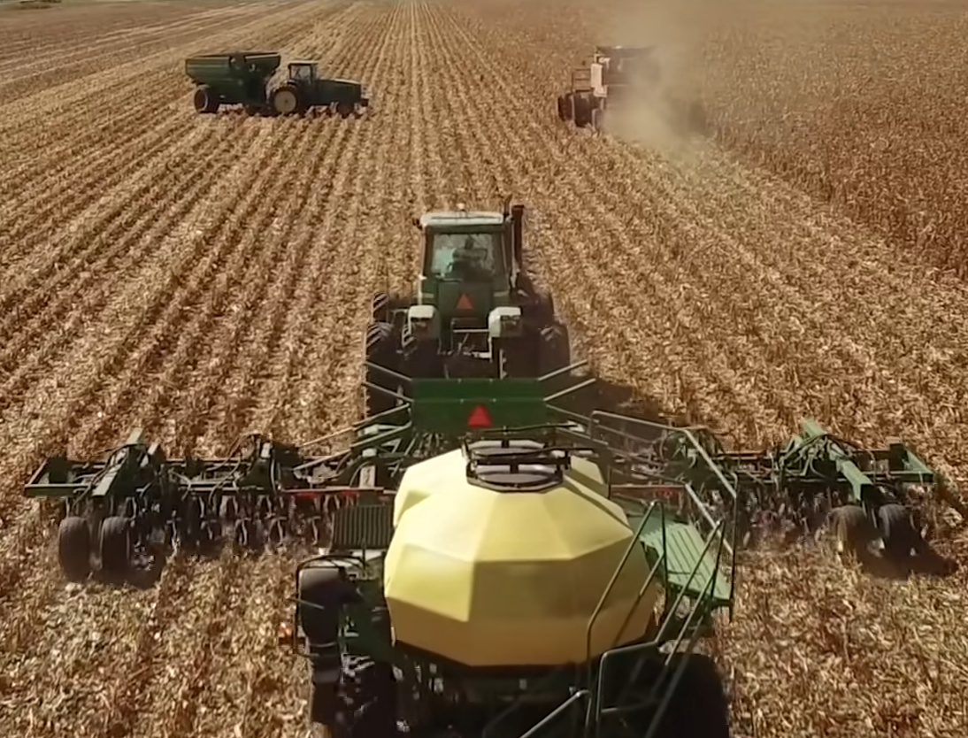
Post Harvest Cover Crops How?

Slide 22
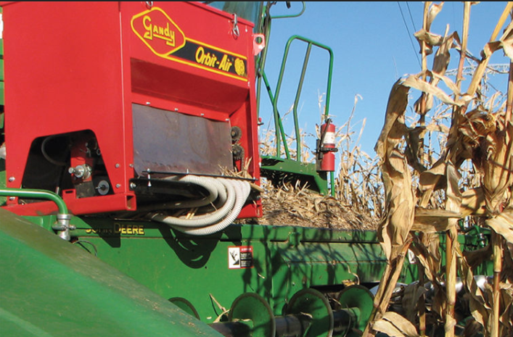
Post Harvest Cover Crops How?

Slide 23
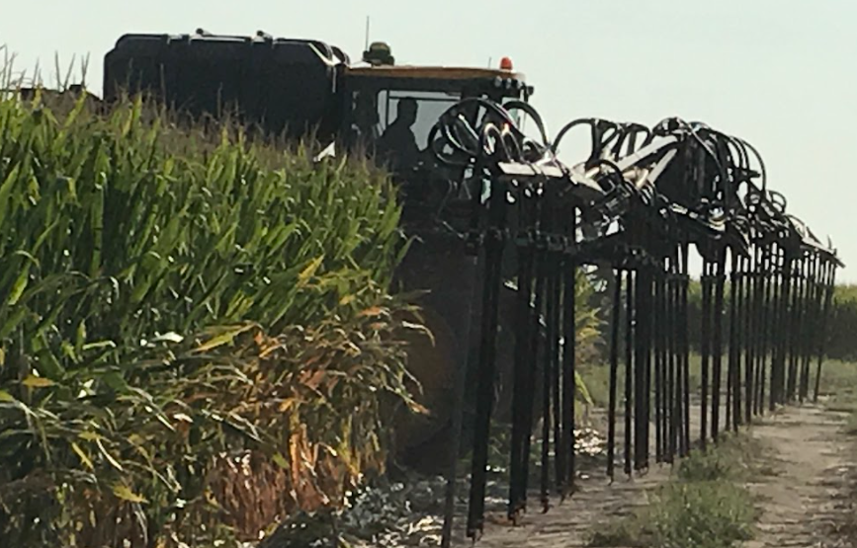
Post Harvest Cover Crops How?

Slide 24
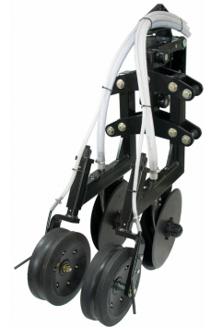
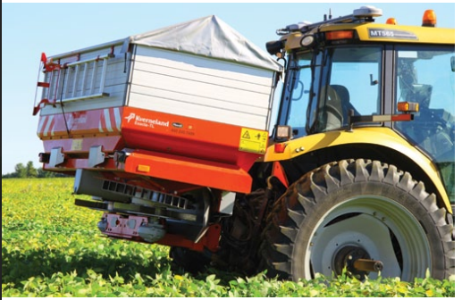
Post Harvest Cover Crops How?

Slide 25
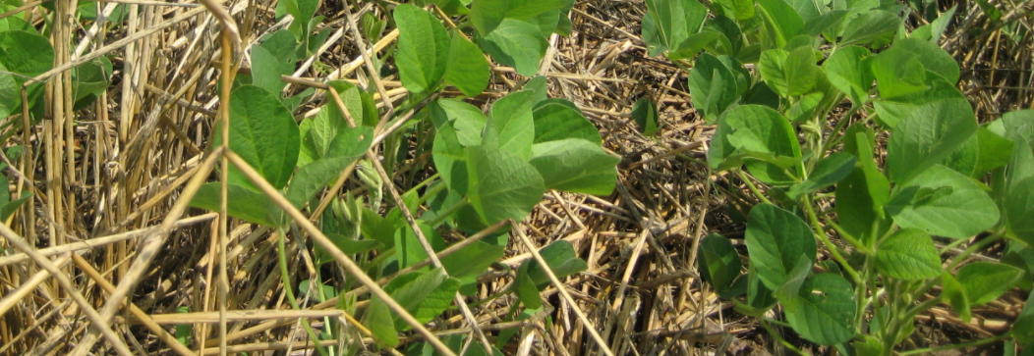
Post Harvest Cover Crops What?
What will the next crop be?
Do no harm to the next crop
Cover crops should be as different as possible (plant family) from the following crop.

Slide 26
Why Diverse Cover Crop Mixes?
If Soil Health is the goal, Crop Diversity cannot be ignored or overstated
Plants were created to grow in diverse ecosystems
Resilience comes from Diversity
Balanced “diet” for soil biology
Balance: because even good things (legumes, brassicas) when not used in moderated balance can be harmful

Slide 27
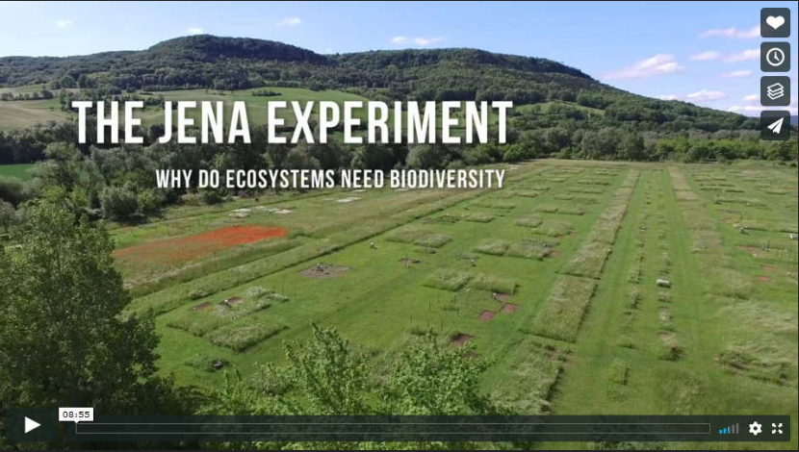

Slide 28
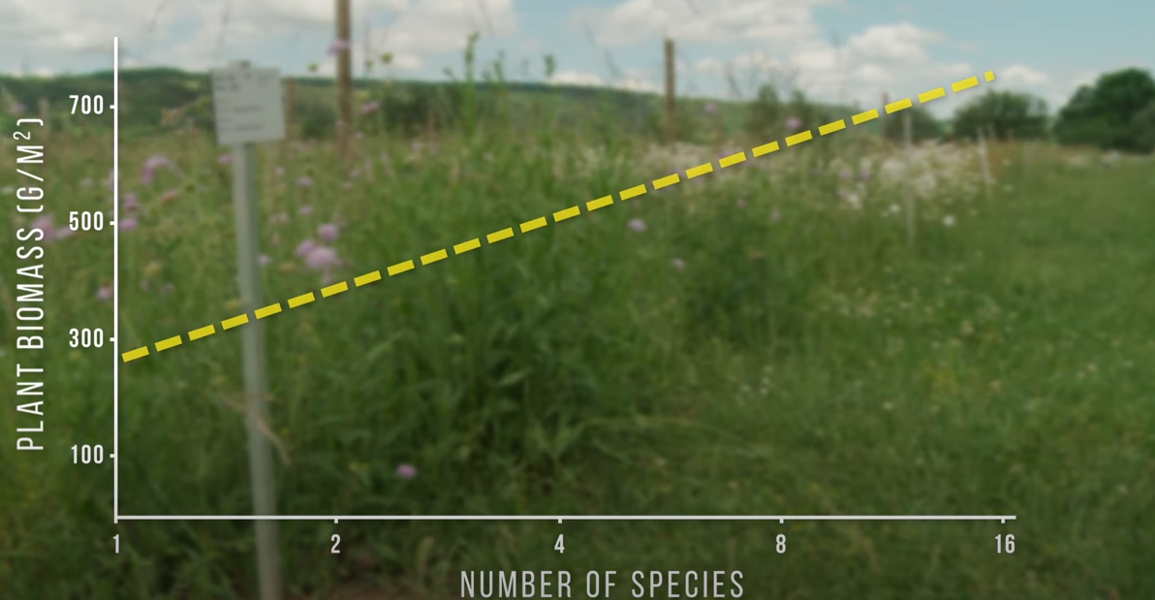
Plant biomass increases as species diversity increases

Slide 29
Plant biomass increases as species diversity increases

Slide 30
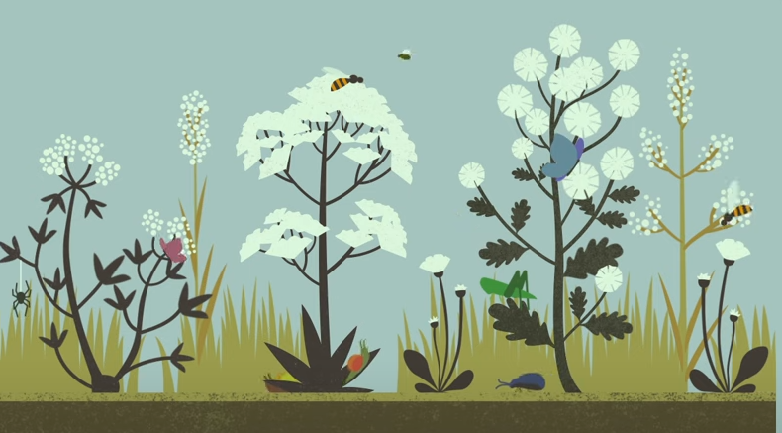
Plant diversity has a positive effect on the diversity of other organisms in the ecosystem

Slide 31
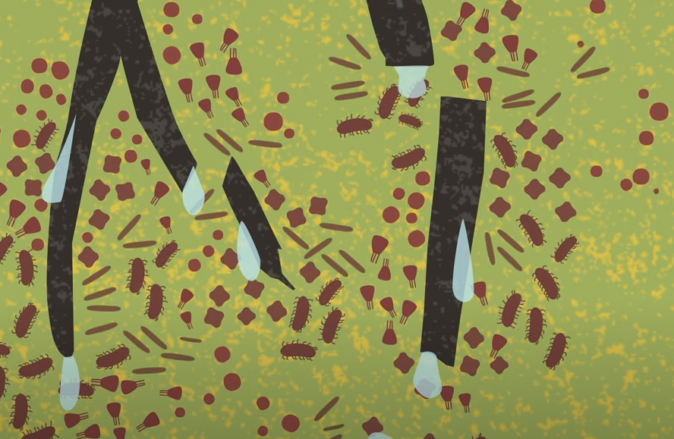
Diverse plant communities release diverse organic compounds into the soil resulting in more carbon sequestration, more microbial activity, and more nutrient availability for plants.

Slide 32
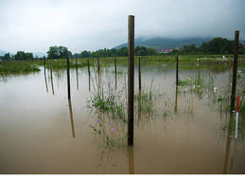
Diversity led to better resiliency against both drought and flooding.

Slide 33
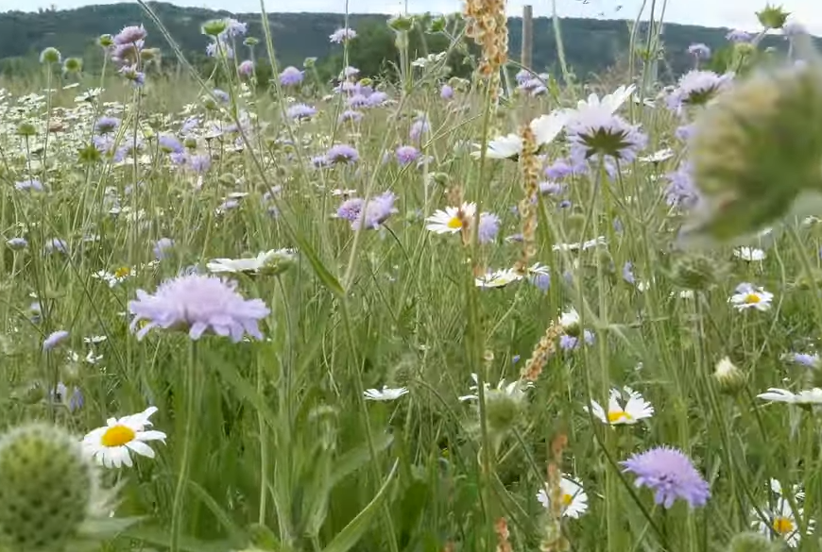
Diversity ecosystems are more productive and more stable than simplified systems.

Slide 34
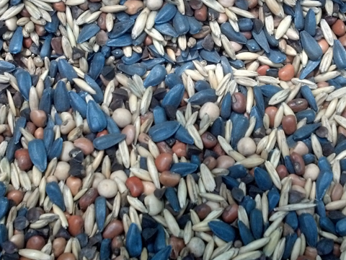
So one of the best ways to introduce more diversity is through cover crop mixes….
Cover Crops are the perfect opportunity to have great plant diversity (above ground and below ground) without needing specialized equipment, knowledge, or markets.

Slide 35
What are your Goals/Resource Concerns?
Soil health – biological life
Supplemental grazing
Increased fertility/organic matter
Nitrogen capture/cycling
Additional lasting residue/cover
Weed suppression/disease cycle
Erosion control
Compaction breaking/deep roots

Slide 36
Get 4 Things Right
The Right Species
The Right Inoculants
The Right Seeding Rates
The Right Seeding Time

Slide 37
Answer 4 Main Questions
What Are The Goals/Concerns?
What Are The Environmentals?
What Is The Timeframe?
What Is The Budget?

Slide 38
What are your environmentals?
Rainfall or irrigation
Evapo-Transpiration (ET)
Growing season
Soil type and condition
Seeding method
Previous crop and next crop
Previous herbicides

Slide 39
What is your timeframe?
Spring - fallow ground or prior to a spring crop (chemical/mechanical termination) (Check crop insurance implications!)
Early Summer - Right after wheat harvest (frost or chemical/mech. termination)
Late Summer – Delay after wheat harvest (frost termination)
Fall - After fall crops (frost termination or over-wintering)

Slide 40
What is your budget?
Low (less than $25/acre) (Low seeding rates – very few legumes)
Medium ($25 - $35/acre) (Average seeding rates – some legumes)
High ($35 - $45/acre) (High seeding rates – high legume %)
Higher ($45 - $60/acre) (special use: organic N production, nematode control, perennials, etc…)

Slide 41
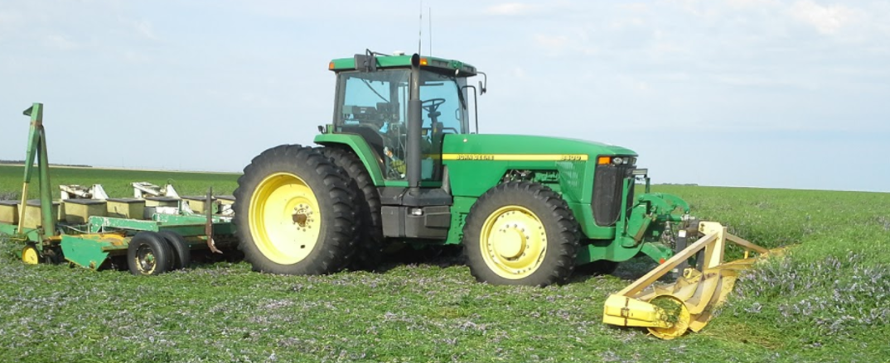
Post Harvest Cover Crops Diversity?
The more specific your goals/concerns, the less diverse your mixes will typically be.

Slide 42
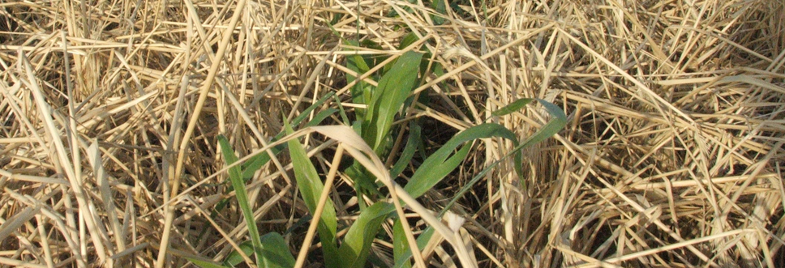
Post Harvest Cover Crops Diversity?
The tighter your planting windows, the fewer species will work and thus the less diverse your mixes will be.

Slide 46
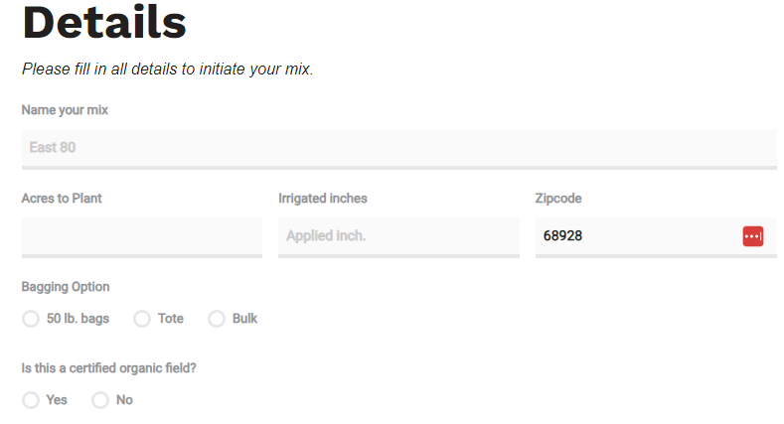

Slide 47
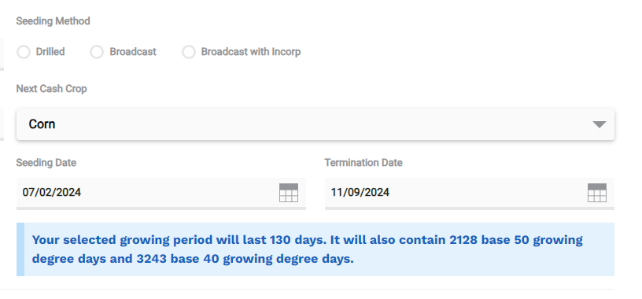

Slide 49
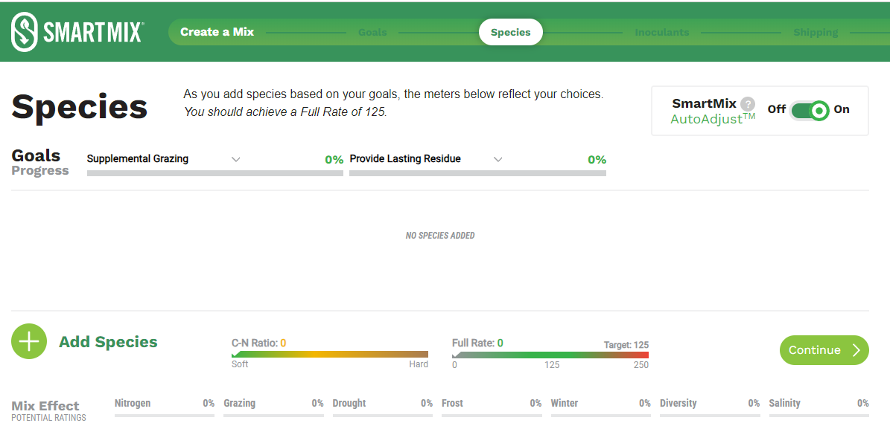

Slide 50
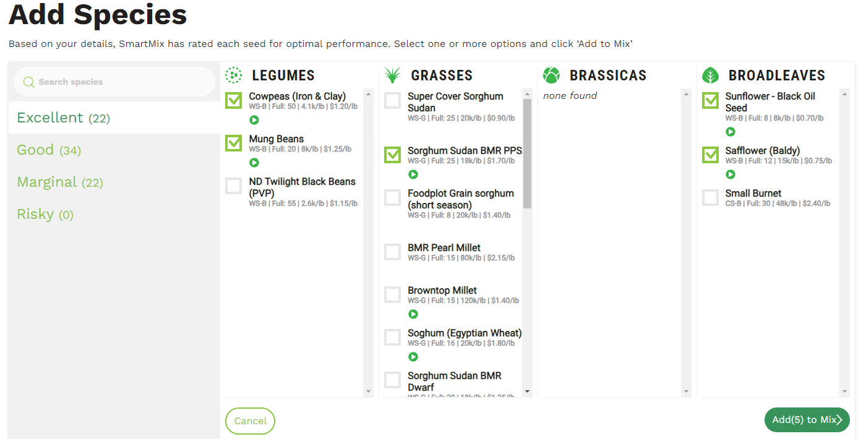

Slide 51
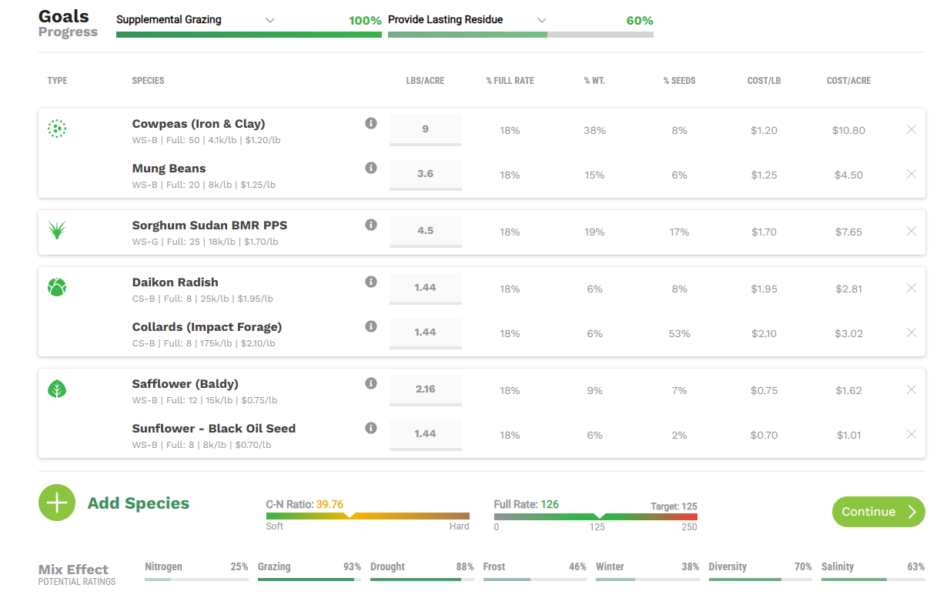

Slide 52
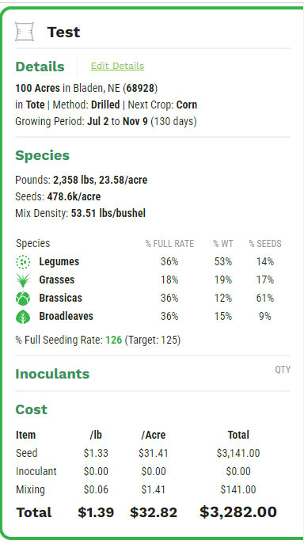

Slide 53
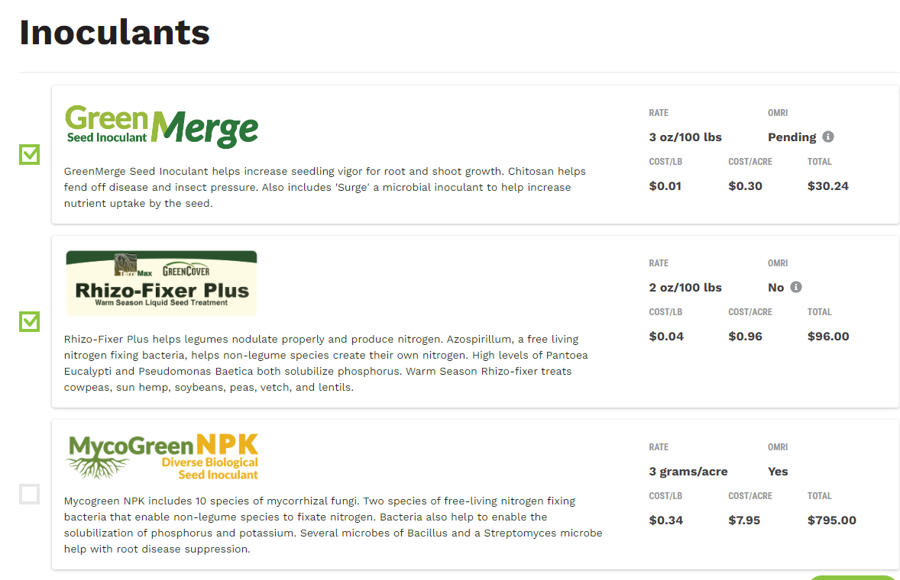

Slide 56
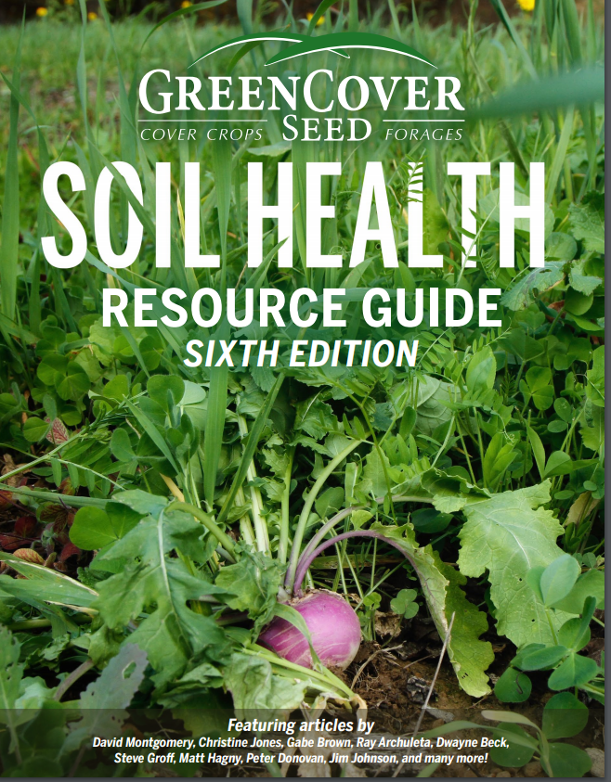
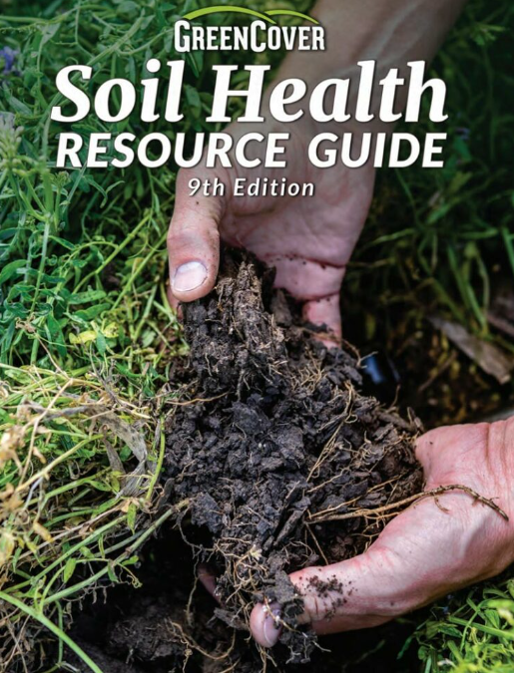
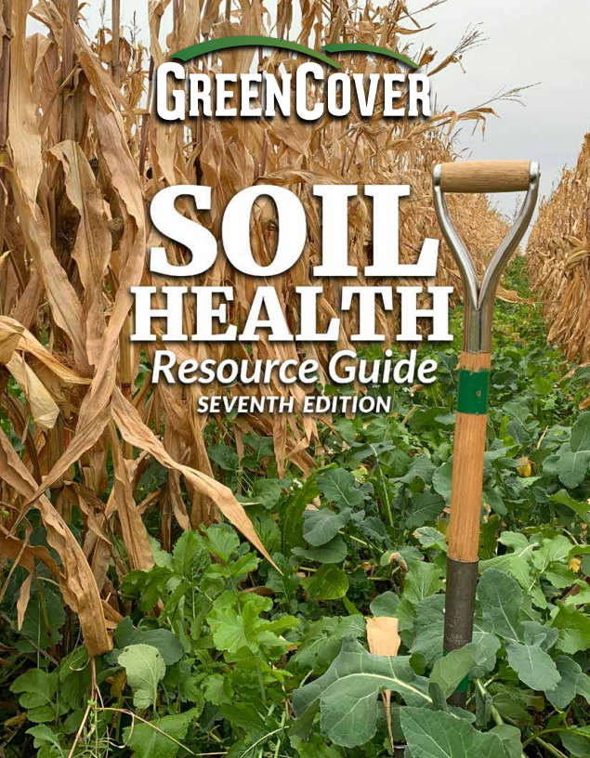
www.greencoverseed.com/guides
keith@greencover.com

