Slide 1
Soil Health U & Trade Show 2024
Jeremy Brown

Slide 2
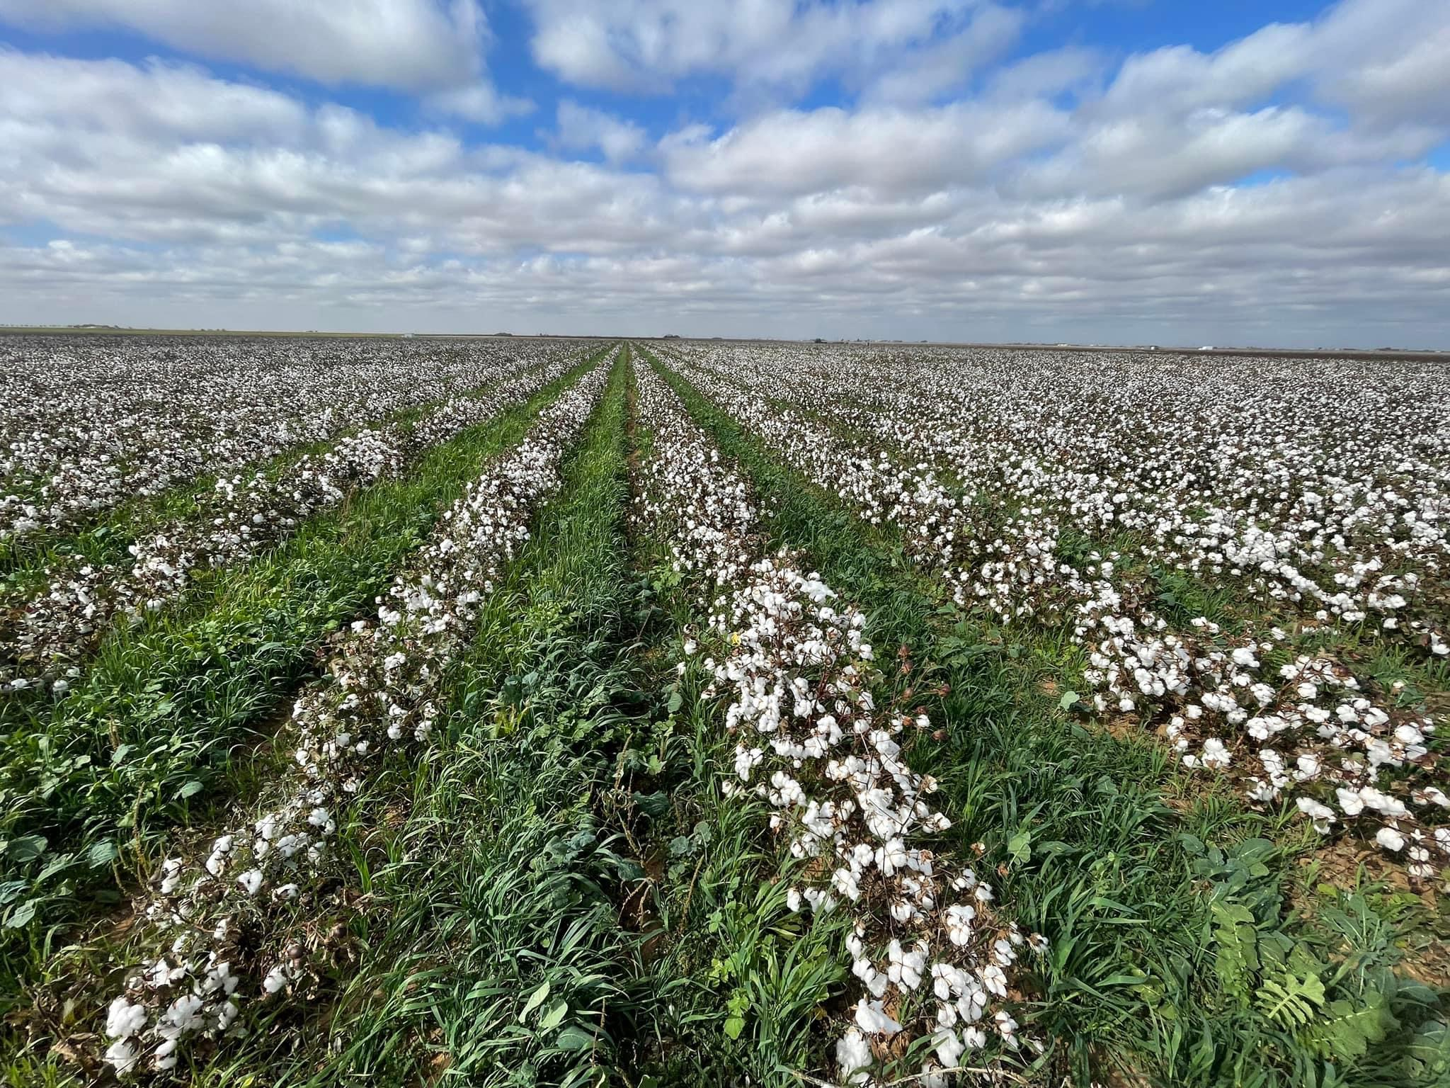
WELCOME

Slide 3
Our Operation
Farm is located on the South Plains, just outside of Lubbock, Texas
Breakdown of Acres
Total acres 5000
3800 acres certified organic
1200 acres non organic
3500 acres non irrigated (dry land)
1500 acres irrigated (semi irrigated)
Main Crop is Organic Cotton

Slide 4
Our Operation
30-year average annual rainfall
18 inches
May – August
9 inches on average
Most rainfall comes in
May, June, & September

Slide 5
Our Operation

Slide 6
Most Important

Slide 7
YOUR WHY

Slide 8
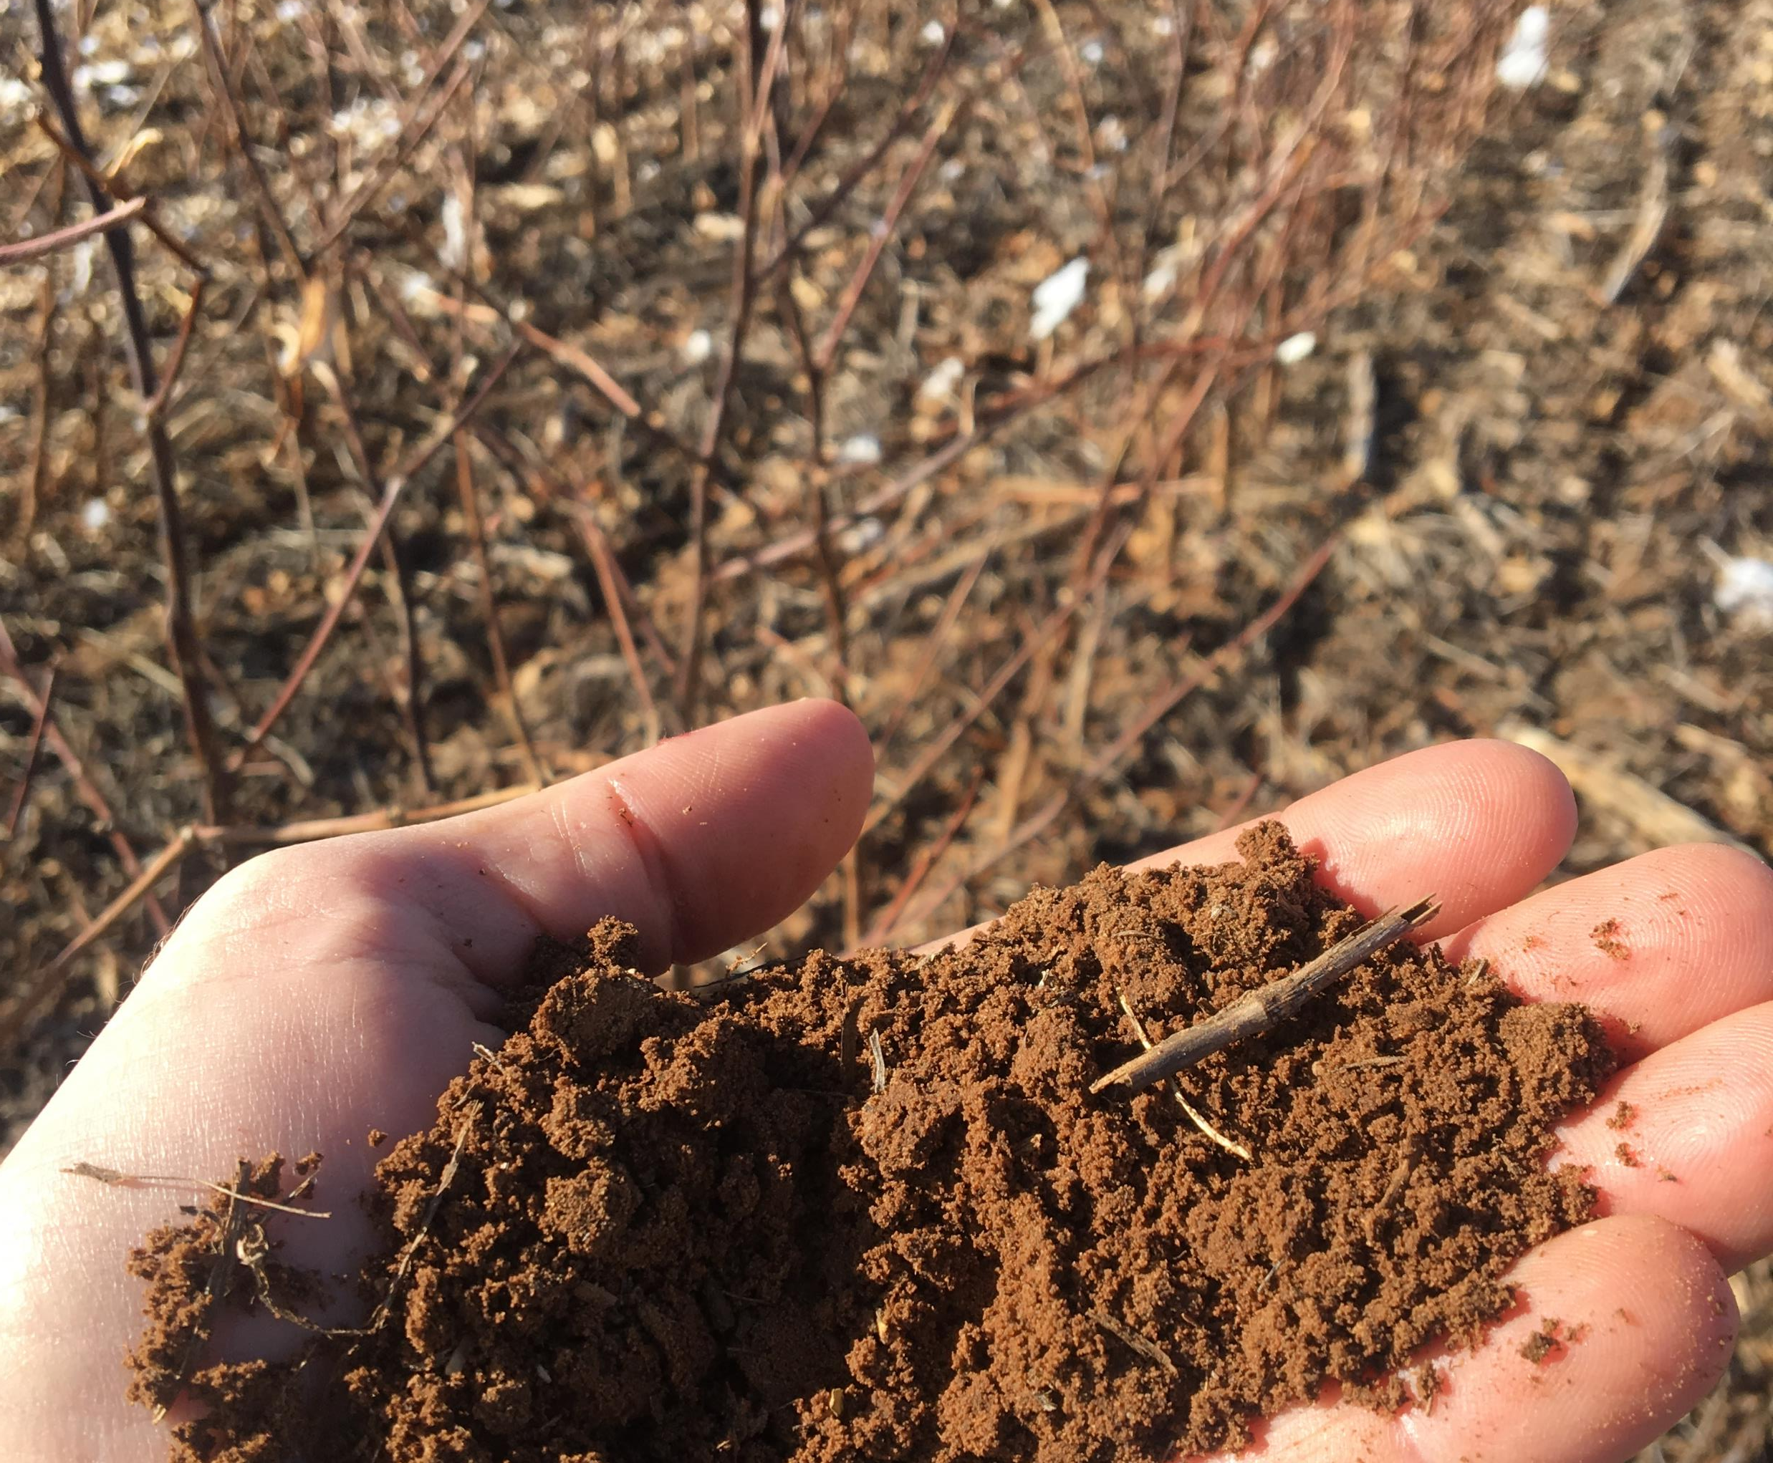
YOUR WHY
Why do you do what you do?
What is your WHY?
WHY Soil Health?

Slide 9
WHY
YOUR PURPOSE, CAUSE OR BELIEF?

Slide 10
YOUR WHY
Your Why is something deeper
It is Your Purpose, Cause or Belief.
It is your motivation to get up everyday.
You must have a “WHY” for soil health

Slide 11
THE GOLDEN CIRCLE Simon Sinek, Start with Why
WHY
HOW
WHAT

Slide 12
THE GOLDEN CIRCLE
WHAT – is easy to identify.
“What is it that you do?” example: I farm
HOW – is HOW you do WHAT you do – The 6 Soil Principles, No Till, Organic
WHY – is why you do what you do, not results.

Slide 13
THE GOLDEN CIRCLE
“WHY is just a belief, HOW are the actions we take to realize that belief and WHAT are the results of those actions.” – Simon Sinek
You have to know WHY you do WHAT you do!

Slide 14
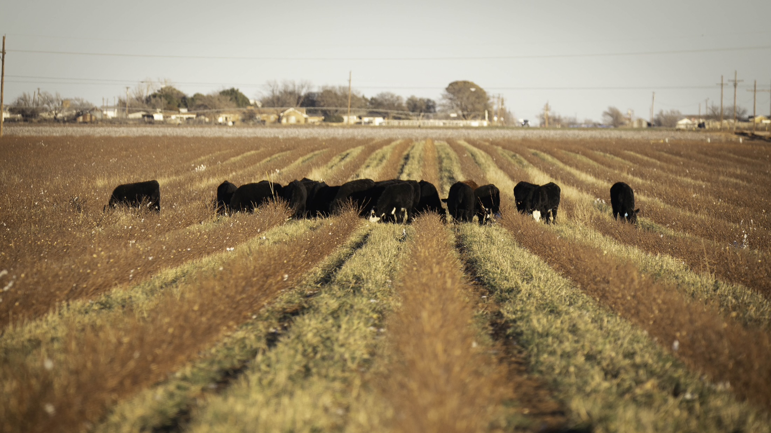
YOUR WHY
“If you want to make small changes, change the way you do things. If you want to make major changes, change the way you see things.” –
Don Campbell – Dirt to Soil, Gabe Brown.

Slide 15
YOUR WHY
“For those who have an open mind for new ideas, who seek to create long-lasting success and who believe that your success requires the aid of others, I offer you a challenge. From now on, start with WHY.” – Simon Sinek, Start with Why.

Slide 16
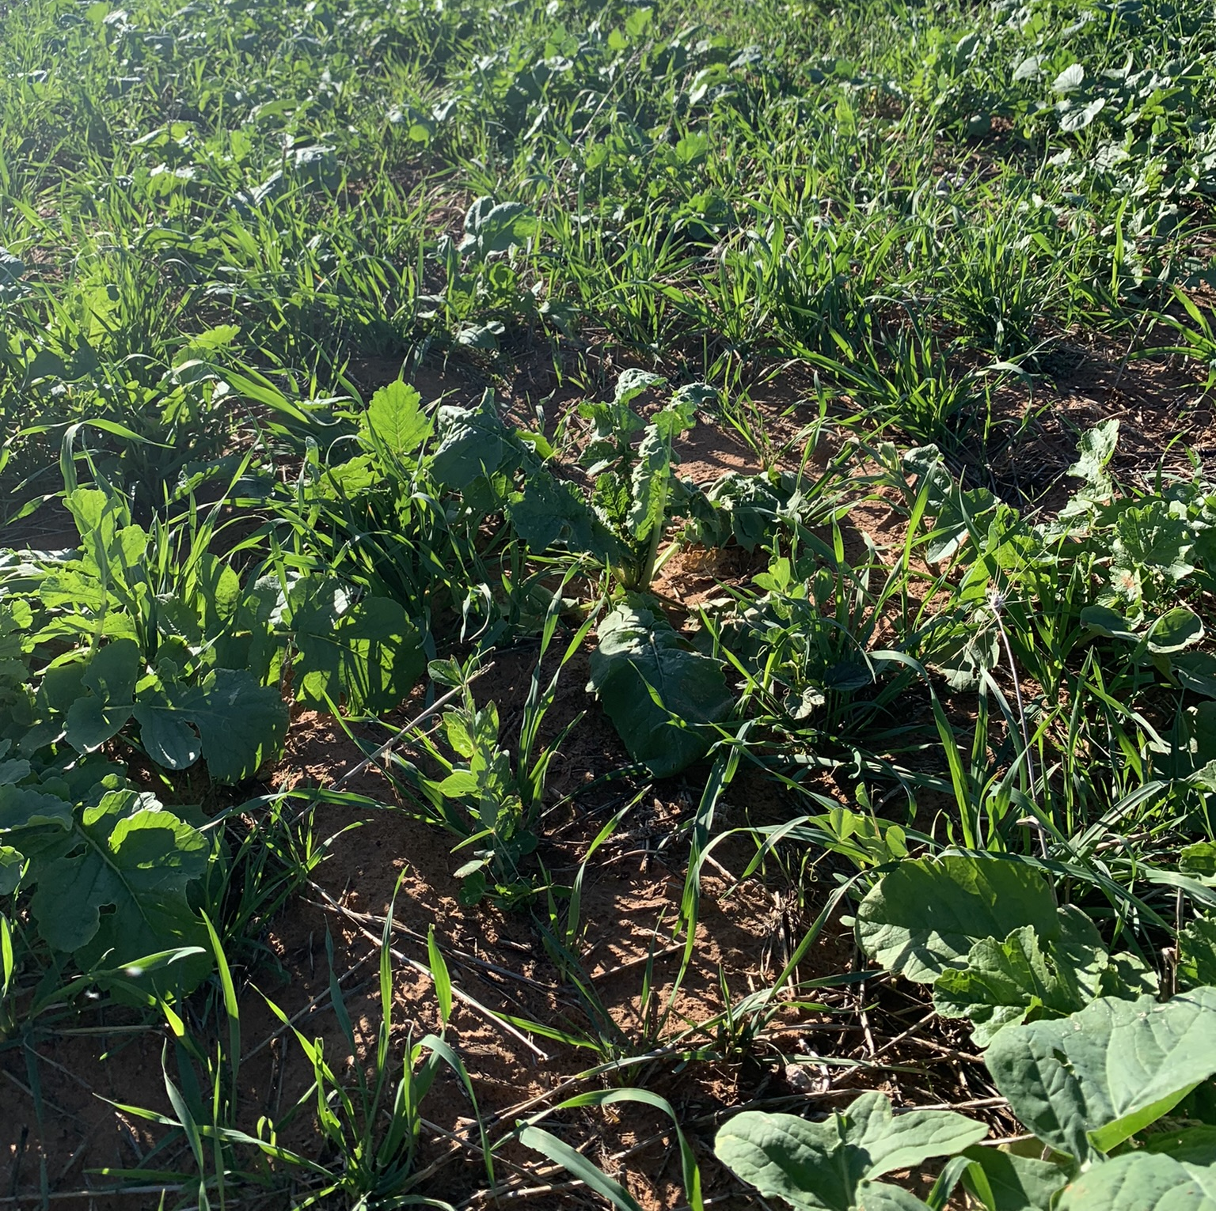
YOUR WHY
WHAT IS YOUR WHY?
WHY SOIL HEALTH?

Slide 17
MY WHY
“Then the Lord God took the man and put him in the garden of Eden to tend and keep it.” – Genesis 2:15
Keep in the Hebrew means to guard, to protect, to attend, preserve

Slide 18
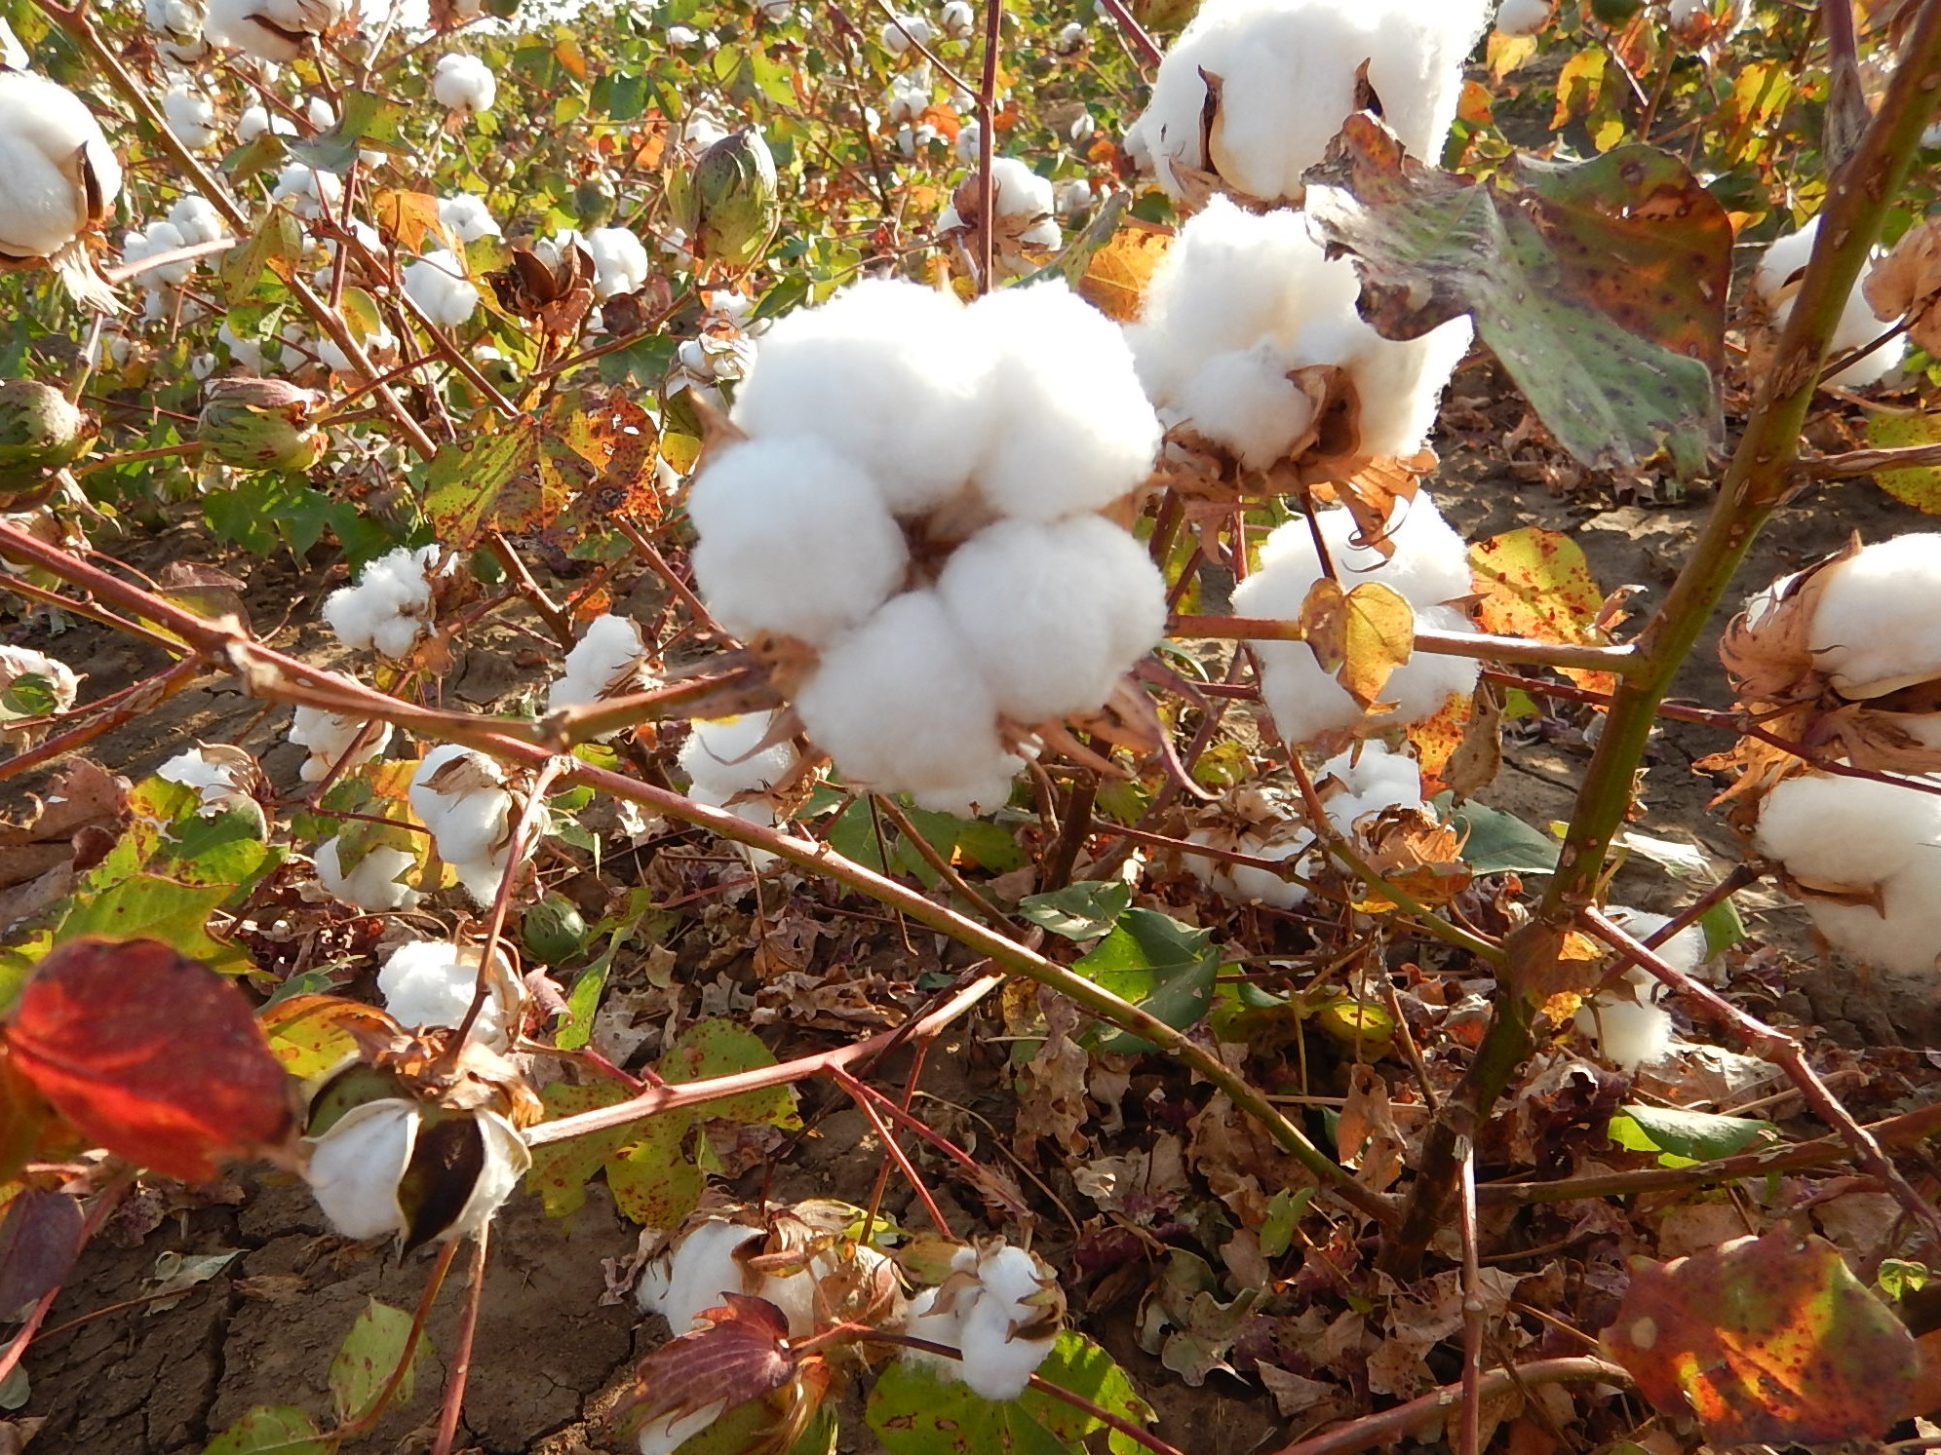
MISSION STATEMENT
“To manage and steward the natural resources that God has given us to feed and clothe the world.”
It was founded upon Proverbs 22:1
“A good name is more desirable than great riches.”

Slide 19
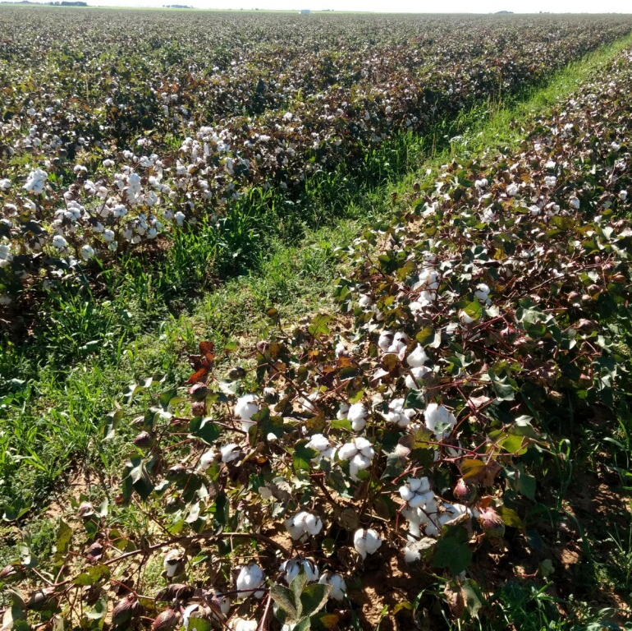
Broadview Ag is committed to:
Producing quality crops that will provide food and fiber for the world.
Being a good steward of the land and its natural resources through regenerative practices.

Slide 20
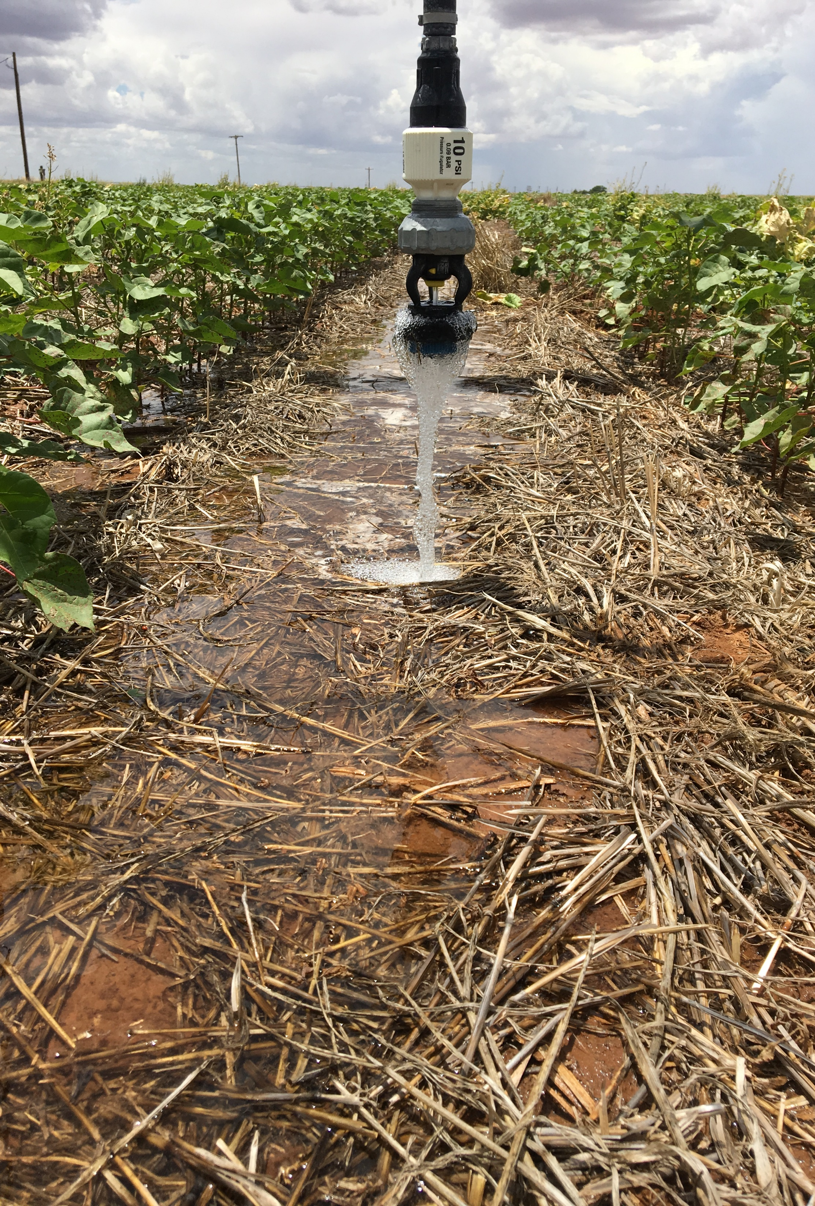
Our Operation - HOW
Our philosophy is that if you take care of the land, it will take care of you.
Matthew 13:8 “… still other seed fell on good soil, where it produced a crop – a hundred, sixty or thirty times what was sown. “

Slide 21
MY HOW: 6 Pillars of Regenerative Agriculture
1. Know Your Context
2. Limit Disturbance
3. Armor
4. Diversity
5. Living Roots
6. Integrate Livestock

Slide 22
MY WHAT
STEWARDSHIP

Slide 23
CLOSING
“I know of no pursuit in which more real and important services can be rendered to any country than by improving its agriculture, its breed of useful animals, and other branches of a husbandman’s cares” – George Washington

Slide 24
Thank You

