Slide 1
Jeremy & Sarah Brown

Slide 2
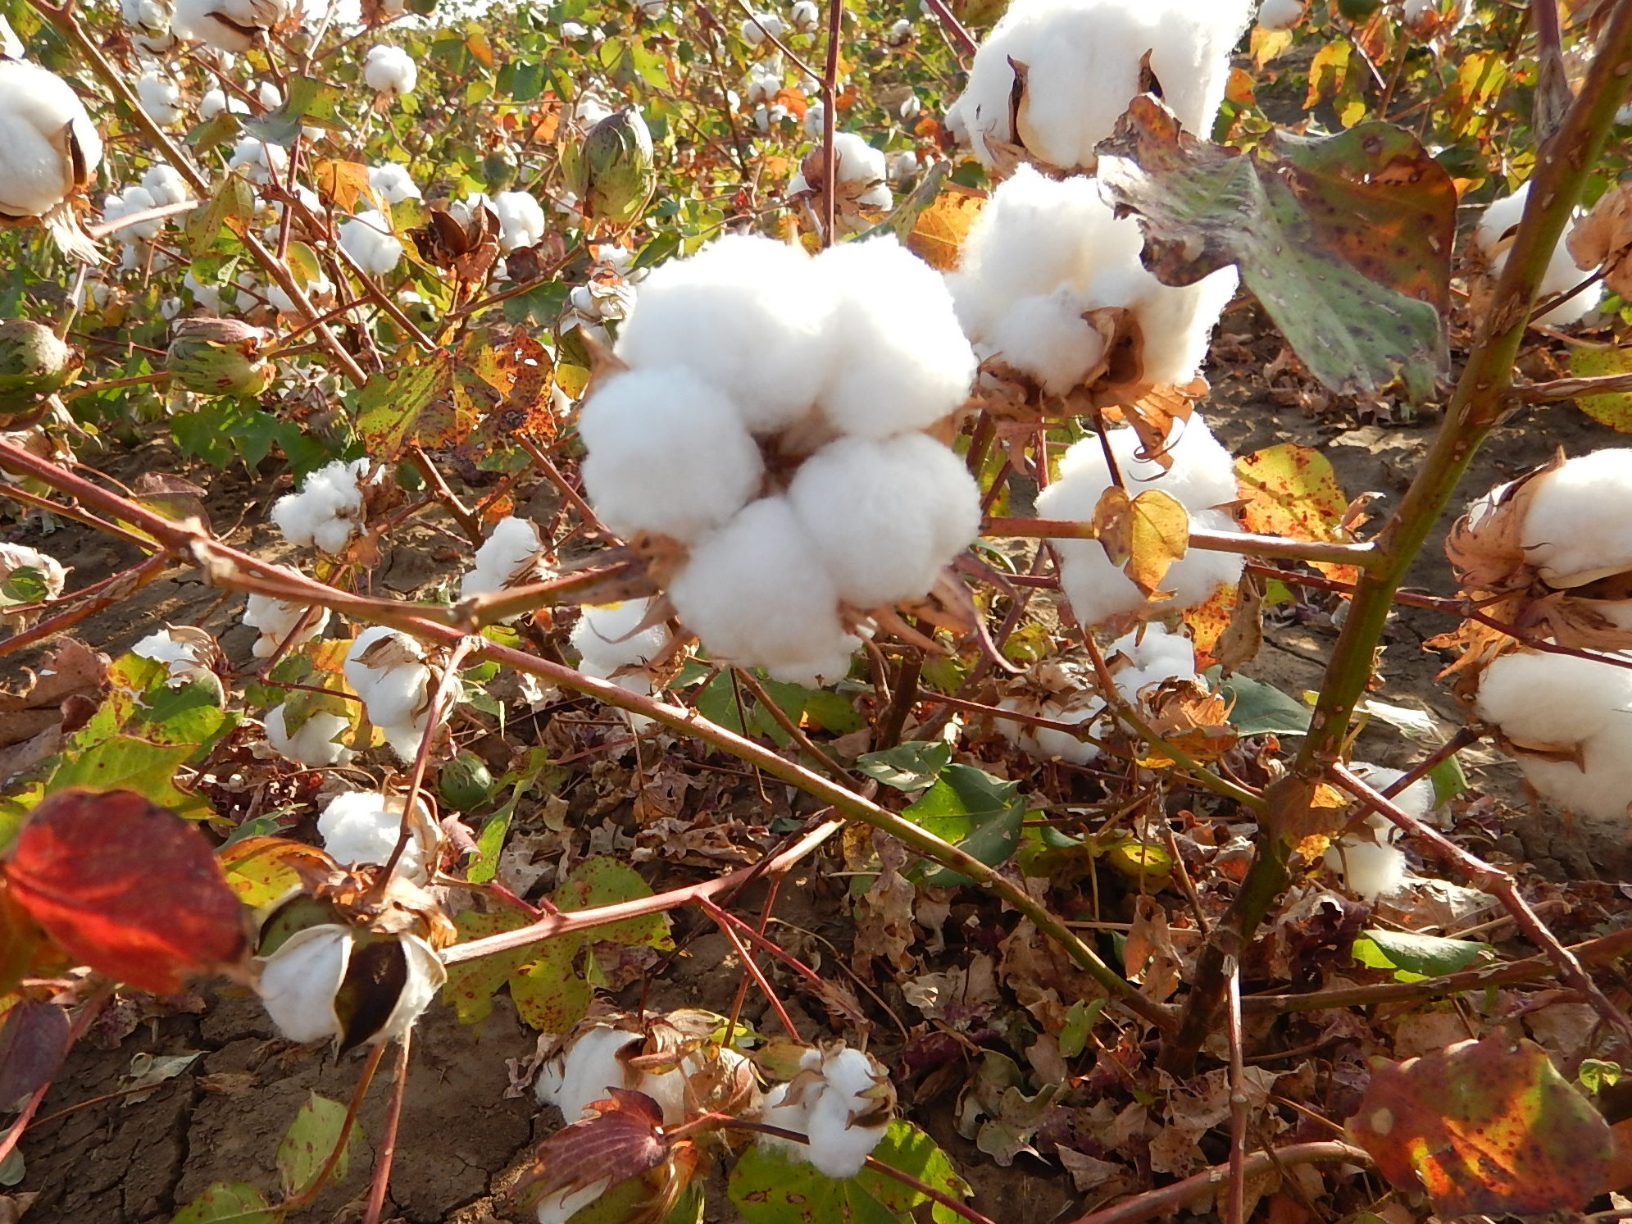
MISSION STATEMENT
“To manage and steward the natural resources that God has given us to feed and clothe the world.”
It was founded upon Proverbs 22:1
“A good name is more desirable than great riches.”

Slide 3
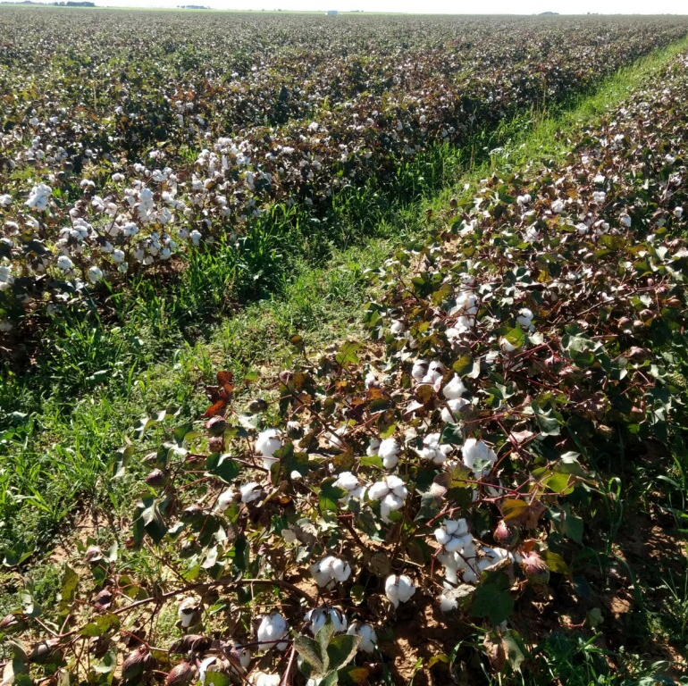
Broadview Ag is committed to:
Producing quality crops that will provide food and fiber for the world.
Being a good steward of the land and its natural resources through regenerative practices.

Slide 4
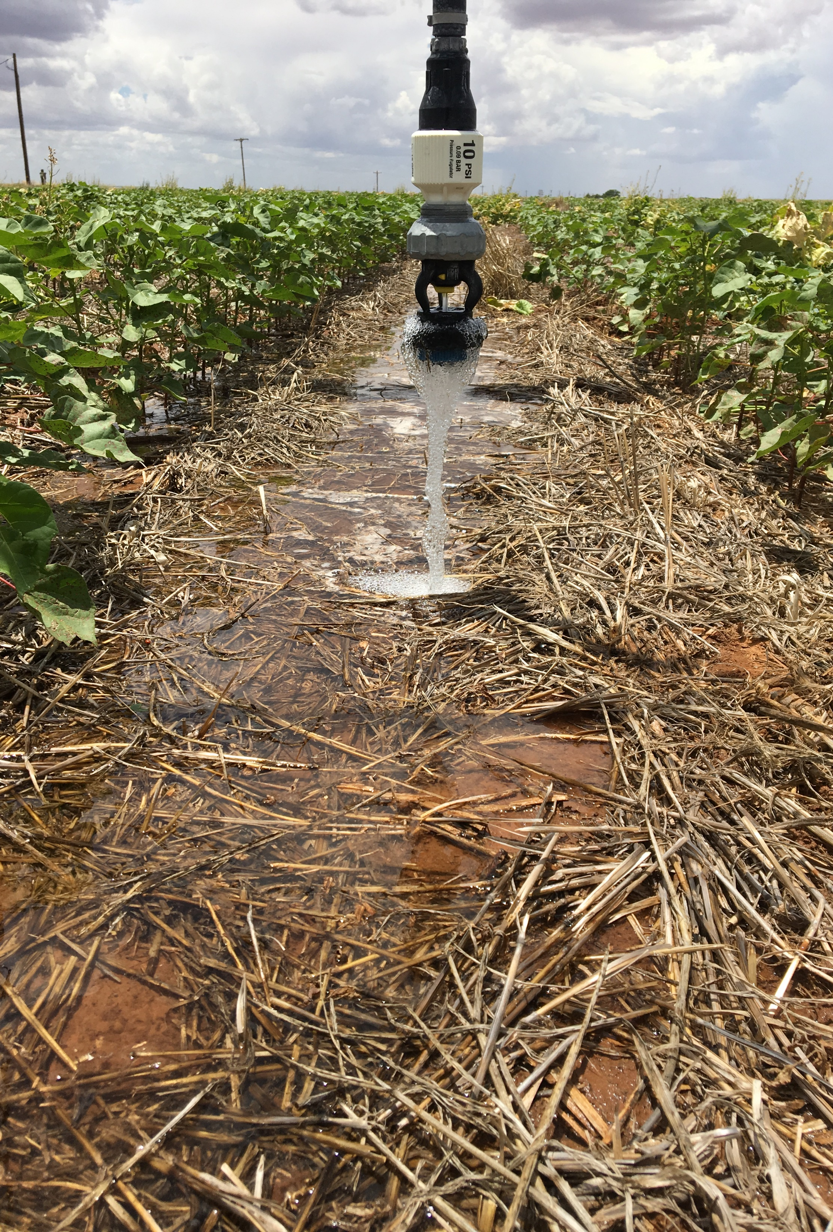
Our Operation
Our philosophy is that if you take care of the land, it will take care of you.
Matthew 13:8 “… still other seed fell on good soil, where it produced a crop – a hundred, sixty or thirty times what was sown. “

Slide 5
Our Operation
Breakdown of Acres
Total Acres 5000
3500 acres certified organic
1500 acres irrigated (30%)

Slide 6
Our Operation

Slide 7
6 Pillars of Regenerative Agriculture
1. Know Your Context
2. Limit Disturbance
3. Armor
4. Diversity
5. Living Roots
6. Integrate Livestock

Slide 8
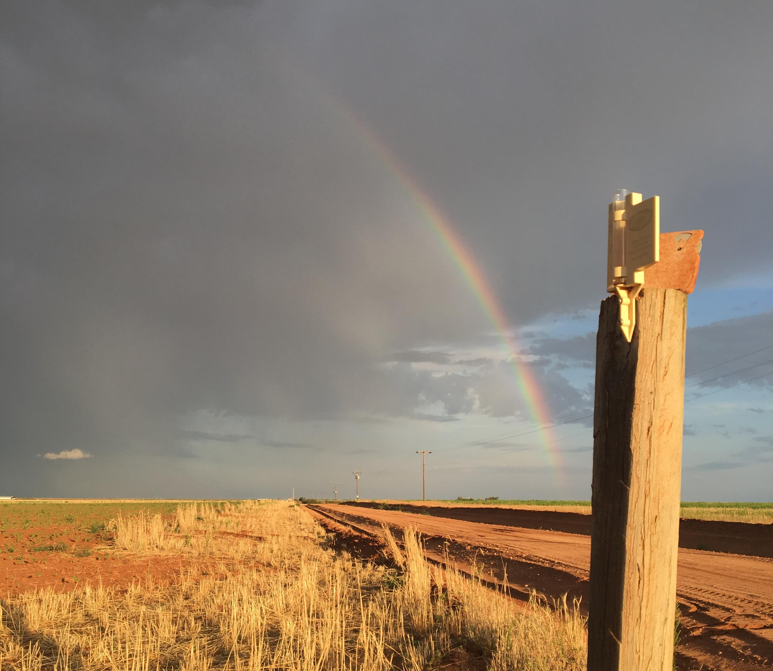
1. Know Your Context
“You cannot outperform your environment” – Gabe Brown

Slide 9
1. Know Your Context
30-year average annual rainfall
18 inches
May – August
9 inches on average
Most rainfall comes in
May, June, & September

Slide 10
2. Limit Disturbance
Limit mechanical, chemical and physical disturbance

Slide 11
3. Armor
Keep the Soil Covered; Nature always works to cover itself.

Slide 12
Terminated Cover before Planting Cotton

Slide 13
4. Diversity
There is no monoculture in nature.

Slide 14
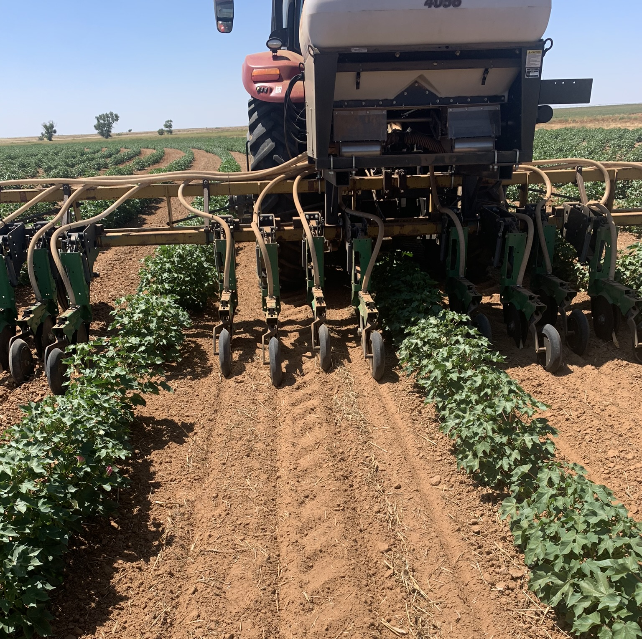
Inter Seeding Multi Species Cover Crop August-September

Slide 15
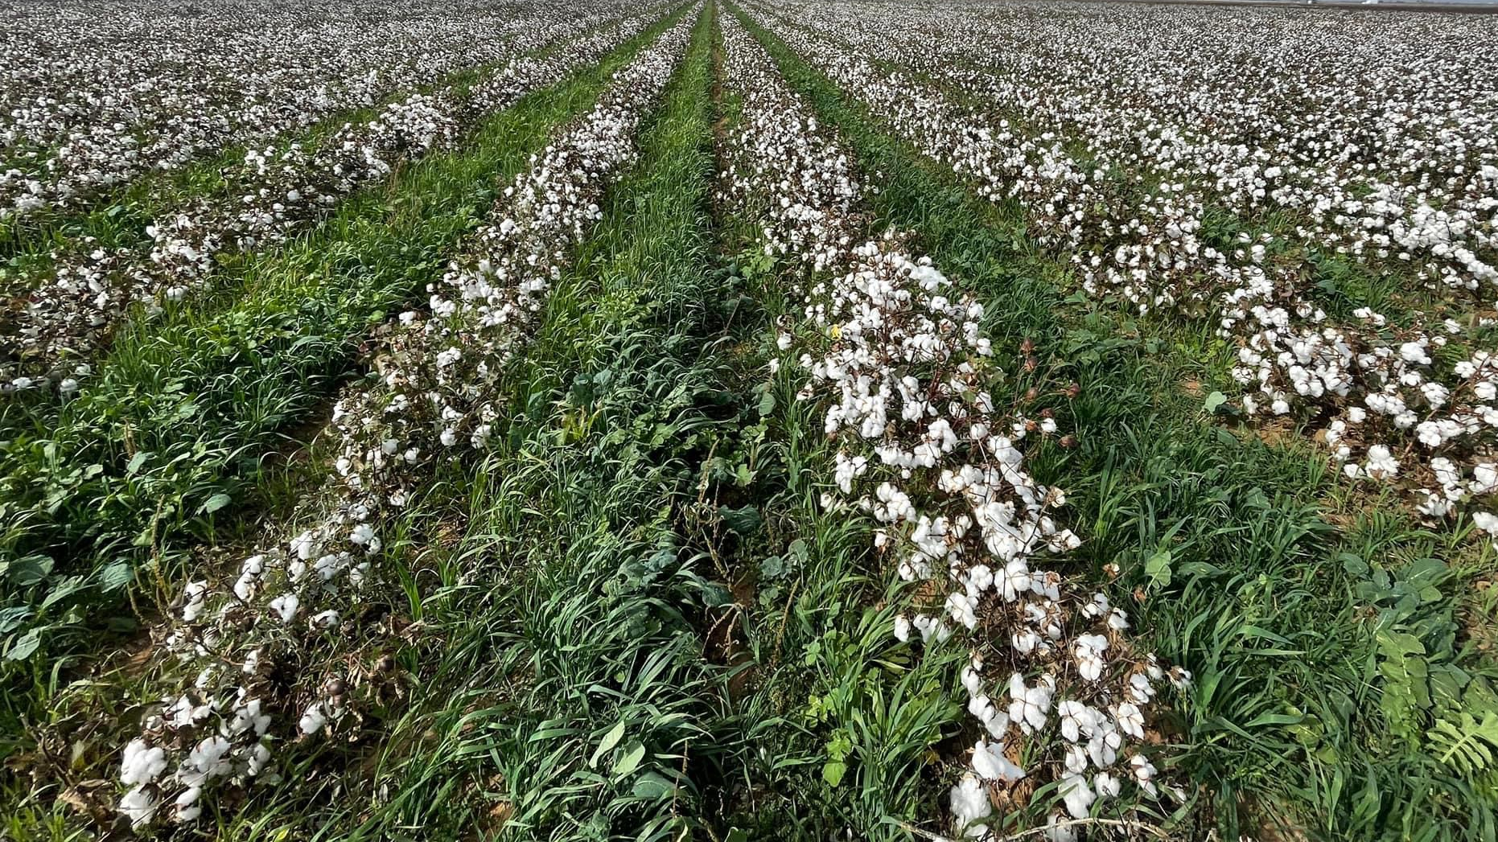
5. Living Roots
Maintain a living root in the soil as long as possible throughout the year.

Slide 16
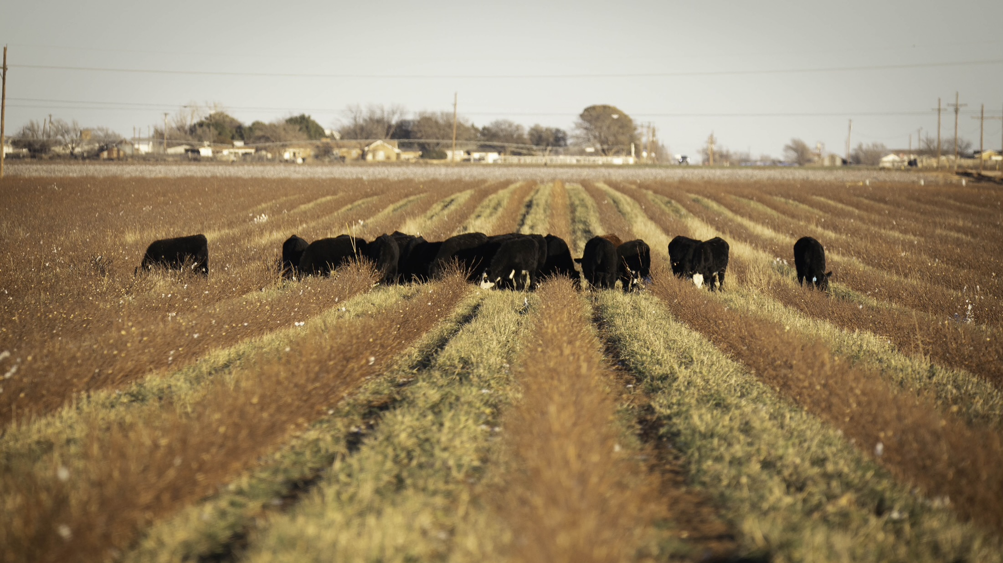
6. Integrate Livestock
Nature does not function without animals.
Grazing plants stimulates the plants to pump more carbon into the soil.

Slide 17
CLOSING
“I know of no pursuit in which more real and important services can be rendered to any country than by improving its agriculture, its breed of useful animals, and other branches of a husbandman’s cares” – George Washington

Slide 18
Thank You

