Slide 1
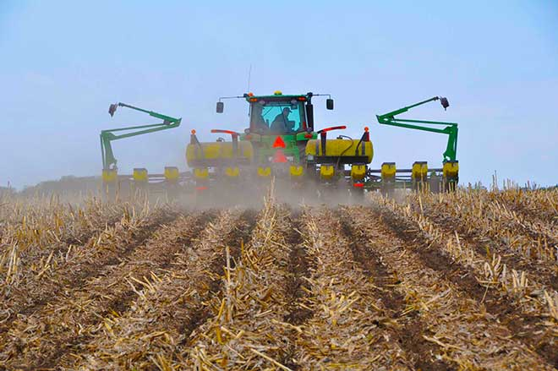
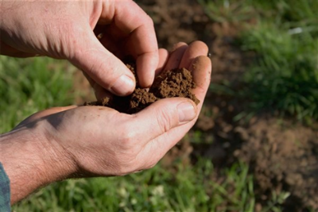
Soil Testing – Not Just All Chemistry
High Plains Journal - Soil Health U
Salina KS
18 January 2024
Fred Vocasek
Senior Lab Agronomist
CCA #01803
ServiTech Laboratories, Dodge City, Kansas

Slide 2
Soil testing is a technology tool that is used
to provide meaningful and functional data
to help make soil fertility management decisions
by:
classifying
identify differences
separate into categories
predicting
to identify probability that some change or activity will occur
monitoring
track progressive changes or activity over time
Notes:
will start with some “philosophy”
ask “What does soil testing do for us?”
Cover Your Acres is all about technology
soil testing is an important technology that has developed over last 80 years
How we use it is important, but it must contribute to making management decisions – short-term and long-term
an classify – sort out fields or areas within a field
good vs. bad
high vs. low
sufficient vs. deficient
can predict
Will I have enough available soil nutrients to meet my yield goal? or do I have to supplement?
Am I going to have some kind of growth problem? How bad will it be?
can monitor
can see progress over time – good or bad
can help identify what caused current situation

Slide 3
Is your soil healthy?
NO
Does the soil blow or flow away?
YES
Does the soil allow water to
soak in quickly?
YES
NO
YES
Does the soil drain?
NO
NO
Does the soil crust or seal off?
YES
YES
Does the crop recover the nutrients
that I applied?
NO
NO
Are there areas where plants die
or grow poorly?
YES
Probably healthy
Probably not healthy
http://csanr.wsu.edu/whats-the-problem-with-my-soil/

Slide 4
Nutrient utilization equation
soil test yield
solid ⇌ solution ⇌ root surface ⇌ plant tissue
solid
soil minerals, organic matter, fertilizer
solution
soil water with dissolved substances
(found in solution as “ions”)
root surface
living root hairs take up ions from solution
plant tissue
roots ⇨ stems ⇨ leaves ⇨ grain, fruit
forage or grain yield is end product
Notes:
important to understand what soil test is truly measuring
common assumption is that soil test is directly related to yield
nutrient utilization equation is good way of thinking about role of soil fertility
are four components
important to note that arrows point both ways
example: solids dissolve into solution, ions in solution crystallize back as solids

Slide 5
Is your soil healthy?
NO
Does the soil blow or flow away?
YES
Does the soil allow water to
soak in quickly?
YES
NO
YES
Does the soil drain?
NO
NO
Does the soil crust or seal off?
YES
YES
Does the crop recover the nutrients
that I applied?
NO
NO
Are there areas where plants die
or grow poorly?
YES
Probably healthy
Probably not healthy
http://csanr.wsu.edu/whats-the-problem-with-my-soil/

Slide 6
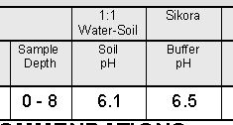
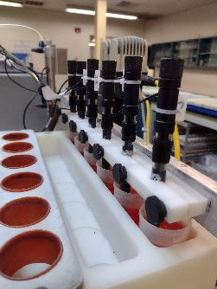
pH – “the soil thermostat”
1 7 14
acidic
neutral
alkaline
solid ⇌ solution ⇌ root surface ⇌ plant tissue
Notes:
quick review
soil pH is probably oldest and most important soil test
soil pH is an expression of acidity or alkalinity
is on scale of 1 to 14
pH 7 is neutral
farther away from pH 7 gets more acid or alkaline

Slide 7
pH
pH
7.0
6.0
5.0
4.0
neutral
100 X
9.0
8.5
8.0
7.5
7.0
Soil pH:
logarithmic scale
(multiples of “10”)
1 X
10 X
10 X
increasing
acidity
increasing
alkalinity
100 X
1 X
neutral
1,000 X
Notes:
is logarithmic scale so each pH unit is a multiple of 10
pH 6 is 10X acidityof pH7
ph 5 is 10X acidity of 6, but 100X acidity of pH 7
same is true for alkalinity

Slide 8
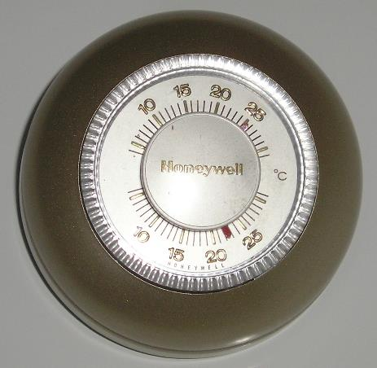
aluminum (Al),
manganese (Mn)
iron (Fe),
zinc (Zn)
Soil pH:
“The soil thermostat” (regulates chemical activity)
7.0
6.5
6.0
5.5
5.0
4.5
4.0
9.0
8.5
8.0
7.5
7.0
increasing
solubility
deficiency
decreasing
solubility
toxicity?!
Notes:
pH affects chemical activity like wall thermostat affects activity in a room
pH affects chemical form and solubility of many compoiunds
micronutrients are example
increased solubility >> increased availability and uptake
too soluble >> potential toxicity
too insoluble >> potential deficiencies

Slide 9
Testing soil pH
15g soil
slurry
read pH_{w}
report soil pH
15 ml
deionized water
≤ 6.2
report
Buffer pH
calculate lime rec:
ECC, Tons/A
Buffer pH solution
(pH 7.5 or 7.7)
add buffer,
wait 30 min.,
read pH
Notes:
this is sequence of we run pH in the lab
often asked “why two pH numbers?”
soil pH measures active acidity which affects soil chemistry and root growth
buffer pH measures reserve acidity held on surfaces of soil clay particles and only used to calculate lime rec
soil pH addresses question “Do I need lime?”
if “yes”, then buffer pH addresses question “How much do I need?”

Slide 10
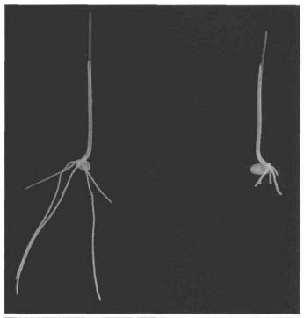
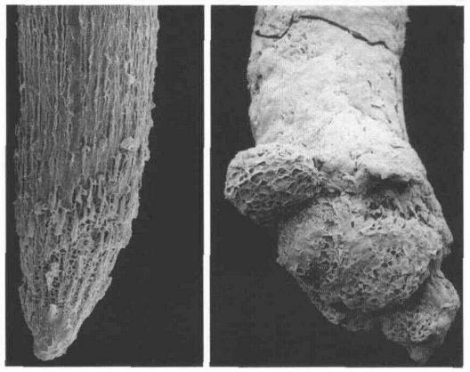
What’s the problem with acidity? … aluminum toxicity
Al-tolerant
Al-sensitive
Al-tolerant
Al-sensitive
wheat plants
grown four days in Al solution
pH = 4.3
meristem ≈ “growth cells”
Notes:
soluble aluminum affects growth cells in root tips
Delhaize and Ryan. 1995. Aluminum Toxicity and Tolerance in Plants. Plant Physiol. Vol. 107:315-320.
Figure 1. Effect of Al on root growth (upper panel) and structure of
the root apex (lower panels) of near-isogenic wheat seedlings (Altolerant
on left; Al-sensitive on right) that differ at the Alt 1 locus. The
seedlings were grown for 4 d in a solution that contained 5 JLIM AICI3
in 200 /J.M CaCI2 at pH 4.3.

Slide 11
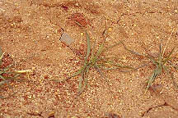
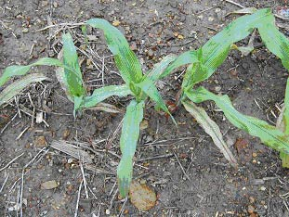
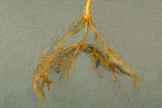
What’s the problem with acidity? … aluminum toxicity
“leaf purpling”
plant symptom of
phosphorus deficiency,
but has high soil test?
X
soil is sufficient
plant is deficient
solid ⇌ solution ⇌ root surface ⇌ plant tissue
clay mineral
soluble aluminum (Al³⁺)
Notes:
common problem in acid soils; plants appear to be phosphorus deficient, but soil test is adequate to high
Is it a problem with soil test??? measuring “unavailable phosphorus”
our soil clays are 15% to 20% aluminum
as soils become more acidic, clay mineral aluminum is dissolved into soluble free aluminum
aluminum damages root system
damage root surface cannot absorb nutrients from soil solution
soil has sufficient phosphorus, but plant cannot take it up
plant deficiency but not soil deficiency

Slide 12
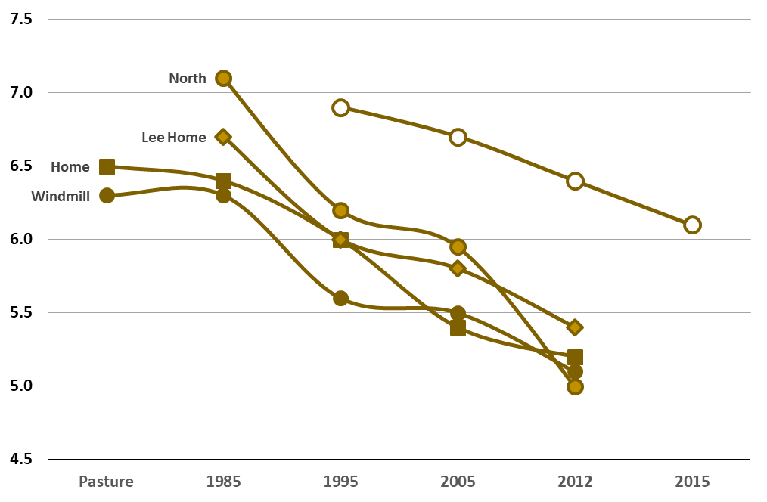
Monitoring soil pH changes over time
Sandy Loam to
Silt Loam
pH 5.5
Sands to
Loamy Sands
average ≈ 0.04 pH unit/year
Northeast Colorado area
15” to 18” rainfall
4000’ elevation
wheat/corn/fallow & continuous corn
farmed since 1890 to 1920
data courtesy of Dave Green, ServiTech
Notes:
Dave Green soil test records
Haxtun CO area, dryland wheat fields, primarily sandy
soil pH dropped from 6.5 and 7.0 to 5.0 and 5.5 over about 25 years
problem became noticeable in 2012; soils had become very acidic, but adequate moisture in previous years helped wheat roots to recover and to mask symptoms of aluminum toxicity
in 2012, wheat was also under drought stress, so roots did not recover and problem became very obvious
drop in pH levels averaged about 0.04 unit/year, too small to measure but accumulates over time
were sandy soils, so dropped more quickly than nearby field (sandy to silt loam) but nearby field showing same trend
important to monitor pH, can start to see problems when pH reaches 5.5
pH drops quickly then because it changes by factor of 10 each time
these fields followed same trend as dryland wheat fields in south central Kansas and north central Oklahoma in 1980’s
we are seeing this trend across the High Plains,
why????

Slide 13
Where does this acidity come from?
Nitrification process:
natural microbial conversion of ammonium to nitrate
yields hydrogen ions which adds to soil acidity
to neutralize acidity from 1 lb. N ≈ 2 to 3 lb. ag lime
organic nitrogen
(“protein”)
NH₄⁺
NO₃⁻
NO₂⁻
ammonium
nitrite
nitrate
urea,
CO(NH₂)₂
NH₃
ammonia
hydrogen ions
H⁺ H⁺ H⁺ H⁺
Notes:
increase yields and increased nitrogen use contribute to soil acidity
nitrate is form typically taken up by plants
normal conversion of nitrogen fertilizers to nitate releases hydrogen ions
soil pH is a measurement of hydrogen ion concentration s in soil solution
requires about 23 to 3 lb ag lime to neutralize acidity from 1 poiund of ammonium type fertilizers
if your soils are calcareous (high excess lime) not to worry for very long time.
acidification occurs more quickly in sandier soils, so important to monitor them
occurs just as well in heavier textured soils, but at a slower rate
may occur more slowly in irrigated soils because many irrigation water sources have bicarbonate hardness which neutralizes

Slide 14
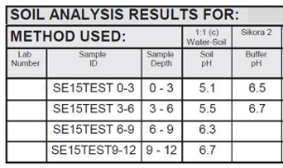
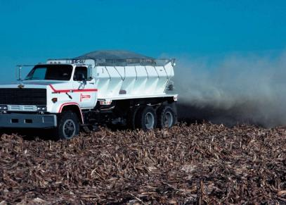
“Stratification”
(“strata”  “layer”)
pH
P ppm
0”–3”
5.1
77 Very high
3”–6”
5.5
pH = 5.9
33 Optimum
P = 32 ppm
6”–9”
6.3
11 Low
0” – 12” sample
9”–12”
6.7
6 Very low
Notes:
acidification can be problem in limited tillage
has been a trend toward broadcast urea or liquid nitrogen to cover acres more rapidly
can cause soil stratification
example from long-term striptill field
12 inch soil sample shows pH 5.9, 32 ppm P
took samples from 3 inch increments
surface applied nitrogen developed acidic surface layer
urea and ammonium are not soil mobile; remain in surface soil during conversion to nitrate
nitrate can then move into subsoil
surface layer has high P, but is very acidic
this is zone where seedlings germinate and establish
young seedling roots can be damaged by high aluminum levels, so cannot take up P
important to maintain consistency in sample depth and location to allow long term fertility monitoring
spot check fields by taking a 3-inch sample and analyzing pH to see if problem is developing

Slide 15
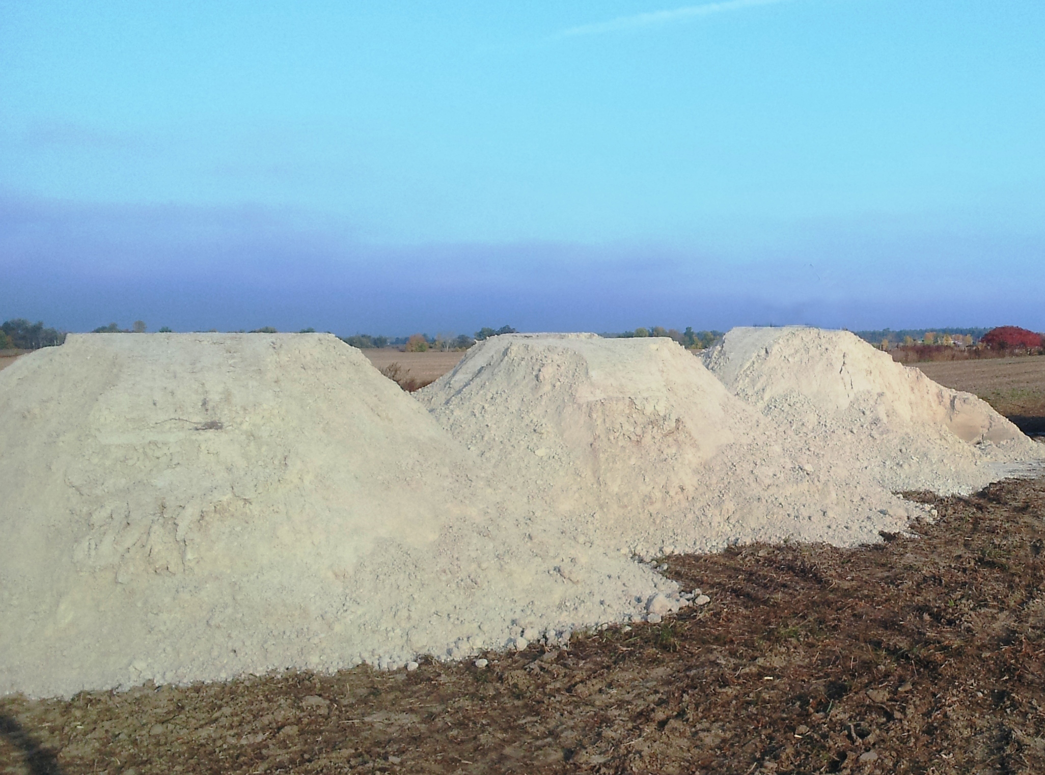
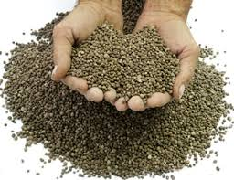
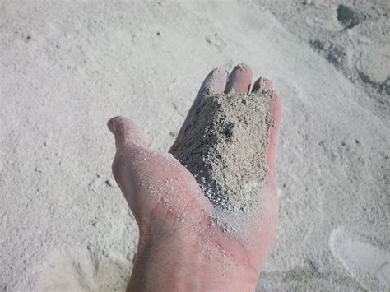
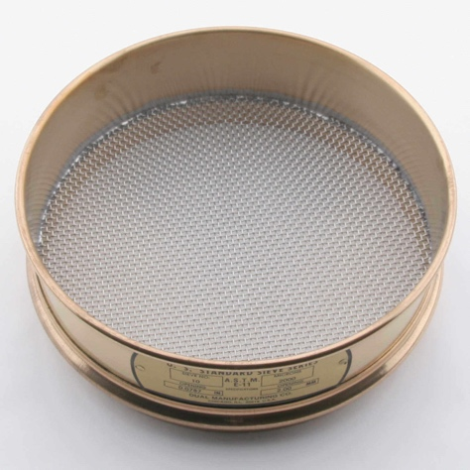
What is ECC? ….. Effective Calcium Carbonate
Lime quality factors
Chemical purity
“Calcium carbonate equivalent”, “Effective neutralizing value”
What’s actually lime and what’s not lime (sand, dirt, etc.)
Carbonate content (CO₃), not Ca or Mg content
Particle fineness
Separated by different sieve sizes
fine particles = 60% - 100% effective $≈$ react in 1 to 2 years
medium particles = 20% - 60% effective $≈$ react in 3 to 5 years
coarse particles = 0% effective $≈$ react in more than 5 years

Slide 16
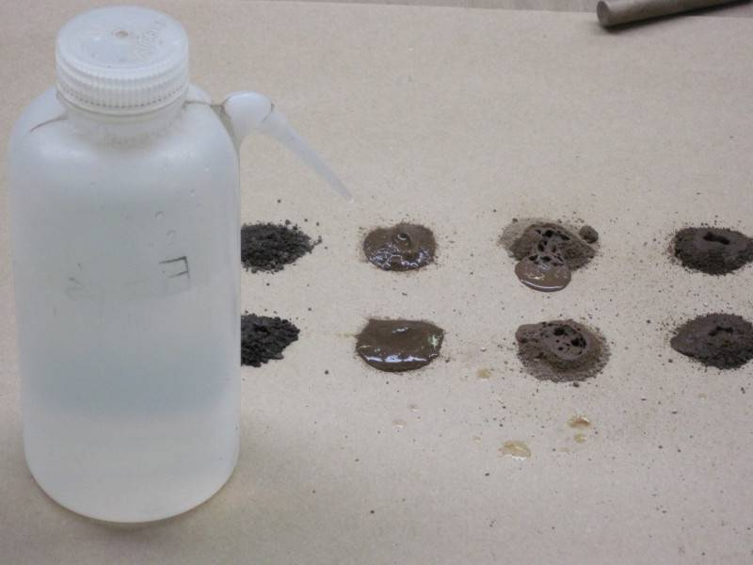
What’s the problem with alkalinity? … IDC, iron deficiency chlorosis
Alkaline soil  soil pH of 7.3 or greater
Calcareous soil  alkaline soil with “excess lime”
Fine lime particles in soil
Typically calcium or magnesium carbonates (CaCO₃, MgCO₃)
Excess lime test …. “Fizzy” test
effervescence
acid reacts with carbonates
Rated as “NO”, “LO”, or “HI”
1:1 Water-Soil
1:1 Water-Soil
Excess Lime
Soil pH
Buffer pH
Sol. Salts mmho/cm
5.9
6.7
0.12
NO
6.4
1.35
NO
7.8
0.15
HI

Slide 17
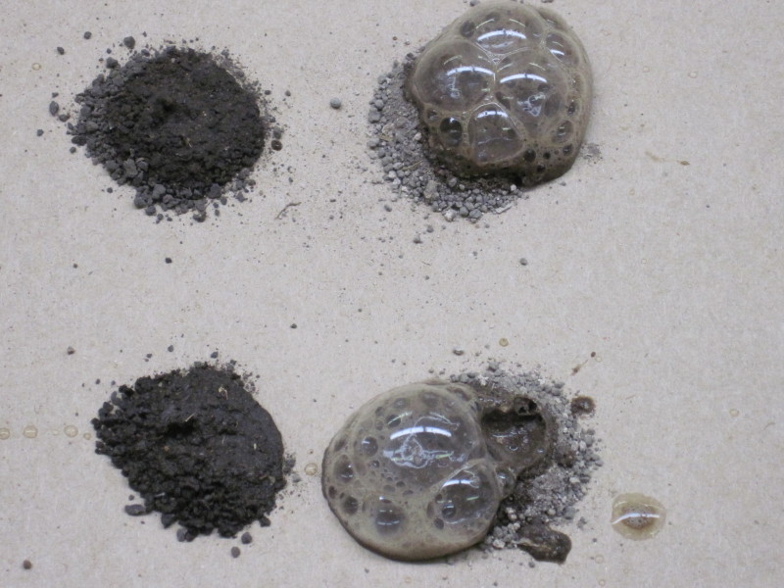
solid ⇌ solution ⇌ root surface ⇌ plant tissue
NO excess lime
HI excess lime
Concerns:
herbicide activity?
carryover potential?
check label
nutrient management
P₂O₅, Zn – if low soil test
surface applied fertilizers with urea, ammonium
(both are high pH soils)

Slide 18
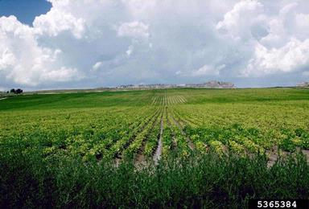
Iron deficiency chlorosis ... ... is not a plant deficiency
chlorosis: “lack of chlorophyll”
Treatment options:
tolerant varieties
manure!
in-furrow iron?

Slide 19
Is your soil healthy?
NO
Does the soil blow or flow away?
YES
Does the soil allow water to
soak in quickly?
YES
NO
YES
Does the soil drain?
NO
NO
Does the soil crust or seal off?
YES
YES
Does the crop recover the nutrients
that I applied?
NO
NO
Are there areas where plants die
or grow poorly?
YES
Probably healthy
Probably not healthy
http://csanr.wsu.edu/whats-the-problem-with-my-soil/

Slide 20
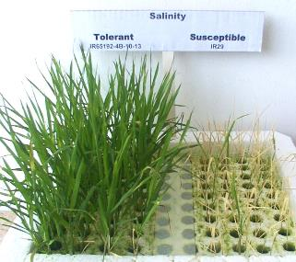
Soluble salts
solid ⇌ solution ⇌ root surface ⇌ plant tissue
1:1 Water-Soil
1:1 Water-Soil
Excess Lime
Soil pH
Buffer pH
Sol. Salts mmho/cm
5.9
6.7
0.12
Uses conductivity probe
“electrical conductivity” or “E.C.”
millimhos per centimeter, mmho/cm
“Saline” soils
excessive total salts
causes water stress
“dry moisture”
Sources of salt
may occur naturally
saline irrigation water
NO
6.4
1.35
NO
7.8
0.15
HI

Slide 21
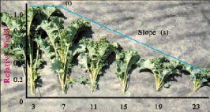
How plants respond to increasing salinity
Yield loss
Yield
Salinity
threshold
Soil salinity

Slide 22
How crops respond to increasing salinity
Different salinity
thresholds
Different salinity
thresholds
100 -
80 -
100 -
GRAIN
YIELD
wheat
60 -
80 -
% Relative yield
sorghum
% Relative yield
FORAGE
YIELD
40 -
60 -
wheat
Double TX
NK-265
NK-ProBred
sorghum
20 -
40 -
Double TX
NK-265
NK-ProBred
0 -
0
2
4
6
8
10
12
14
Soil salinity, mmho/cm
20 -
0
2
4
6
8
10
12
14
Soil salinity, mmho/cm
after Francois, et. al., Agron J. 1984
Notes:
Francois, L.E. et.al. 1984. Salinity effects on seed yield, growth, and germination of grain sorghum. Agron Journal. 76:741-744.
Francois, L.E. 1986. Effect of salinity on grain yield and quality, vegetative growth, and germination of semi-dwarf and durum wheat.

Slide 23
Is your soil healthy?
NO
Does the soil blow or flow away?
YES
Does the soil allow water to
soak in quickly?
YES
NO
YES
Does the soil drain?
NO
NO
Does the soil crust or seal off?
YES
YES
Does the crop recover the nutrients
that I applied?
NO
NO
Are there areas where plants die
or grow poorly?
YES
Probably healthy
Probably not healthy
http://csanr.wsu.edu/whats-the-problem-with-my-soil/

Slide 24
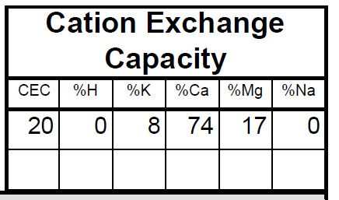
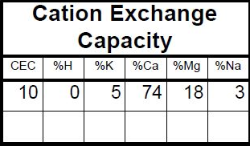
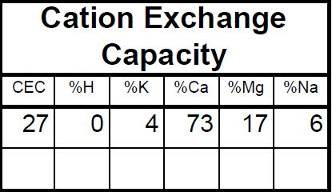
Sodium-affected soils
Type of salts
sodium vs. calcium/magnesium
exchangeable sodium percentage, “%Na”
Soil aggregates deflocculate
aggregates ≈ “granules”
deflocculate ≈ “break down”
Symptoms of sodic soils
surface crusting or sealing
excess runoff
reduced water infiltration, air permeability
“massive” soil structure in surface and subsoil

Slide 25
“Sodic” soil: affects infiltration rate, percolation
Sandy loam soil
Rain intensity = 1 in/hr
1.00
1% Na
Treatment options:
reduced tillage?
apply gypsum
tile drainage??
2% Na
0.75
5% Na
Infiltration rate, in/hr
0.50
11% - 15% Na
0.25
0.00
0.00
1.00
2.00
3.00
Accumulated rainfall, inches
Kazman, Z, I. Shainberg, and M. Gal. 1983. Effect of low levels of exchangeable Na and applied phosphogypsum on the infiltration rate of various soils. Soil Sci. 135:184-192.
Notes:
Kazman, Z, I. Shainberg, and M. Gal. 1983. Effect of low levels of exchangeable Na and applied phosphogypsum on the infiltration rate of various soils. Soil Sci. 135:184-192.

Slide 26
Irrigation water quality interpretations
15
Water analysis  Predictive tool
EC_{water}  EC_{soil} ≈ 1½X - 2X
SAR_{adj}  ≈ soil %Na
12
9
SOIL: permeability concerns
Sodium asorption ratio (adjusted) SARa
6
Very Poor
Poor
Fair
3
Acceptable
Good
Excellent
0
750
1500
3000
5000
7500
CROP: total salinity concerns
Electrical conductivity, µmho/cm

Slide 27
Is your soil healthy?
NO
Does the soil blow or flow away?
YES
Does the soil allow water to
soak in quickly?
YES
NO
YES
Does the soil drain?
NO
NO
Does the soil crust or seal off?
YES
YES
Does the crop recover the nutrients
that I applied?
NO
NO
Are there areas where plants die
or grow poorly?
YES
Probably healthy
Probably not healthy
http://csanr.wsu.edu/whats-the-problem-with-my-soil/

Slide 28
What does a soil test actually test? ….. “available nutrients”
solid ⇌ solution ⇌ root surface ⇌ plant tissue
“inventory” of
soil nutrients
110 -
100 -
“calibration curve”
(functional data)
90 -
80 -
70 -
60 -
% yield without fertilizer
50 -
40 -
30 -
20 -
10 -
Soil test, ppm P
0 -
-
-
-
-
-
-
-
-
-
-
-
after Mengel. 2009.
Kansas State Univ.
0
5
10
15
20
25
30
35
40
45
50
Notes:
calibration curve links laboratory (ppm P) to field (% relative yield)
ppm is not used to calculate pounds per acre, but to sort soils into categories of low, medium, optimum, high
graph is compilation by Dave Mengel of 40 years of Kansas State research (corn, sorghum, wheat) , other states have data like this
because of different weather, hybrids, planters, soils, etc. –did not use yield in bushels
expressed as relative yield – unfertilized check yield divided by top yield in plots
then shoot a line through the cloud of data using statistics
is now a predictive tool: ppm from soil analysis result gives general idea of potential yield without applying phosphate – all other things being equal
not perfect, but gives good idea

Slide 29
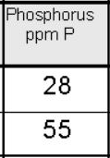
Soil testing
Soil test history -- monitoring
30
Sampling consistency!!
Depth
Location
Time of year
20
15
PHOSPHORUS, ppm P
14
10
2018 2019 2020 2021 2022 2023
YEARS

Slide 30
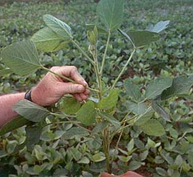
solid ⇌ solution ⇌ root surface ⇌ plant tissue
Plant tissue
analysis
Tissue - Low
Soil - High
Tissue - High
Soil - High
High
Root or Water Problem?
“False/Transient Deficiency”
Rapid growth (dilution)?
Too much nutrient –
Hold back!
SOIL analysis result
Tissue - Low
Soil - Low
Tissue - High
Soil - Low
Low
Not enough nutrient –
Add some!
“True deficiency”
Stressed, stunted plants?
(concentration)
Sample contamination?
Low
High
PLANT analysis result
Notes:
comparing soil test and plant test gives clue to possible cause or effect

Slide 31
Diagnostic sampling: soil and plant samples
“The Good, The Bad, The Ugly”
“Normal” area
“Problem” area
The Good
The Bad
The Ugly
DO NOT SAMPLE
paired samples
?
Notes:
Samples taken from “good” and “bad” spots in the field
don’t sample dead or diseased tissue
Always pair samples
Sample same plant part
Critical levels are based on specific plant parts and growth stage

Slide 32
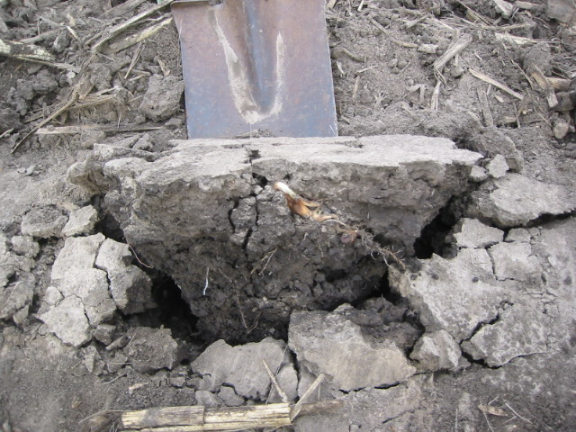
solid ⇌ solution ⇌ root surface ⇌ plant tissue
Likely not healthy?
Presley, D. 2009.
Kansas State

Slide 33
Soil health checkup?
NO
Does the soil blow or flow away?
YES
Visual
observation
Does the soil allow water to
soak in quickly?
YES
NO
YES
Does the soil drain?
NO
NO
Does the soil crust or seal off?
YES
% Na, (water test?)
soil test (history?)
plant test
YES
Does the crop recover the nutrients
that I applied?
NO
Are there areas where plants die
or grow poorly?
soil pH,
soluble salts
NO
YES
Probably healthy
Probably not healthy

Slide 34
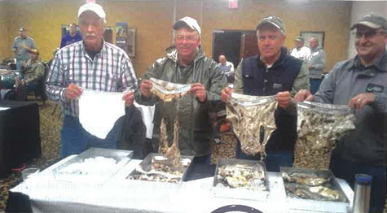
Really cheap soil health test?

Slide 35
THE END
We appreciate your attention and your business!

