Slide 1
Notes:
Feel Free to use this slide! Thanks!

Slide 2
Lance Gunderson
Regen Ag Lab - President and Co-Owner
What Can Soil Health Tests Tell Us?

Slide 3
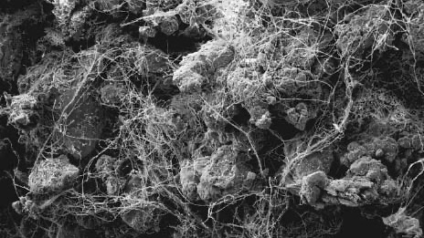
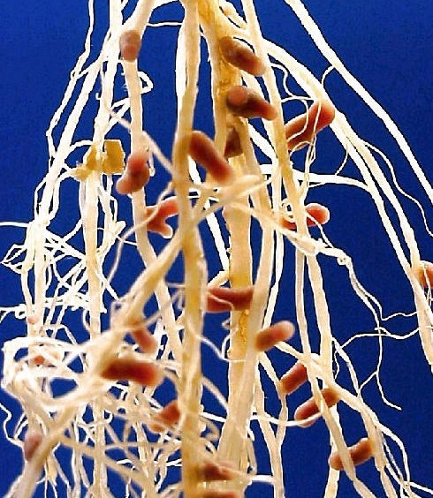
Soil as an Ecosystem
Nutrient Cycling
Organic matter pools
N, P, C availability
Microbial predations
Soil Aggregation
Glomalin and fungal hyphae
Increases soil stability
Increases water holding capacity
Plant/Microbe Interactions
Symbioses
Nutrient uptake
Suppress disease

Slide 4
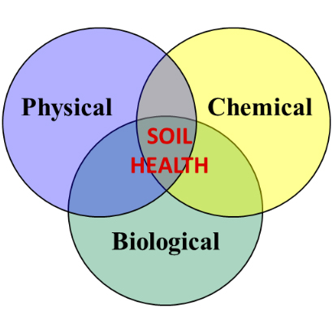

Slide 5
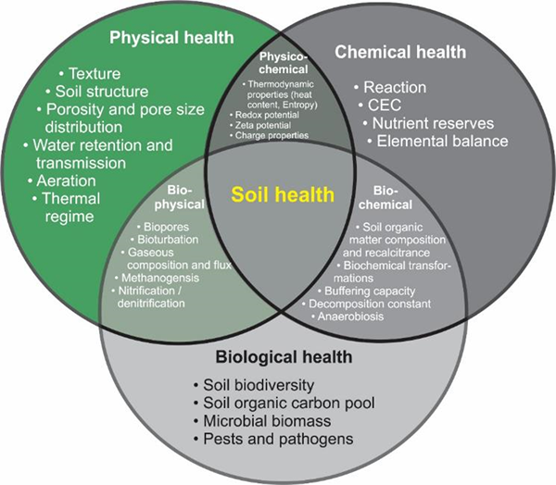

Slide 6
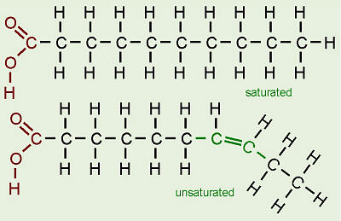
Phospholipid Fatty Acid (PLFA)
Cell membrane
Quantifiable
Represent living biomass
Degrade quickly upon death
Influenced by environment and land management

Slide 7
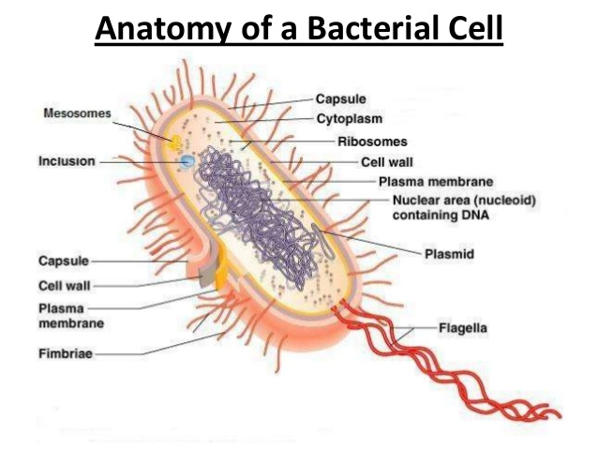

Slide 8
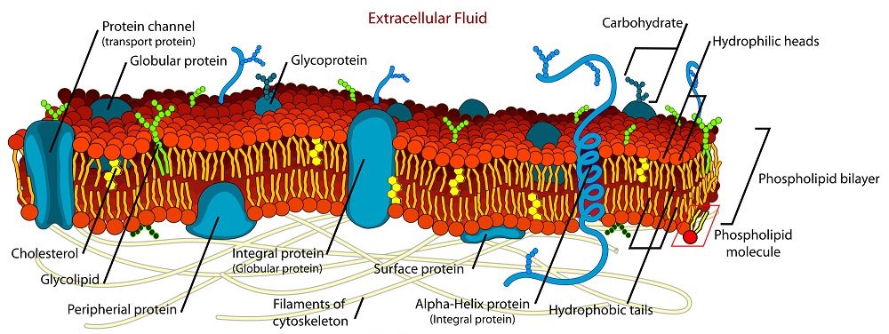
Bacterial Membrane

Slide 9
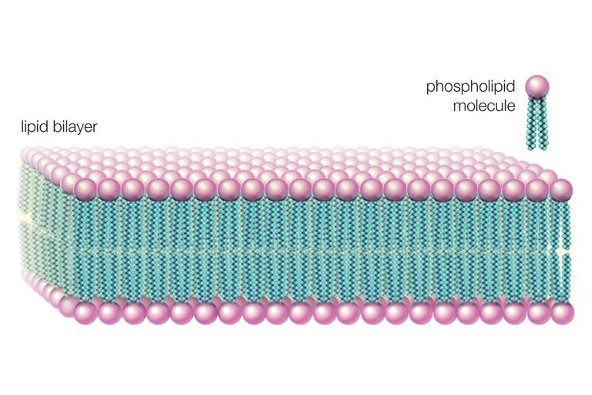
Lipid Bilayer

Slide 10
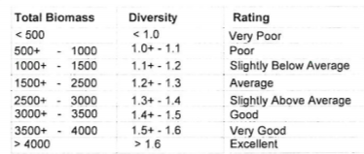
Interpreting PLFA
Higher biomass and diversity are better
No standard ranking established
Dependent on soil type, climate, etc.

Slide 11
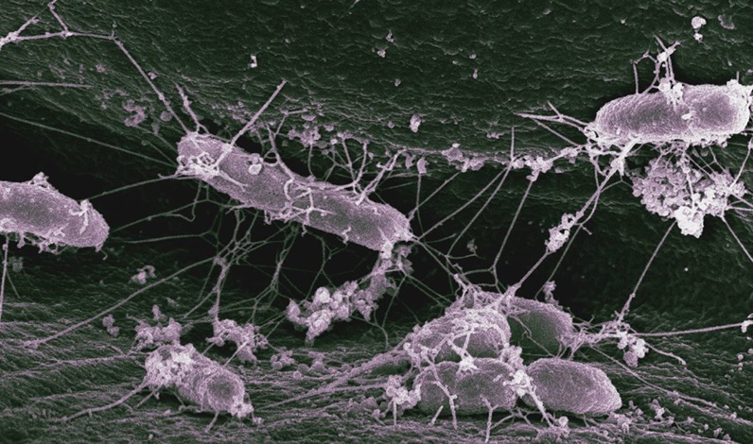
PLFA Report Ratios
Fungi:Bacteria
Predator:Prey
Gram(+):Gram(-)
Sat:Unsat
Mono:Poly
Pre 16:1 to cy17:0
Pre 18:1 to cy19:0
The ratios give us an indication of community
balance and stress.

Slide 12
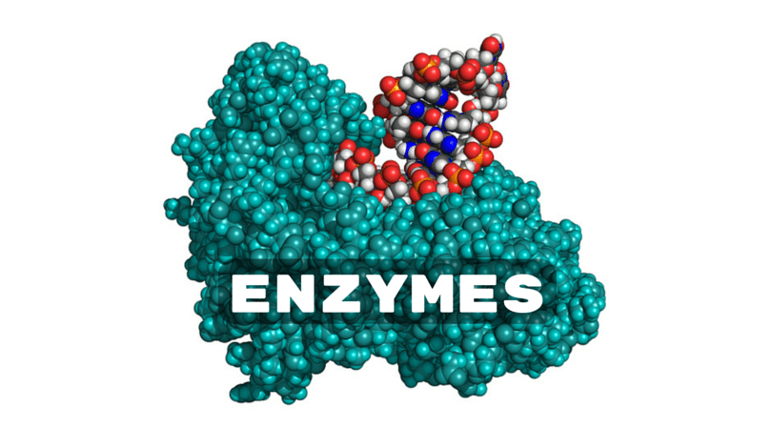

Slide 13
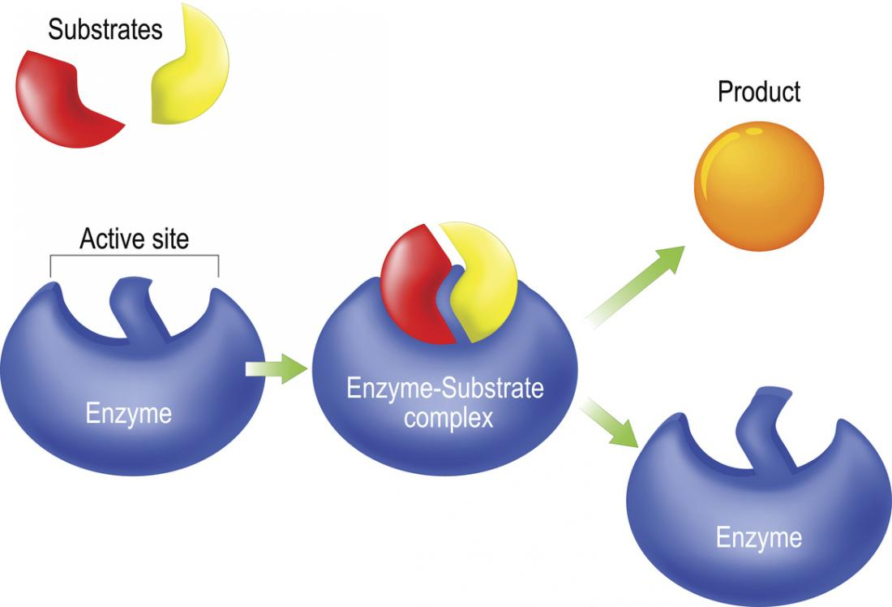
Enzyme Function

Slide 14
Enzyme Function

Slide 15
Enzyme Function

Slide 16
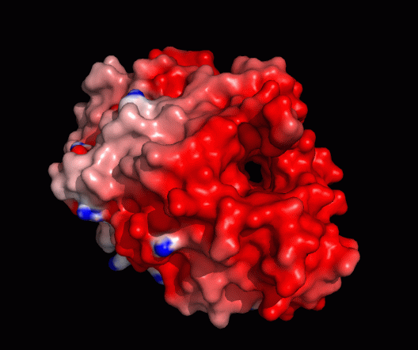
https://phys.org/news/2013-06-enzyme-wood-eating-gribble-biofuel.html

Slide 17
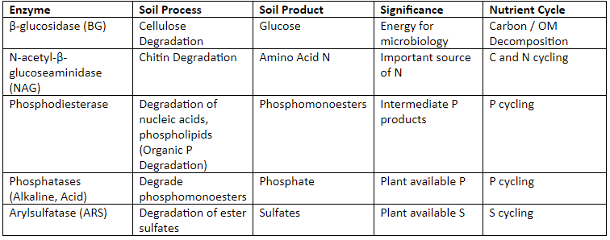
Important Functions

Slide 18
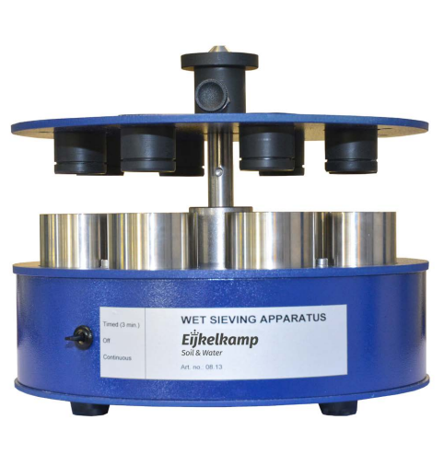
Aggregate Stability

Slide 19
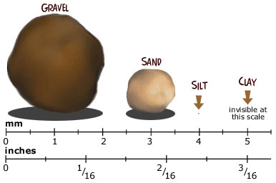
Soil Particles

Slide 20
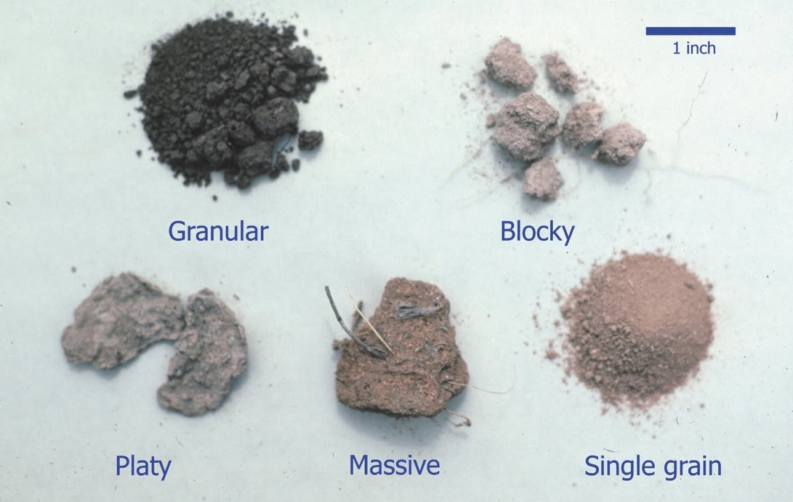
Soil Structure

Slide 21
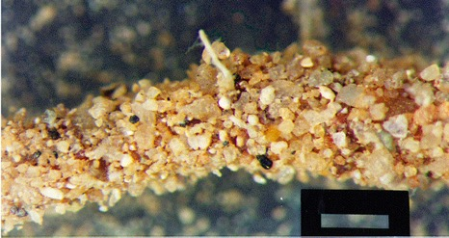
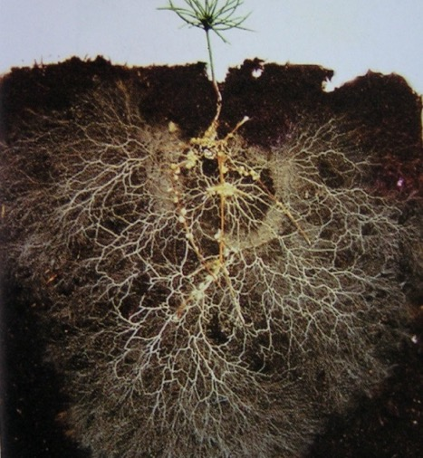
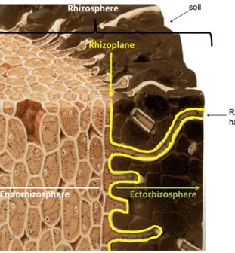
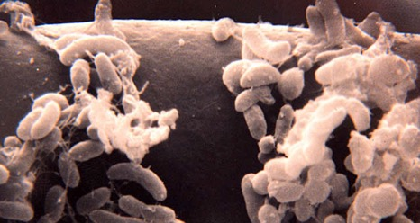
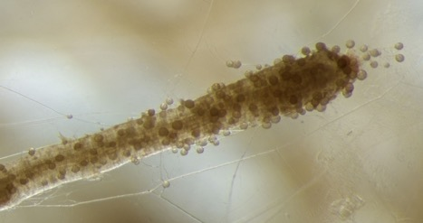
The Rhizosphere

Slide 22
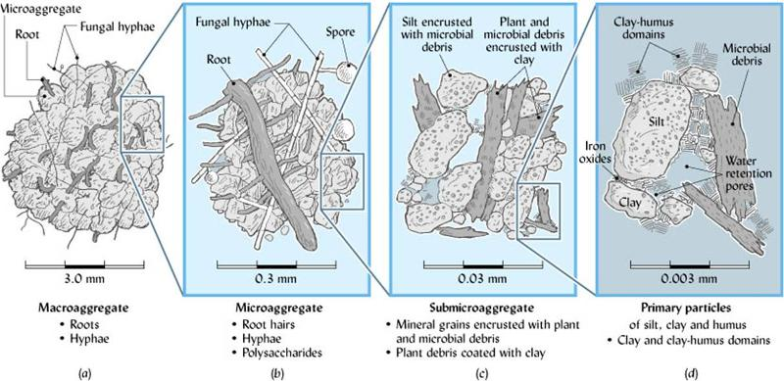
Aggregate Formation

Slide 23
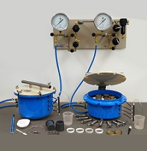
Water Holding Capacity

Slide 25
Haney Test
Soil Fertility
Soil Organic N and P
Microbial Biomass
C:N balance
Water Extractable C
Dr. Rick Haney – USDA-ARS Temple, TX

Slide 26
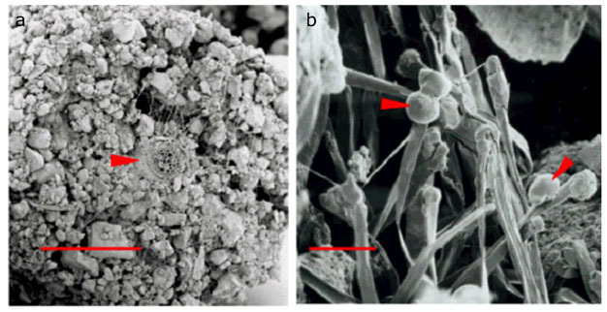
Green Chemistry – H3A
A soil extractant that mimics soil solution by using organic acids produced by living plant roots to temporarily change soil pH and increase nutrient availability.
http://www.nature.com/scitable/knowledge/library/the-rhizosphere-roots-soil-and-67500617

Slide 27
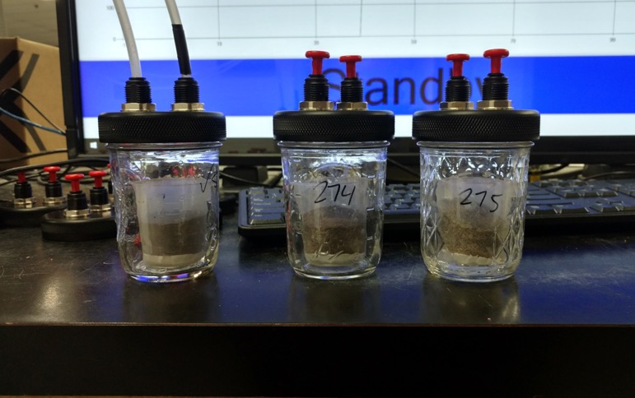
Microbial Biomass
1-day CO2 Burst uses drying and rewetting techniques to mimic natural field events and represents the flush of microbial activity, leading to nutrient cycling. The amount of cycling is related to soil habitat including available food (WEOC) and soil fertility.

Slide 28
CO2-C | Ranking | Implications
0-10 | Very Low | Very little potential for microbial activity; slow nutrient cycling and residue decomposition; high carbon residue may last >2-3 yrs. with limited moisture; Nearly no N credit given; Additional N may be required due to microbial immobilization
11-20 | Low | Minimal potential for nutrient cycling; residue management can still be a problem; Very little to no N credit given
21-30 | Below Average | Some potential for nutrient cycling; residue management can still be a problem with prolonged use of high carbon crops; Little N credit given
31-50 | Slightly Below avg. | Low to moderate potential for microbial activity; Some N credit may be given
51-70 | Slightly Above avg. | Moderate potential for microbial activity; Moderate N credit may be given; May be able to start reducing some N fertilizer application
71-100 | Above Average | Good potential for microbial activity; Moderate N credit may be given depending on size of organic N pool; Can typically reduce N application rates
101-200 | High | High potential for microbial activity; more carbon inputs may be needed to sustain microbial biomass; moderate to high N credit from available organic N pools may be given; N fertilizer reduction can be substantial
>201 | Very High | High to very high potential for microbial activity; residue decomposition may be <1 yr.; keeping the soil covered could be a problem in some systems; high potential for N mineralization and N credits from available organic N pools may be given; N fertilizer reduction can be substantial
http://soilhealthinnovations.com

Slide 29
Nature’s Solvent – H2O
Water Extract
Organic C
Total N
Nitrate
Ammonium
Calculated
Organic N
Organic C:N
Organic N Release
Soil Health Score
Microorganisms have the greatest access to nutrients and food that are either suspended, dissolved, or solubilized in soil water.
Therefore, the water extract represents what the microbes see in their soil environment.

Slide 30
% SOM vs. WEOC
% SOM reflects the quantity of organic C and is the house that soil microbes live in.
WEOC reflects the quality of organic C and is the house’s refrigerator. This is FOOD DRIVING THE SOIL MICROBES AND ENERGY FOR NUTRIENT CYCLING!
2% SOM, 12,000 ppm C
100-300 ppm C from water extract
House
Food
This portion is nearly 80 times smaller than SOM
Dr. Rick Haney – USDA-ARS Temple, TX

Slide 31
C:N Balance
Organic C and N have to be balanced to get the highest potential return from the WEON bank account.
Above 20:1 = No net N-mineralization
N is limiting and remains tied up in microbial biomass.
Ideal 8:1 to 15:1
Microbes release inorganic or plant available N and P to feed the plants
Organic N and P release
Organic C:N
Dr. Rick Haney – USDA-ARS Temple, TX

Slide 32
Soil Health Score/Calculation
SHS = (1-day CO2-C/10) + WEOC/50 + WEON/10
We like to see this value above 7 to start
Achieve C:N balance first and then work on building the pools of WEOC and WEON to help increase microbial biomass/activity to drive nutrient cycling.
Cover crop recommendation based on SHC and C:N ratio

Slide 33
Nitrogen Fertility Recs
Conventional Way
Crop to be grown and yield goal
Total amount of nutrient needed
Credit from Soil Test
NO3 Only
Credit from Past Crop
Credit from Subsoil
Credit from SOM – Guess?
Credit from Irrigation Water
Haney Way
Crop to be grown and yield goal
Total amount of nutrient needed
Credit from Soil Test
NO3, NH4, Organic N Release
Credit from Past Crop
Credit from Subsoil
Credit from Irrigation Water

Slide 34
The N-umbers
CONVENTIONAL
Corn @ 200 bu/A
220 lbs of N req’d
N credits
10ppm NO3 or 20lbs/A
Soybeans past crop – 40lbs
??? Or assumed to be 25lbs
HANEY
Corn @ 200 bu/A
220 lbs of N req’d
N credits
10ppm NO3 or 20lbs/A
5ppm NH4 or 10lbs
Organic N Release – 30lbs
Soybeans past crop – 40lbs
??? Or assumed to be 25lbs

Slide 35
The N-umbers
CONVENTIONAL
Corn @ 200 bu/A
220 lbs of N req’d
N credits
Total Credit = 85 lbs
Rec = 135 lbs
HANEY
Corn @ 200 bu/A
220 lbs of N req’d
N credits
Total Credit = 125 lbs
Rec = 95 lbs

Slide 36
The Soil Health Effect
Improving soil health and biological function increases nutrient use efficiency by the crop.
Using conventional tests and fertilizer requirements can lead to excess fertility being applied.
Healthier soils require fewer fertility inputs due to the increased ability of plants to acquire necessary nutrients.

Slide 37
When and How to Use Soil Health Tests
Comparing two different systems
Tracking change over time
Troubleshooting problems
Spring and/or Fall when soil temps >50º

Slide 38
Lance Gunderson
Regen Ag Lab - President and Co-Owner
308-440-1681
Lance.gunderson@regenaglab.com

