Slide 1
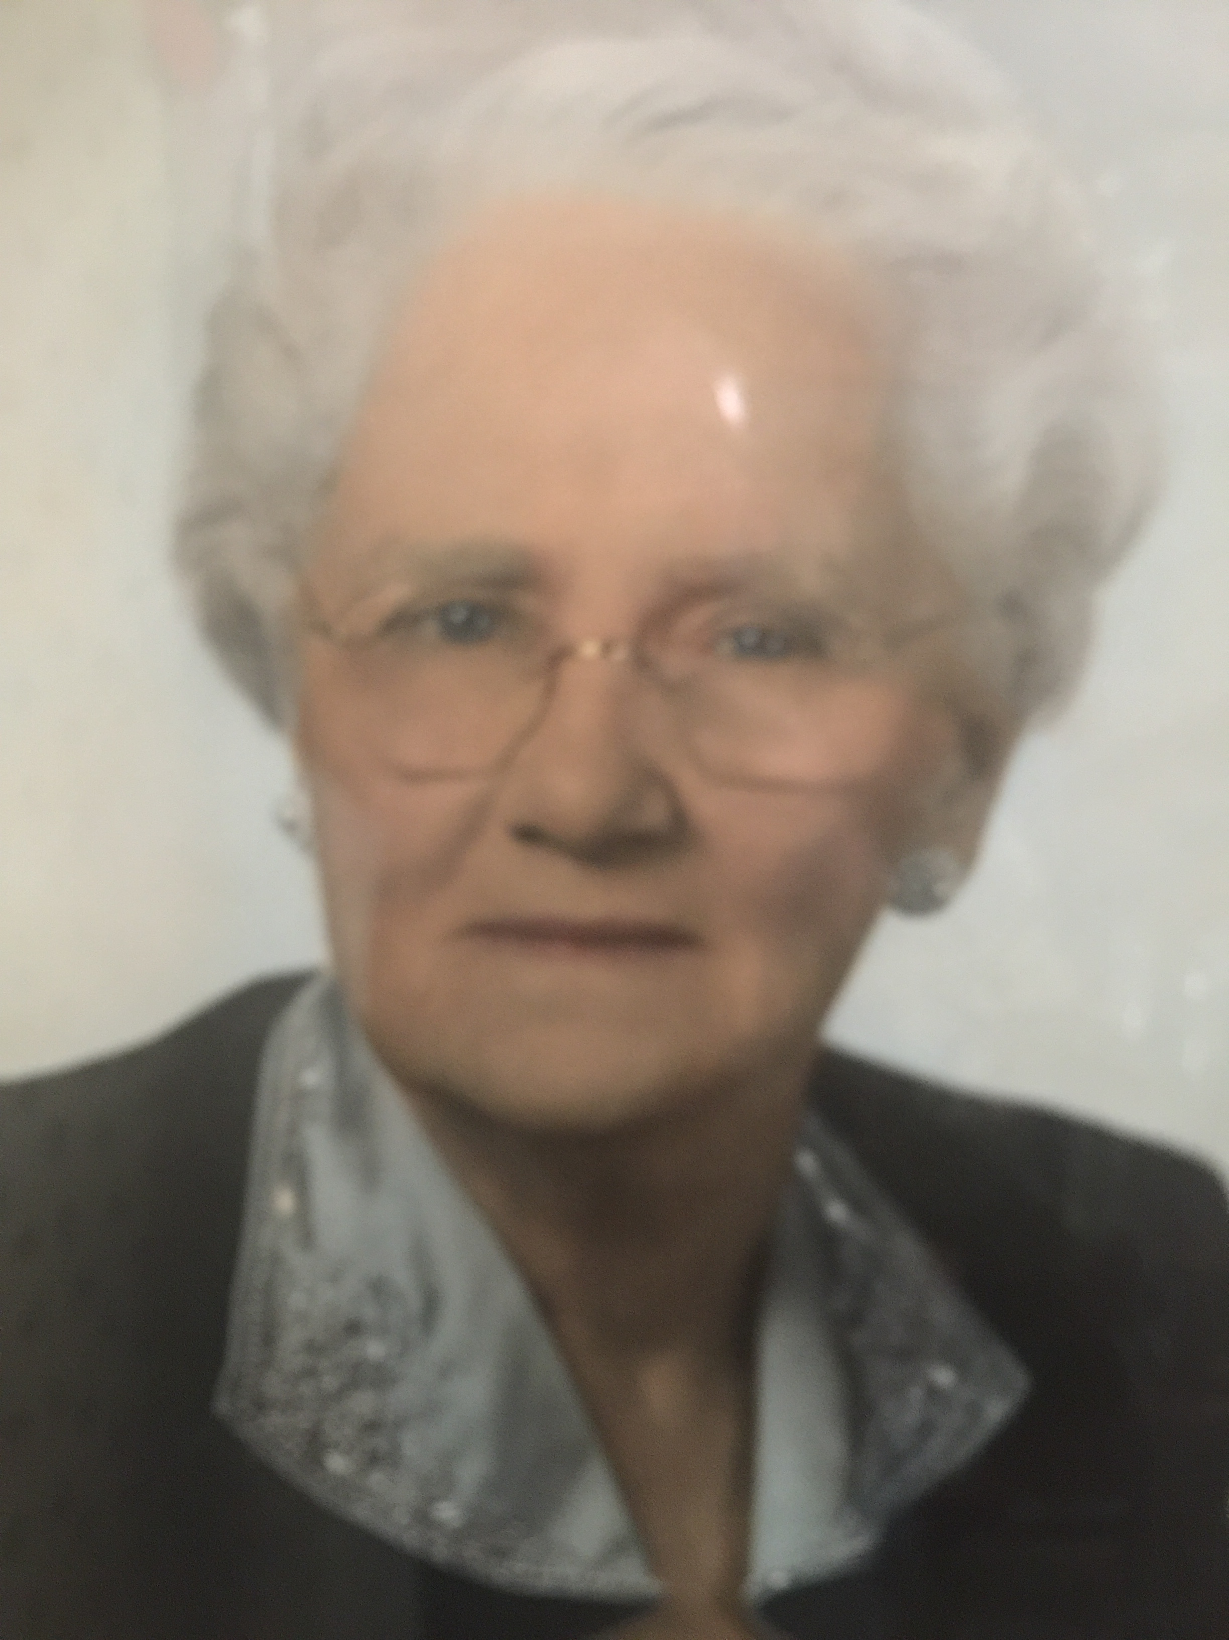

Slide 4
How is it possible to start an operation in the middle of “the great American desert”?

Slide 6
Ag School said,
“It won’t work here.”

Slide 8
“This can’t work without herbicides and fertilizer.”

Slide 9
3 stories with doorways to much richer systems.

Slide 11
Tom

Slide 12
Tom

Slide 13
GOAL

Slide 14
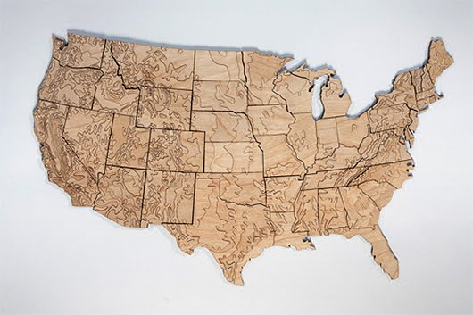
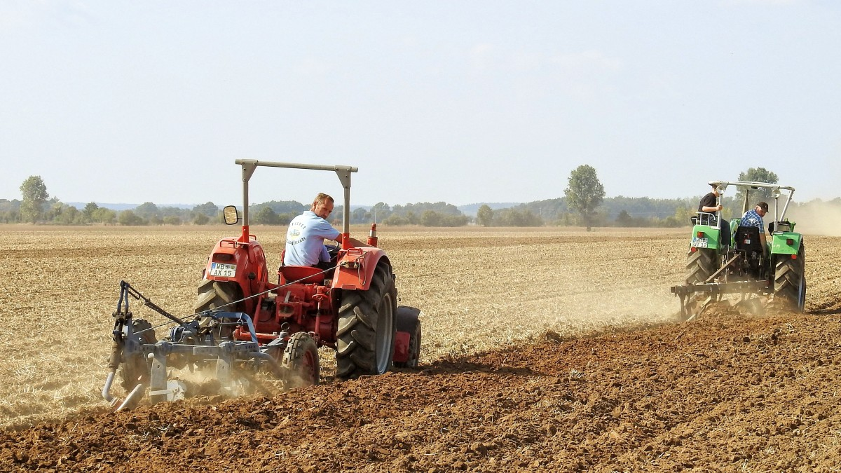

Slide 15
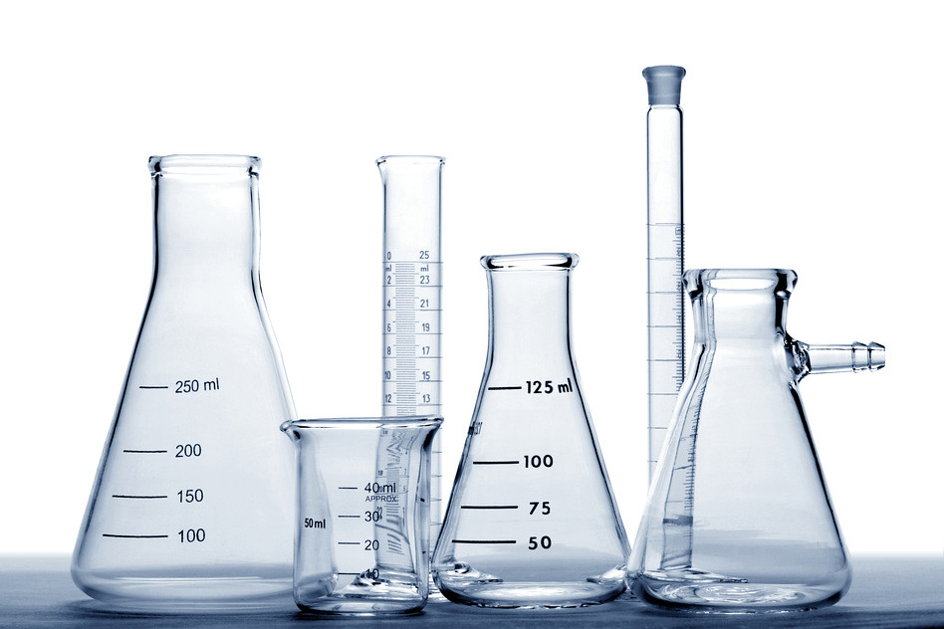

Slide 17
More bigger?
Acres
Inputs
Equipment
Time
Sweat
Blood

Slide 18
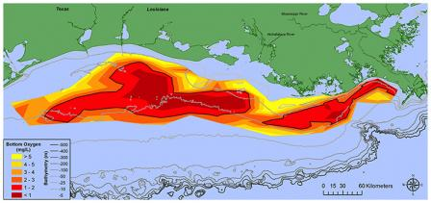
2019
6,952 square miles

Slide 19
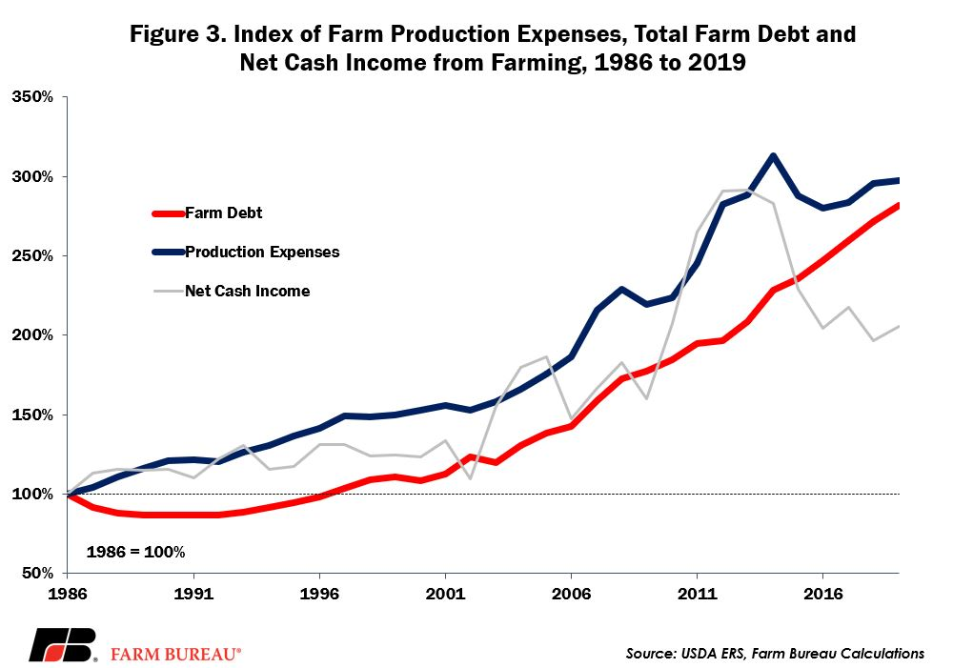

Slide 20
Romans 12:2
² Do not conform to the pattern of this world, but be transformed by the renewing of your mind. Then you will be able to test and approve what God’s will is—his good, pleasing and perfect will.

Slide 21
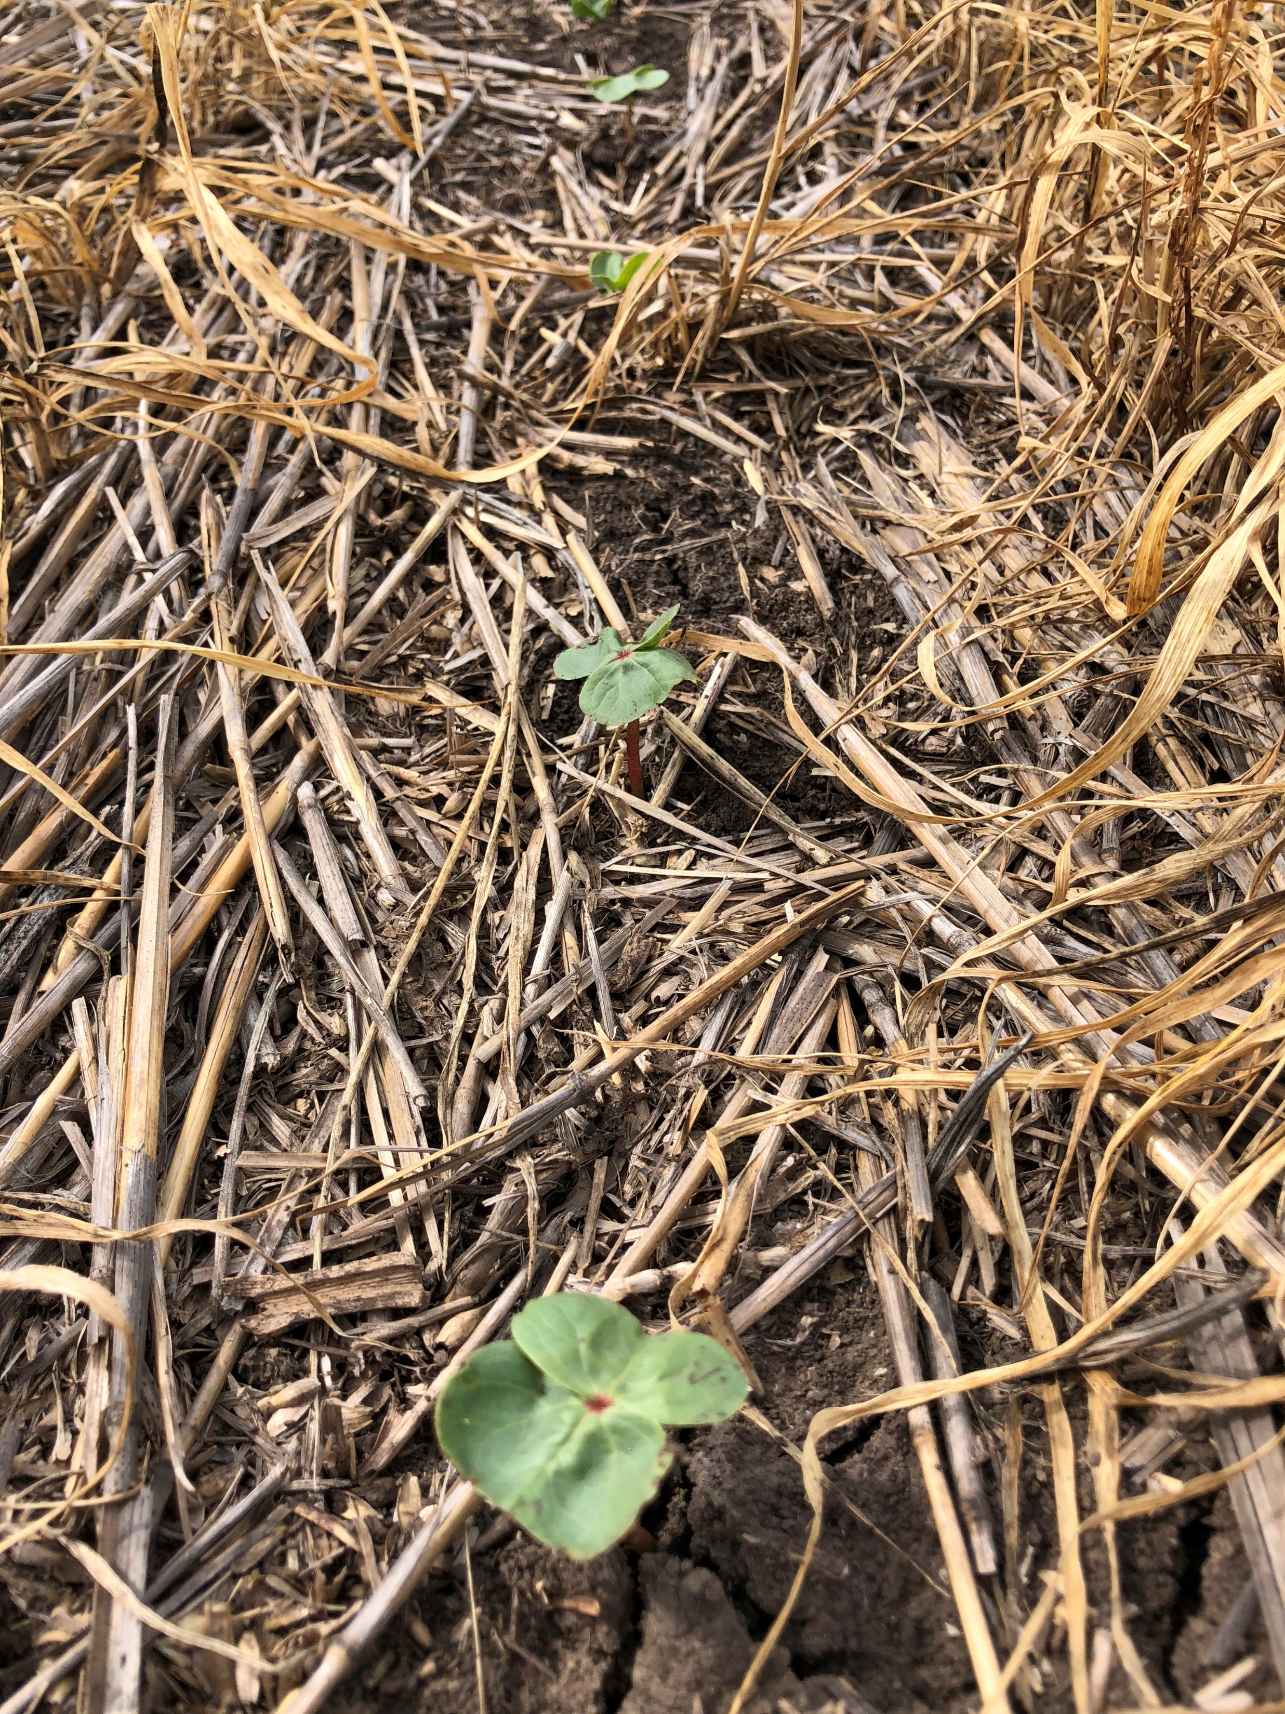

Slide 22
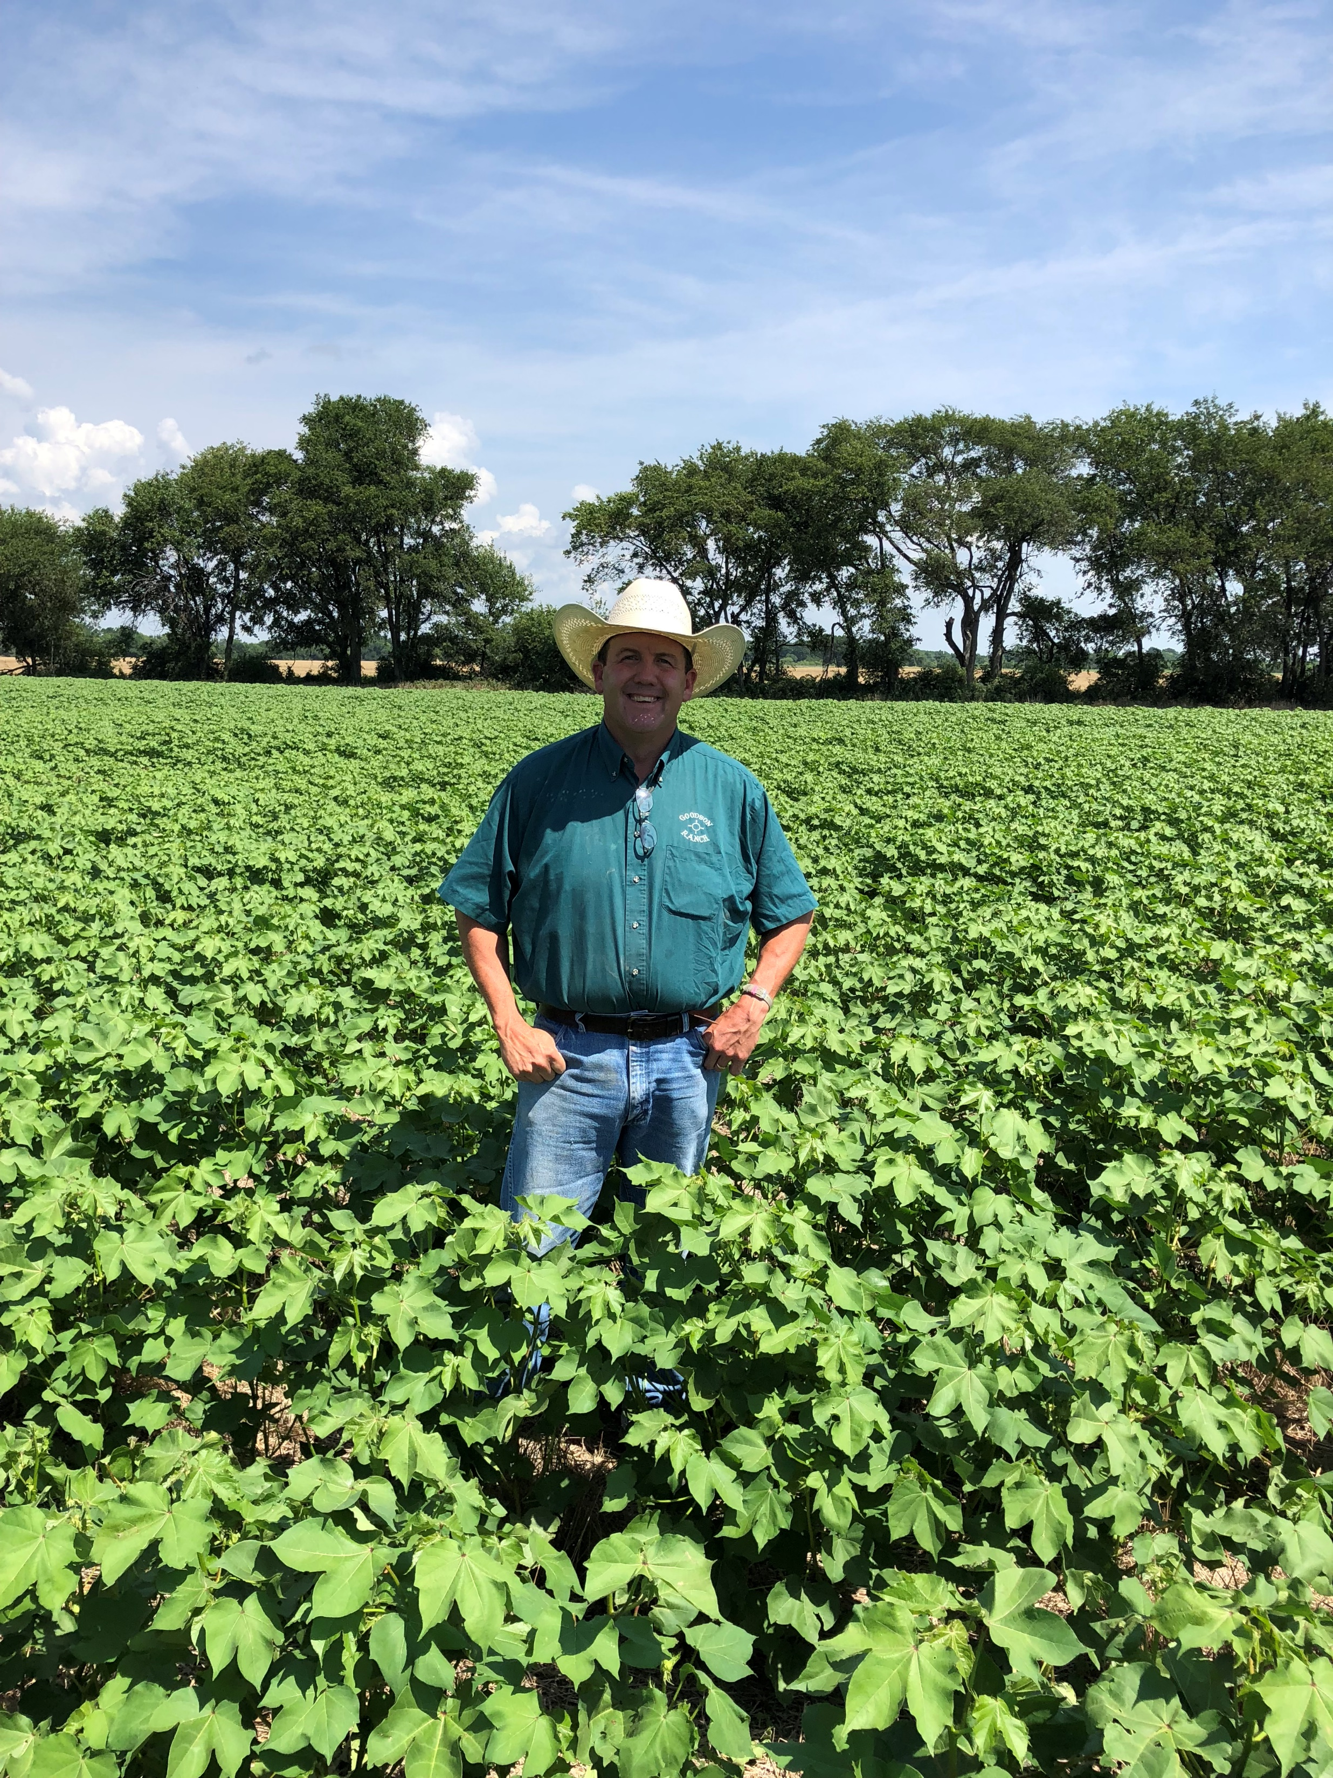

Slide 23
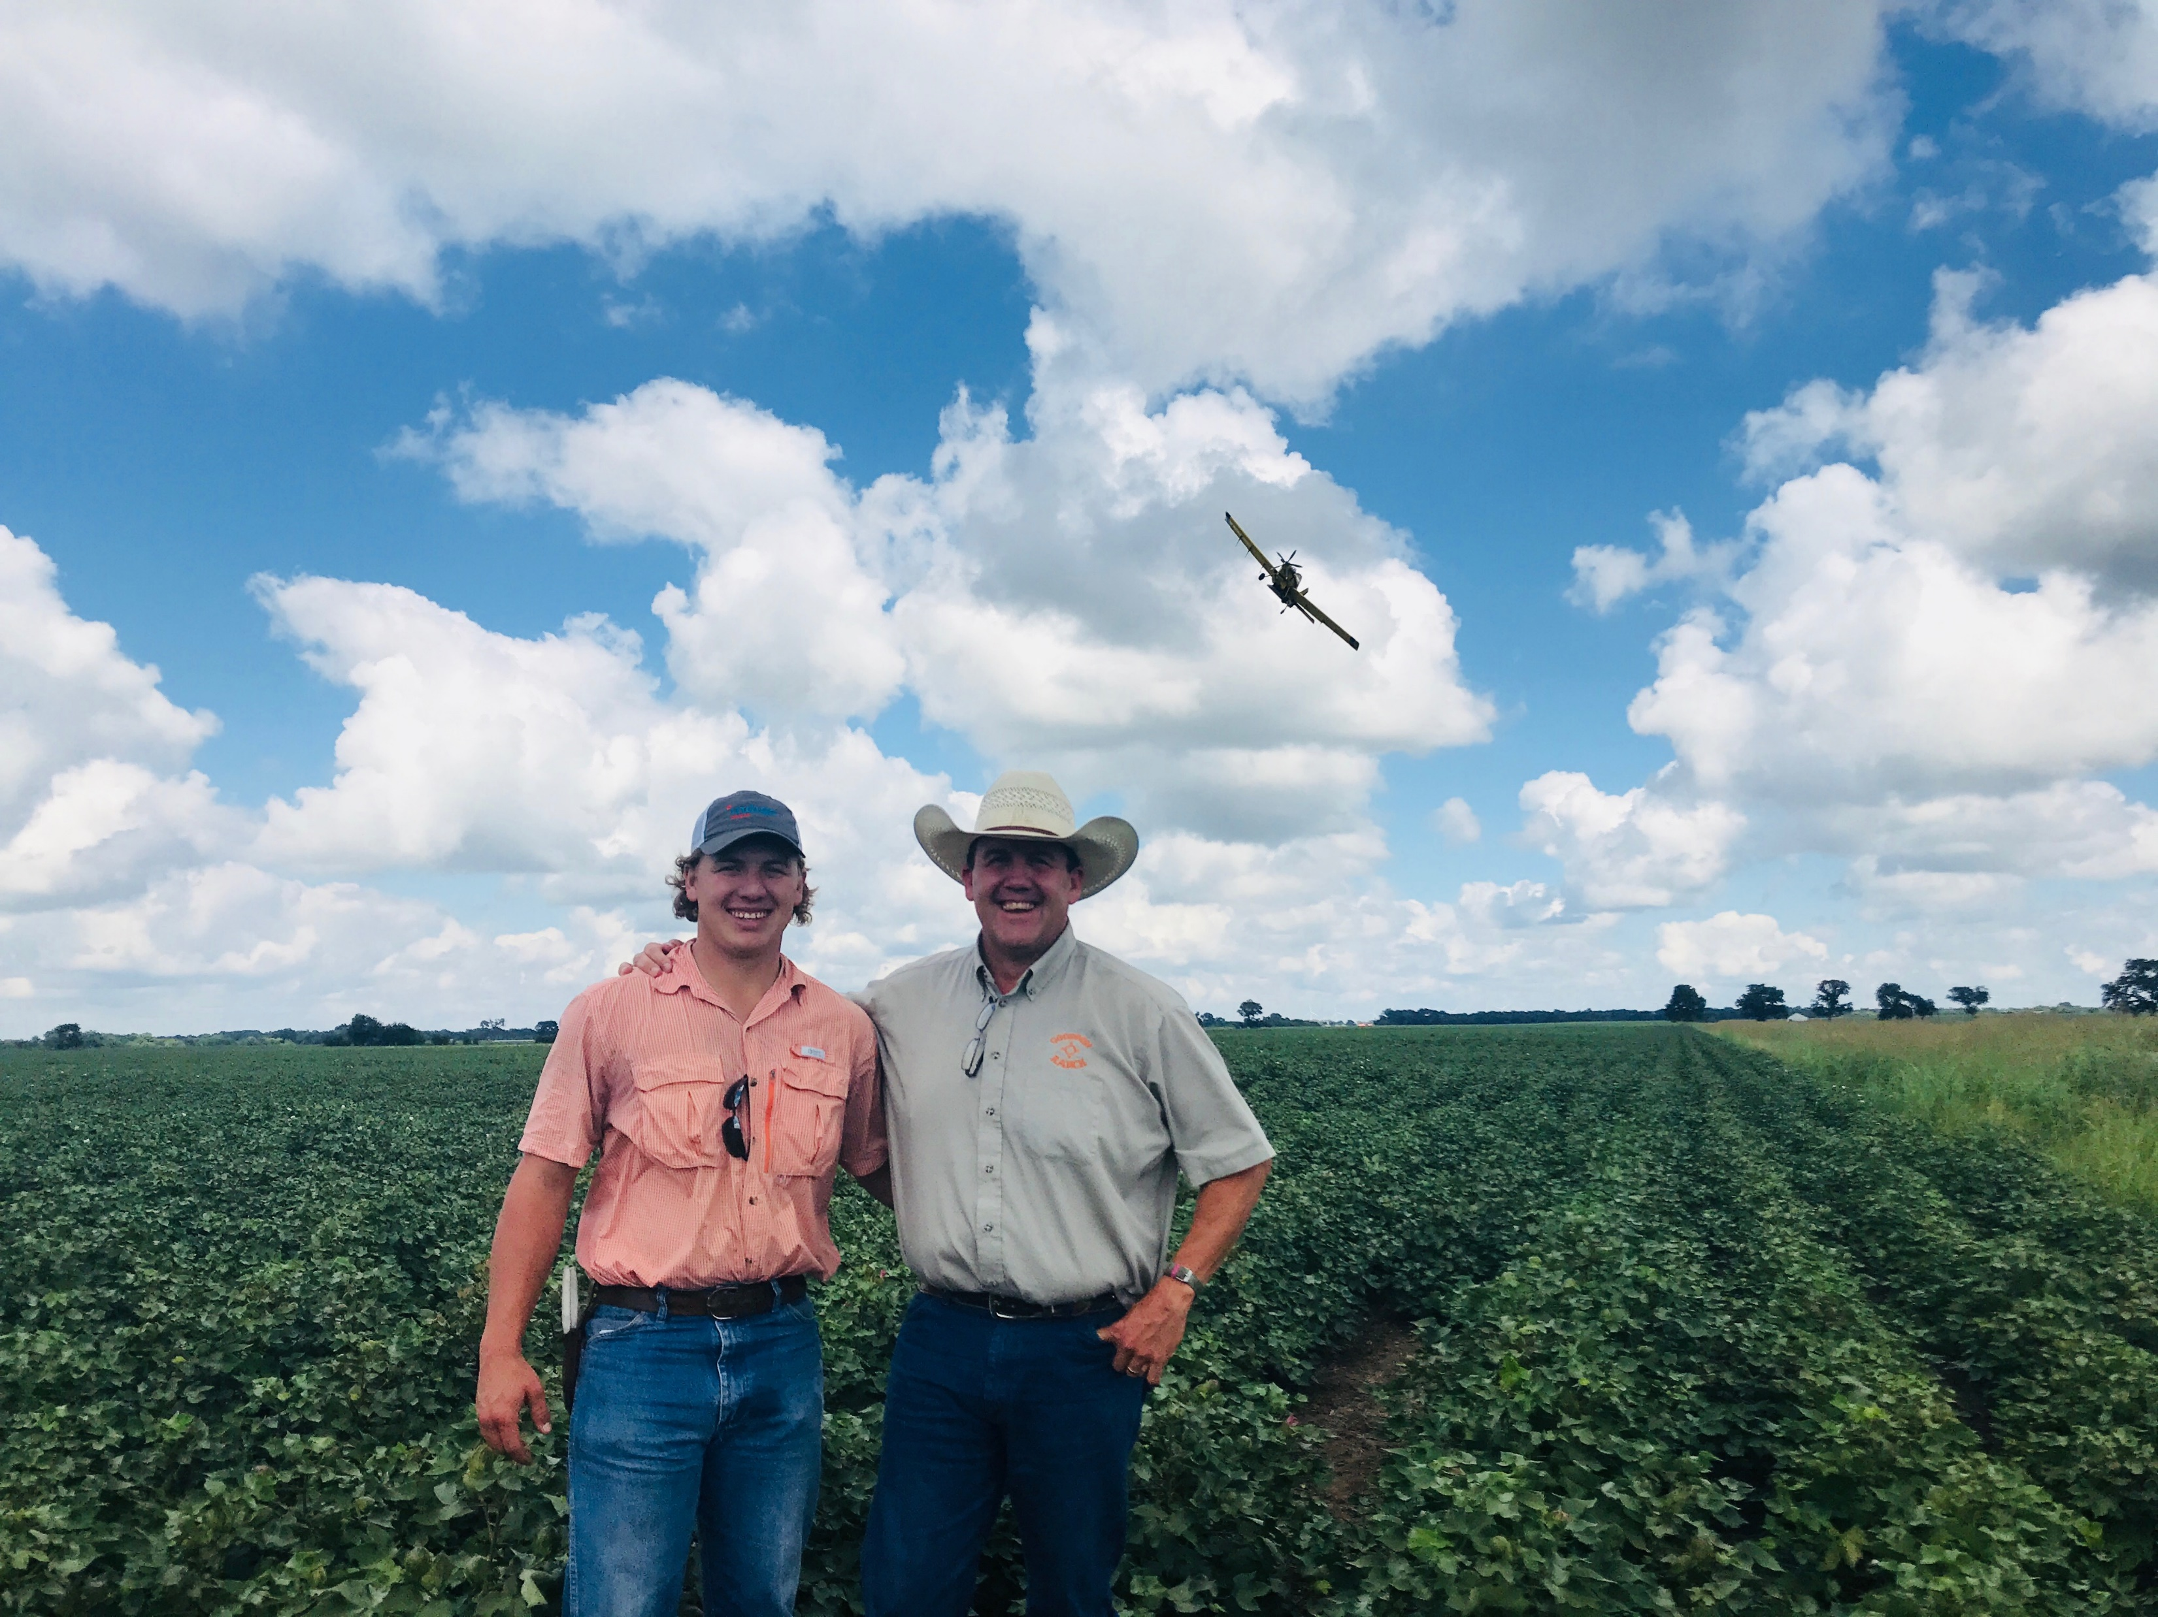

Slide 24
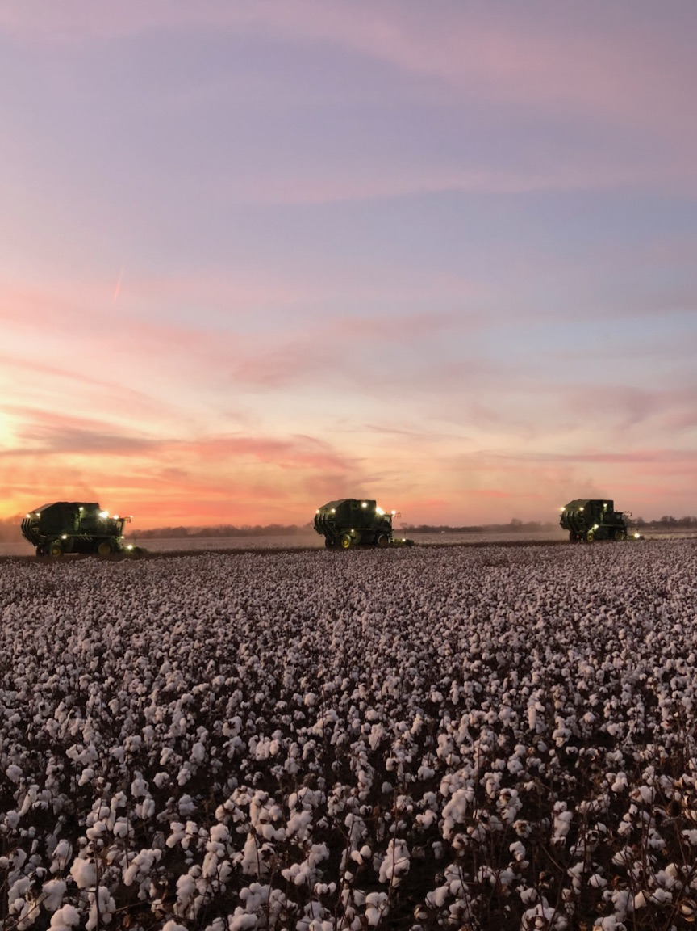

Slide 25
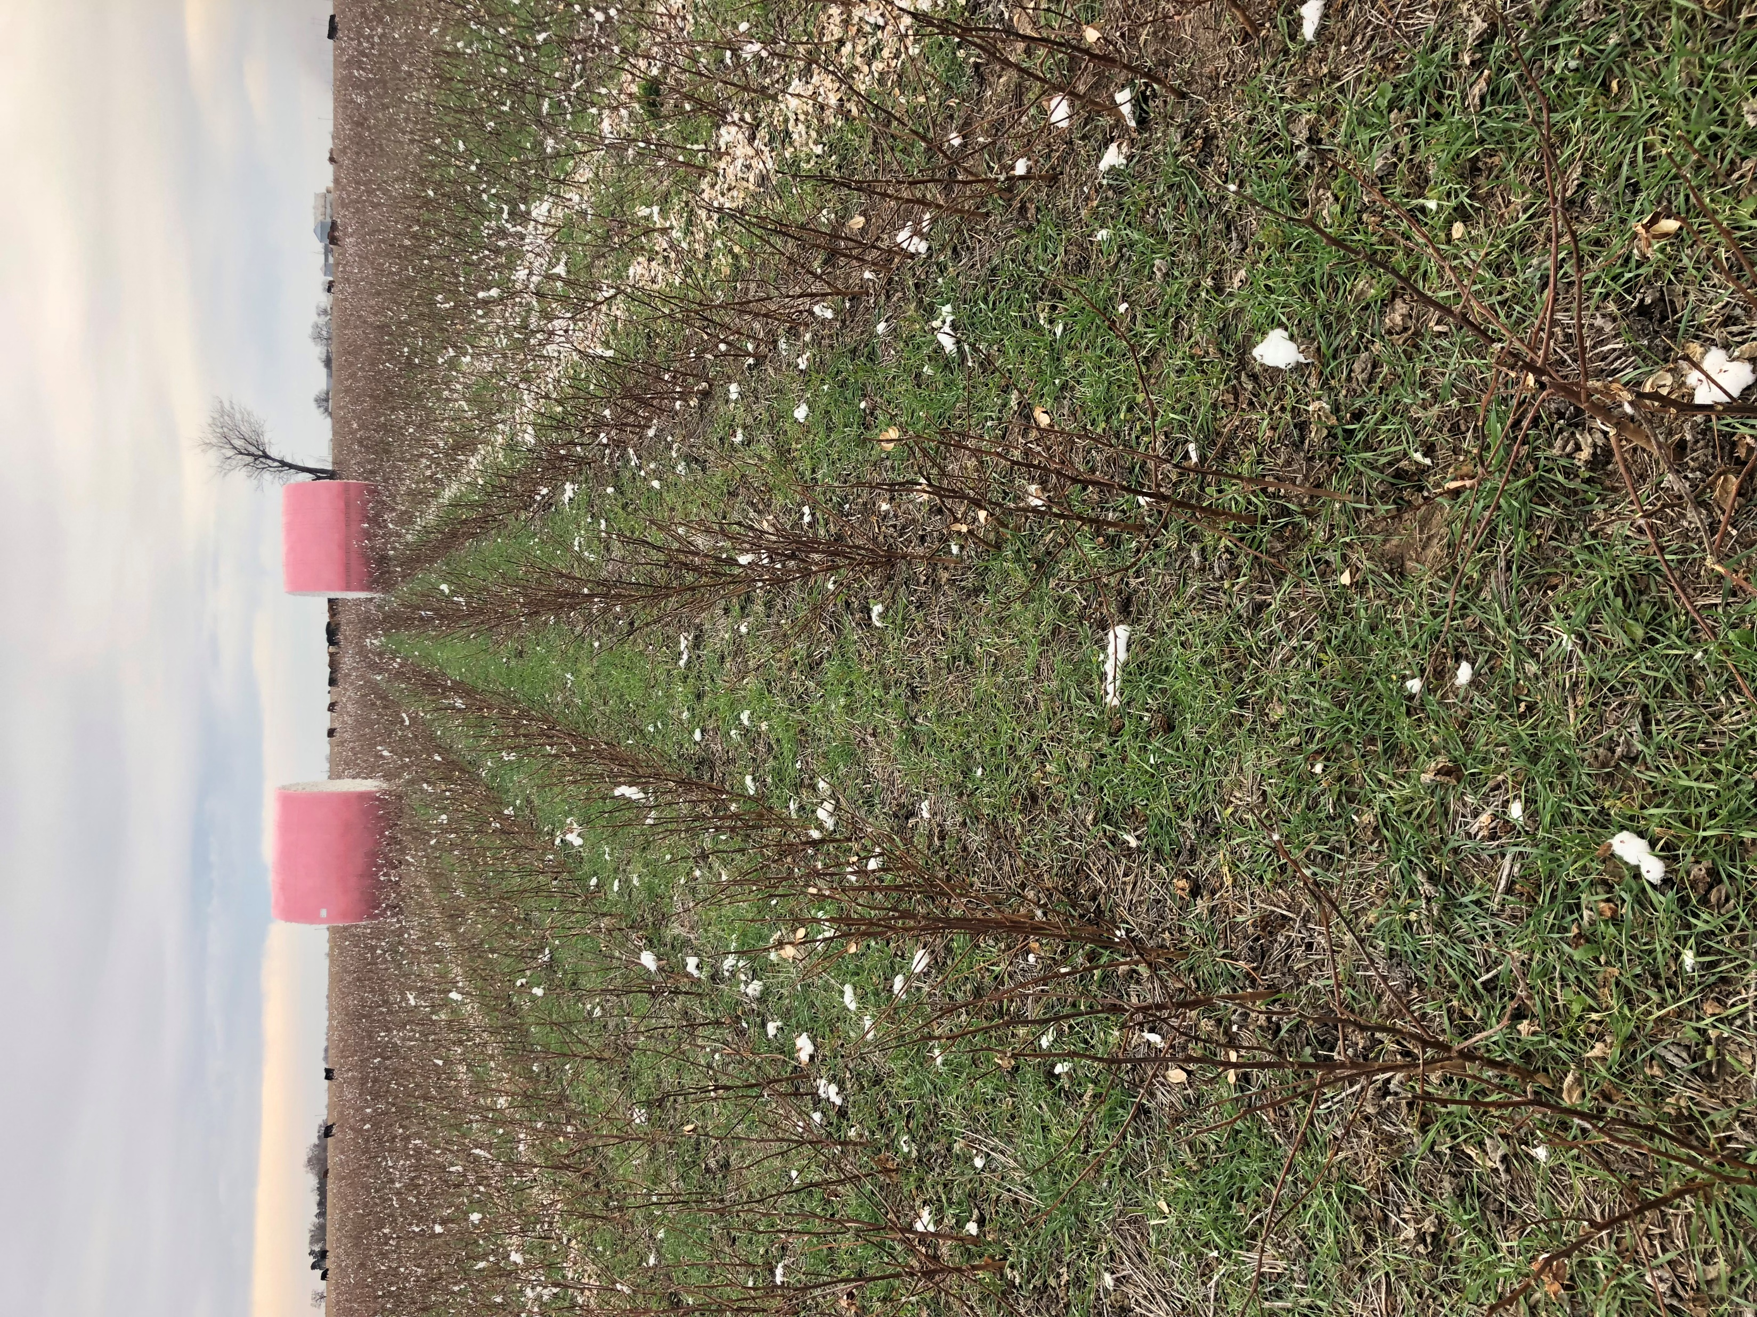

Slide 26
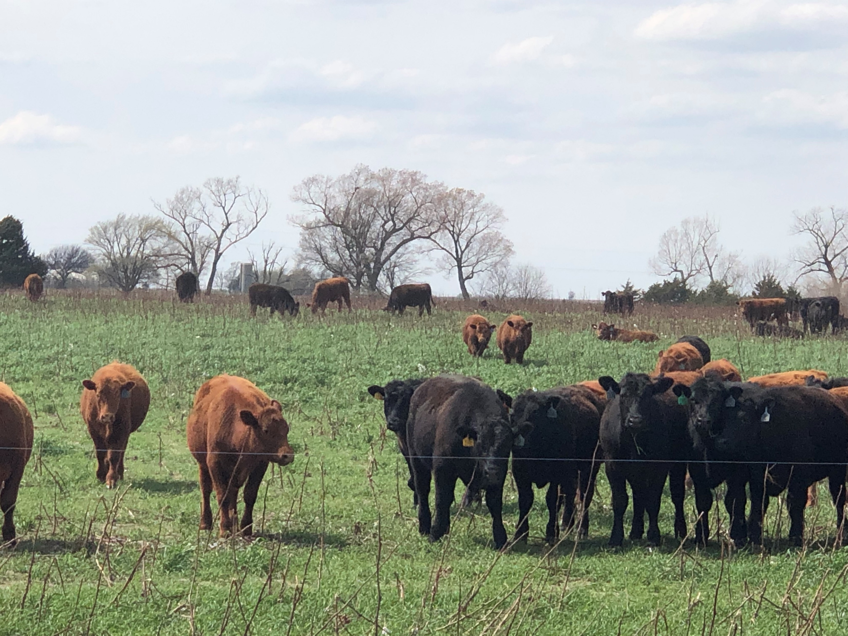

Slide 27
Tom

Slide 28
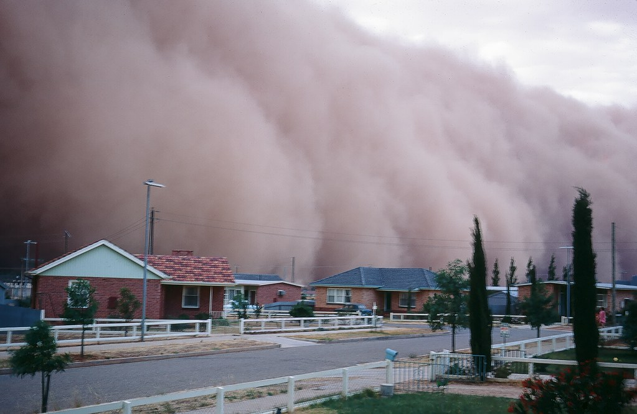

Slide 29
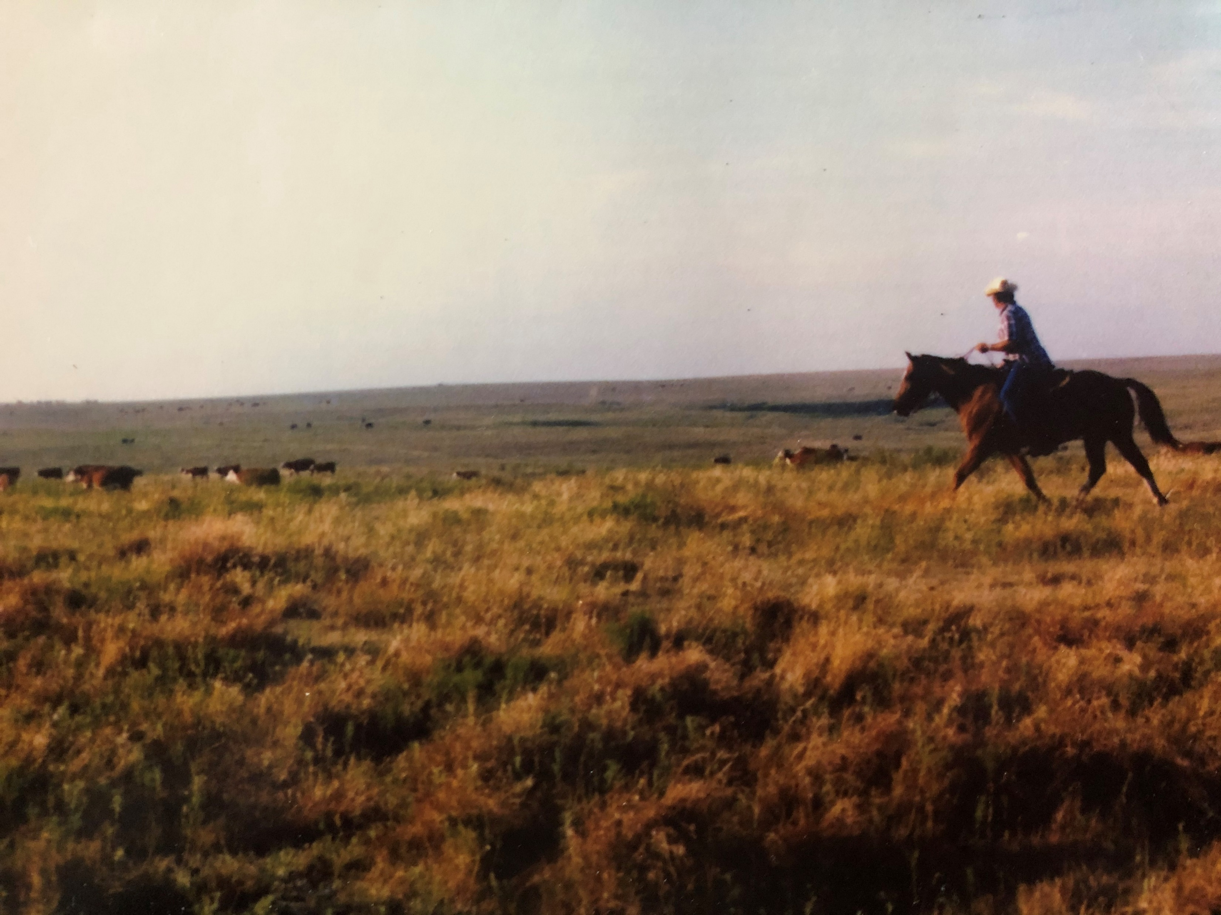

Slide 30
What if success depends on your intimacy with the living soil?

Slide 31
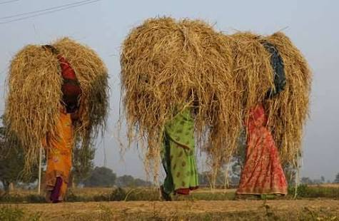

Slide 33
What if we don’t develop intimacy?

Slide 34
What if we do?

Slide 35
