Slide 1
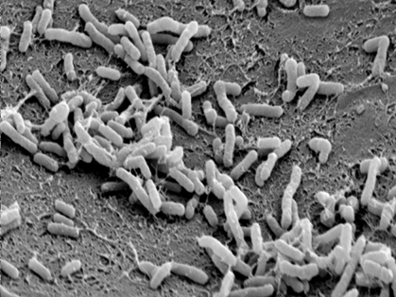
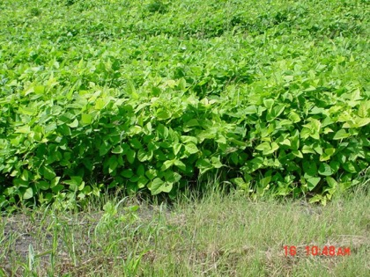
Soil Health Paradigm Shift
Rick Haney PhD, USDA-ARS, Temple, TX

Slide 2


Slide 3


Slide 4


Slide 5


Slide 6
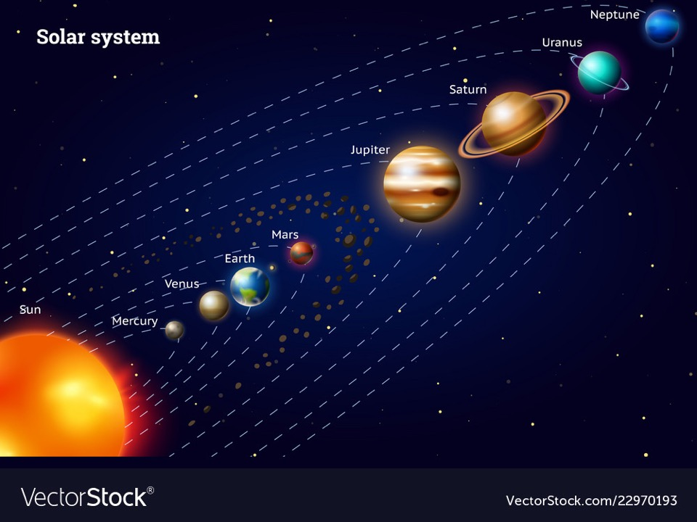

Slide 7

The Home Place

Slide 8

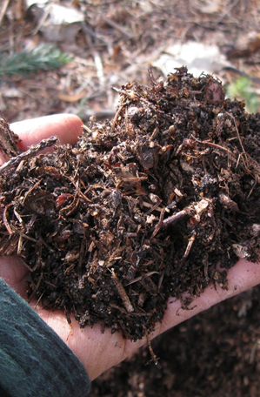
Natures Way
Grows a skin for living systems
Cycles nutrients
Diverse, no monoculture
Seeks balance
Sustainable

Slide 9

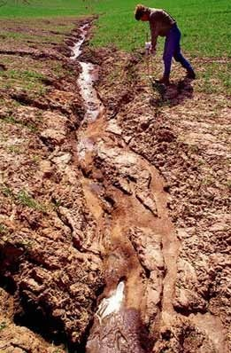
How we do it
Strip off the soil’s skin
Destroy organic matter
Increase erosion
Increase inputs
Waste water

Slide 10
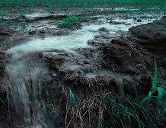

When you go to the bank, do you throw your money at the window and hope some goes in or do you make it so you can deposit it all.
So why do we do this with rainfall and our fields? We have to deposit all the water in our soil account.

Slide 11
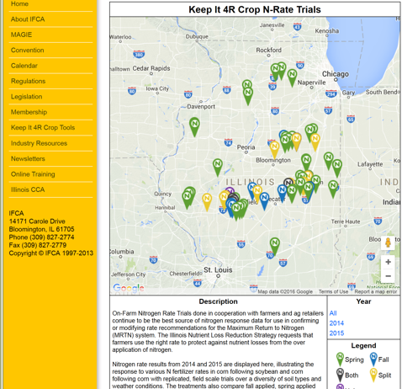
Illinois Fertilizer and Chemical Association Data

Slide 12
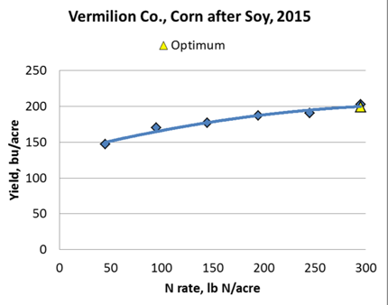
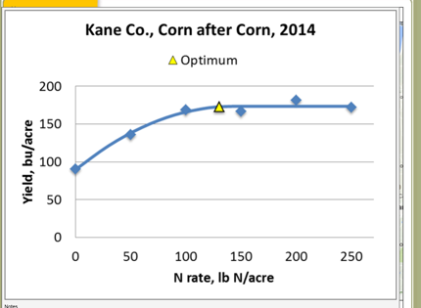
http://ifca.com/nrate_map/

Slide 13
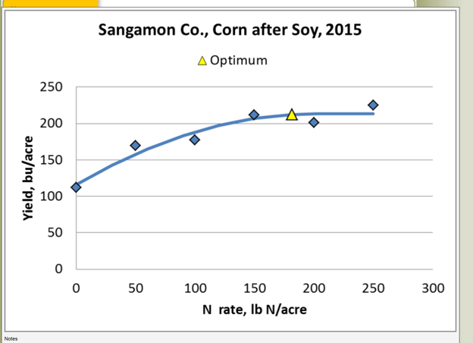
http://ifca.com/nrate_map/

Slide 16
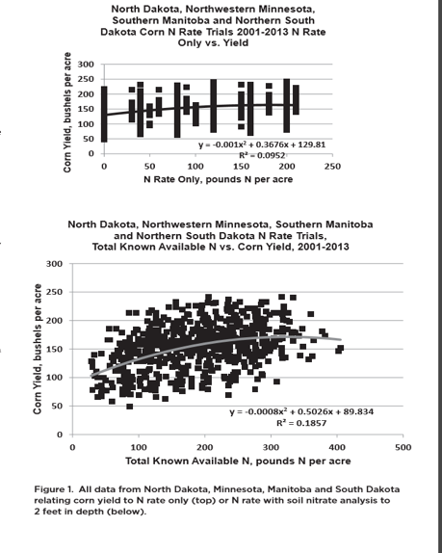
Soil Test Calibration

Slide 17
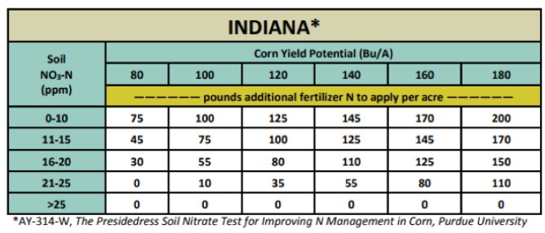
20 lbs available then add 200
30 lbs available then add 170
40 lbs available then add 150
50 lbs available then add 110
>50 lbs available then add 0 ??

Slide 18
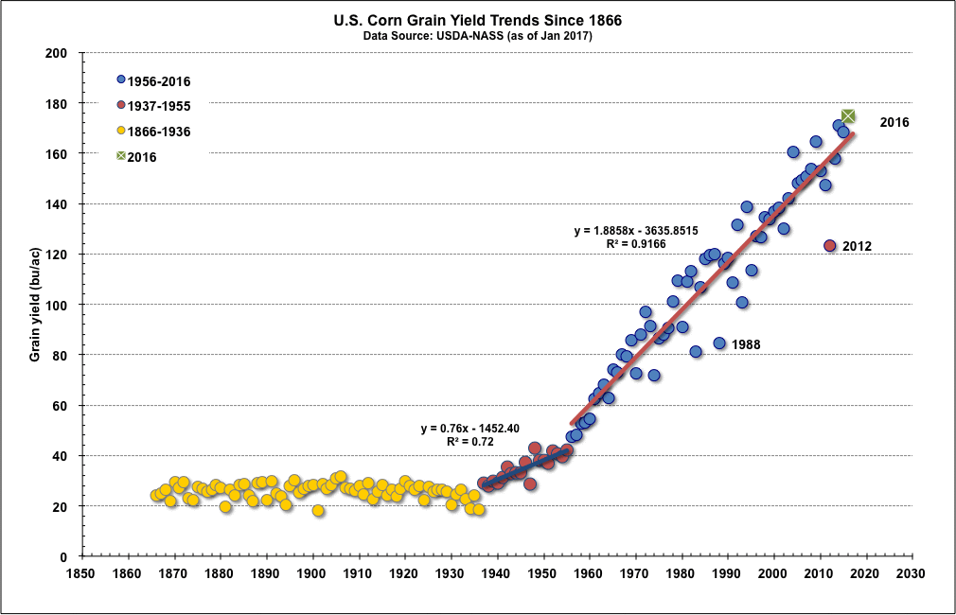
Corn Yield

Slide 19
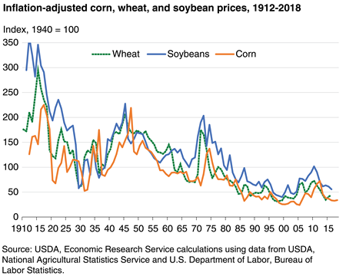
Produce more get less model

Slide 20
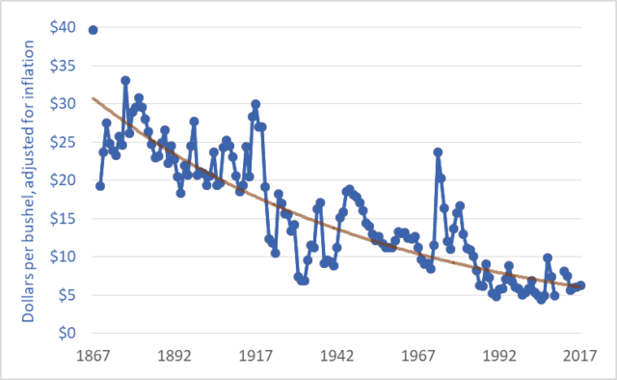
150 years of Wheat Prices

Slide 21
Example: Yield Goal of 200 bushel corn
Soil 1
Soil 2
Nitrate nitrogen 20 lbs
N recommendation 180 lbs Soil health Score 8.0
Nitrate nitrogen 20 lbs
N recommendation 100 lbs Soil health score 26.0

Slide 22

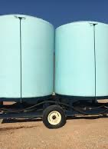
Fertilizer and Trucks

Slide 23
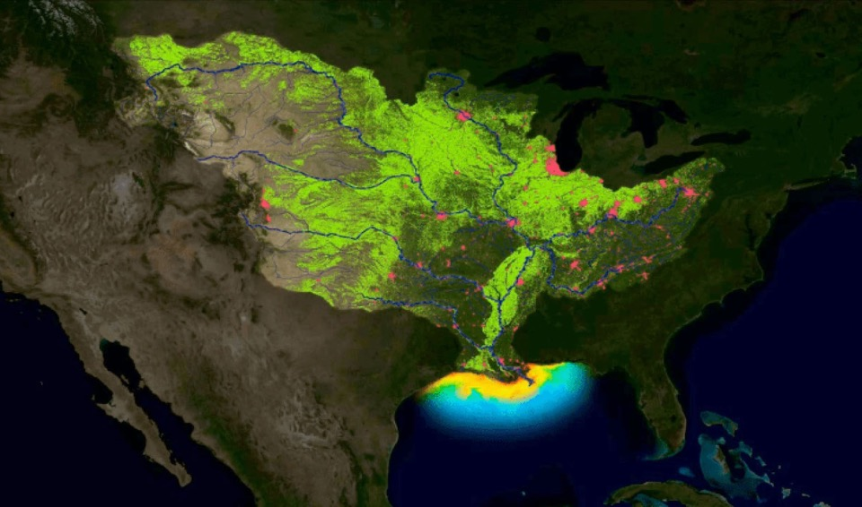
Dead Zone in Gulf: 8500 square miles in 2019

Slide 24


Paradigm shift

Slide 25

How it’s tested: Soil NPK
As a non-living non-integrated system
Focus on physical and chemical
Ignore the biological
Extract soil with chemistry that soil never sees
Measure the house and not the food

Slide 26
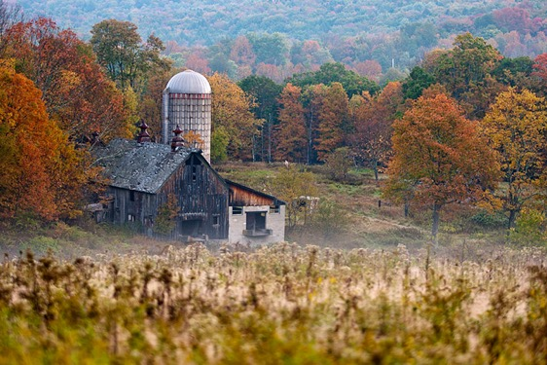
Soil Testing
We are trying to mimic how the soil responds after rainfall in the field, not how it responds to 30-60 year old lab methods.

Slide 27
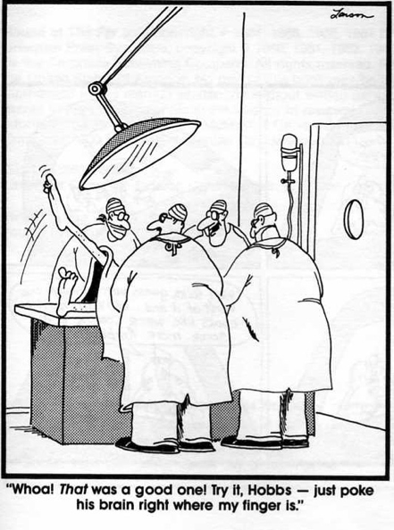
Soil Health Tool
Measure soil health by asking our soil the following questions:
    What is your condition?
    Are you in balance?
    What can we do to help?

Slide 28
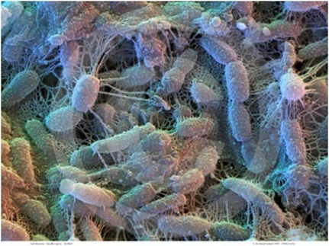
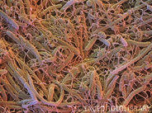
Soil bacteria and fungi

Slide 29

An Incredibly Dynamic Living System
Soil microbes require organic carbon compounds for growth and energy
Soil microbes take in O₂ and release CO₂
This CO₂ release is coupled with energy production, nutrient cycling and microbial growth
Soil microorganisms have been in R&D for millions of years.

Slide 30
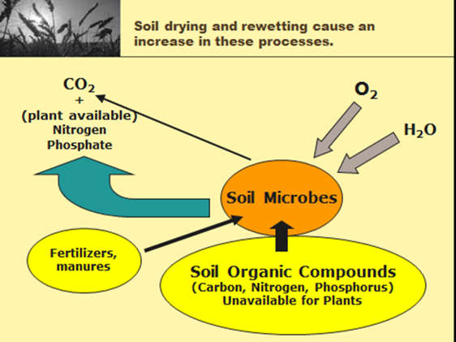
Nutrient Cycle

Slide 31
Soil drying and rewetting
The majority of nutrient cycling is due to the drying/rewetting effect
Laboratory analysis does not account for this process
Plants turn greener after it rains due to the release of N and P, not just the water

Slide 32
Soil Health Methods
The SHNT is geared towards soil microbial activity and the readily available substrate that they act upon. In other words, we assess the soil as a living system, using many measurements of health viewed collectively to attain an overall picture of soil vigor.
The measurements include:
  Water extractable organic C (WEOC)
  Water extractable nitrogen (WEN)
  Water extractable organic N (WEON)
  C: N ratio of the two
  Soil microbial respiration
  Inorganic N and P and K
  H3A extractable Al, Fe, K, Ca, and P.
Soil Microbes
Organic Carbon Nitrogen
Phosphate
Mineralized C, N and P

Slide 33
Soil Health Integration
Soil Health Calculation
% MAC
Organic N
Inorganic N, P
Organic C
Organic C:N
Organic N:P
Soil respiration

Slide 34
Soil Organic Matter is the “House” microbes live in, Water Extractable Organic Carbon is the “Food” they eat.
2% SOM, 12,000 ppm C
100-1000 ppm C from water extract = microbial food
House
Food

Slide 35
Soil Organic C (%OM)
6.4 %
5.96 %
4.6 %
3.0 %
1.0 %
Maine
Wyoming
Alfalfa
Wyoming
Native
Idaho
Texas

Slide 36
Soil Organic C (water extract)
6.4 %
5.96 %
4.6 %
3.0 %
1.0 %
Maine
Wyoming
Alfalfa
Wyoming
Native
Idaho
Texas

Slide 37










Soil Microbial Activity

Slide 38
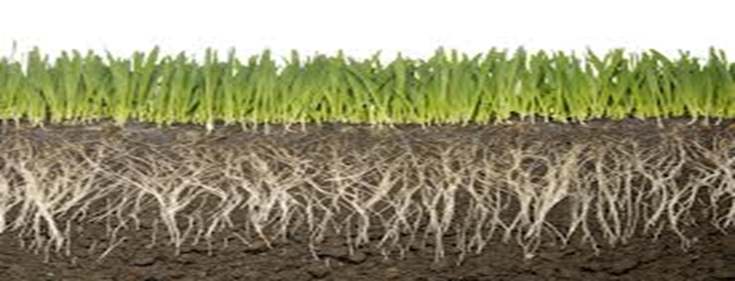
Soil Extraction H3A and Water
What does the plant root really see?
WATER and a complex mixture of plant root exudates along with microbial derived enzymes and nutrients
The root system flows with elegance and complexity
We extract soil with highly disruptive acidic or alkali solutions and call it “plant available”

Slide 39
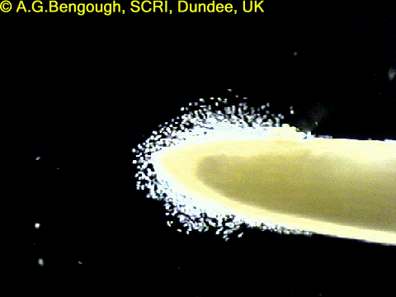
Liquid Sun
About 20% of the carbon fixed by the plant (photosynthesis)
is exuded from the roots into the soil environment.
Notes:
About 20% of the carbon fixed by the plant (photosynthesis) is exuded from the roots into the soil environment. Roots stop growing, DOC will drop back to base levels
The organic compounds released through these processes can be further divided into high and low molecular weight (HMW and LMW, respectively).
By weight, the HMW compounds which are those complex molecules that are not easily used by microorganisms (e.g. mucilage, cellulose) make up the majority of C released from the root;
the LMW compounds are more diverse and thus have a wider array of known or potential functions. The list of specific LMW compounds released from roots is very long, but can generally be categorized into organic acids, amino acids, proteins, sugar, phenolics and other secondary metabolites which are generally more easily used by microorganisms.
The cocktail of chemicals released is influenced by plant species, edaphic and climactic conditions which together shape and are shaped by the microbial community within the rhizosphere.

Slide 40
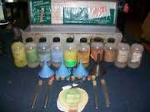
Phosphate
Current labs
ICP P or PO4-P using 7 different extractants
Soil Health
ICP P
PO4-P
H3A (mimics plant root exudates)
Soil respiration
Org C:N
P min
% water P/ H3A P
% P/ FeAl
Ca/FeAl

Slide 41
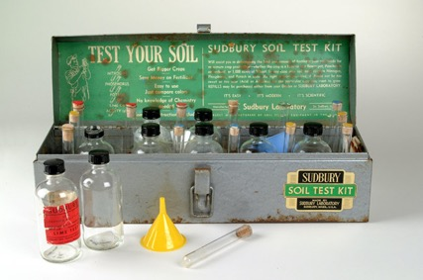
Nitrogen
Current labs
NO3-N
2 M KCl (1965)
None
Soil Health Tool
NH4-N
NO3-N
WETN
Soil respiration
Org N
Org C:N
MAC WEON
N min
Water

Slide 42
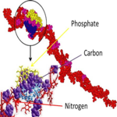
Since 1965* we have been missing half of the N
*2M KCl 1965 Bremer
How can we “calibrate” a soil test when we miss half of what we are looking for?

Slide 43
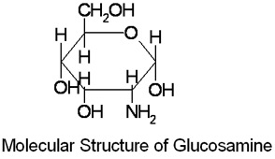
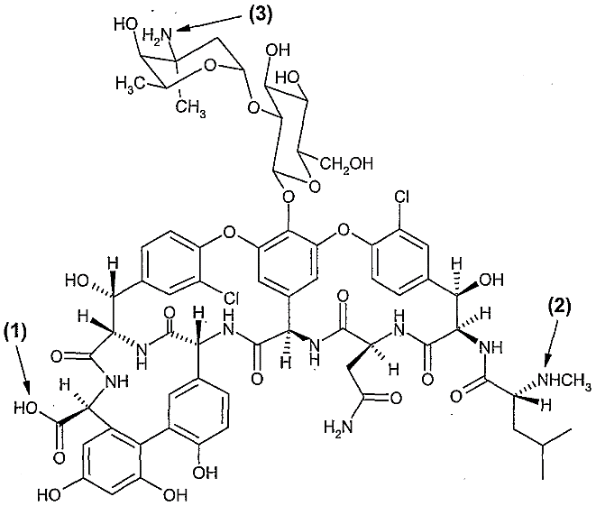
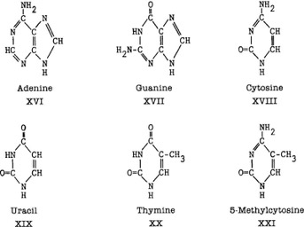
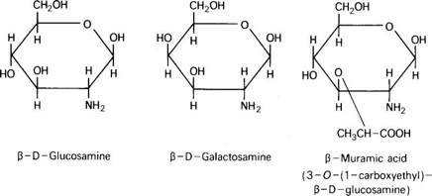
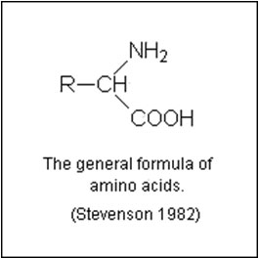
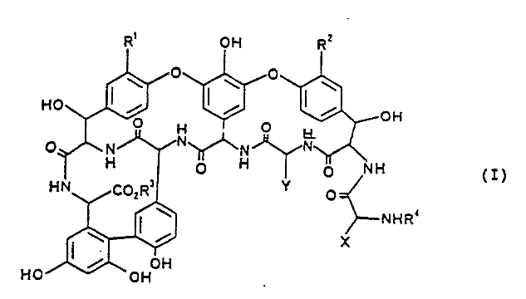
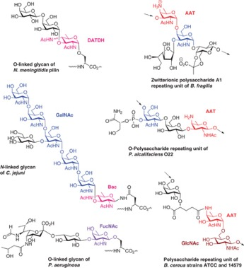
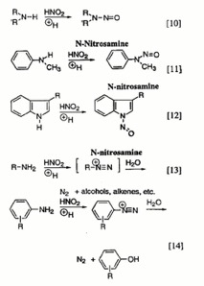
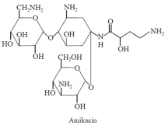
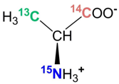
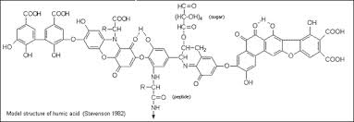
NO₃-N

Slide 44
Plant available N

Slide 46
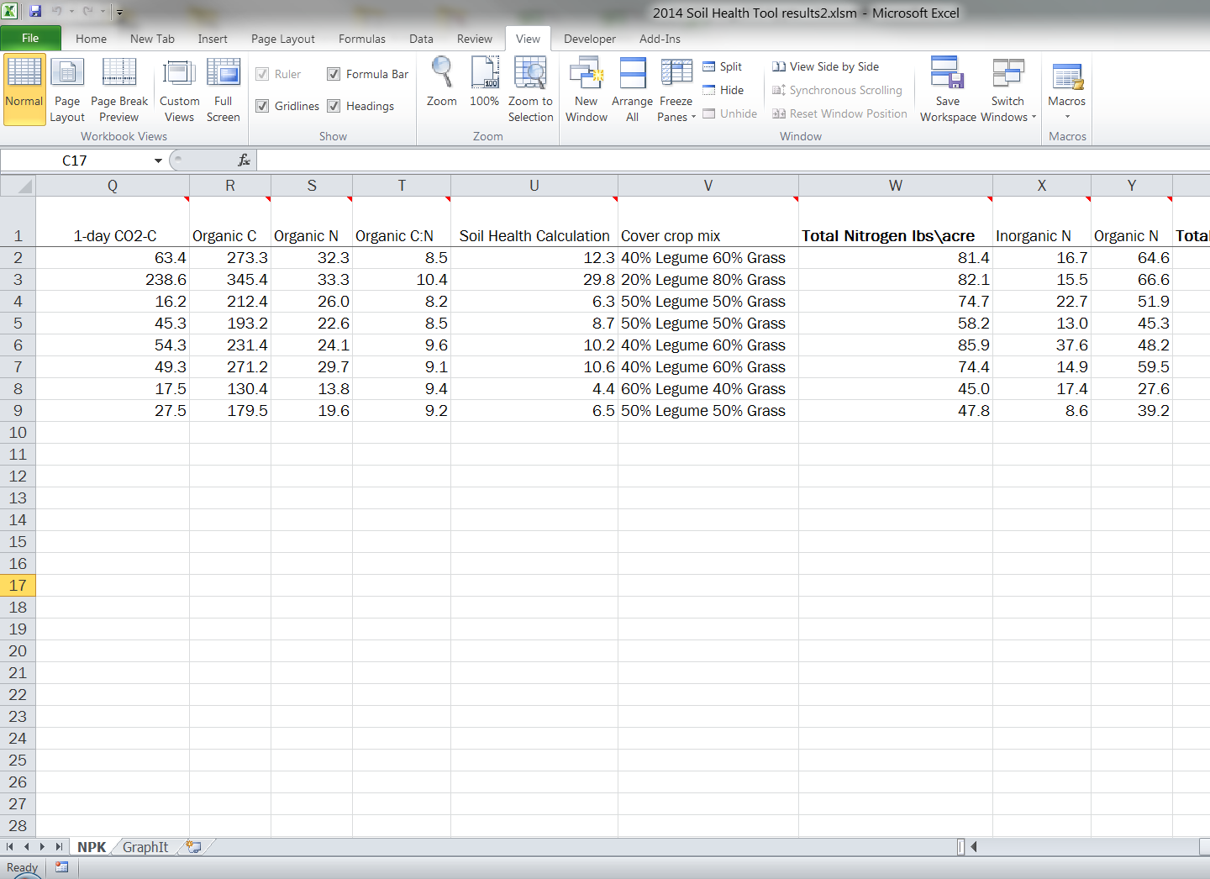

Slide 47
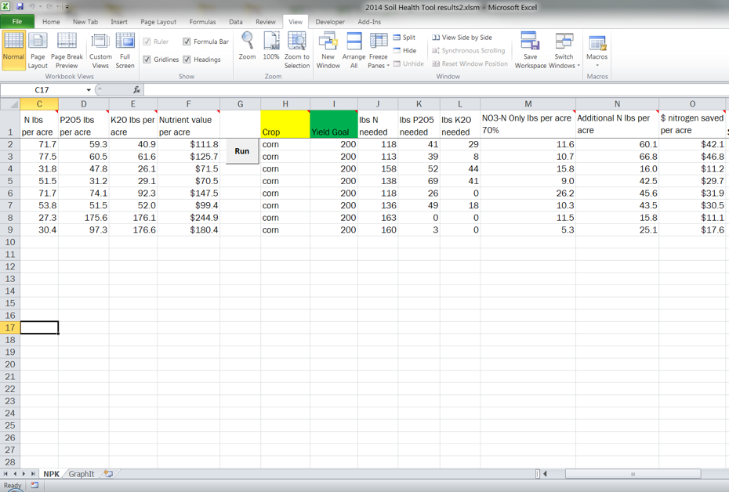

Slide 48
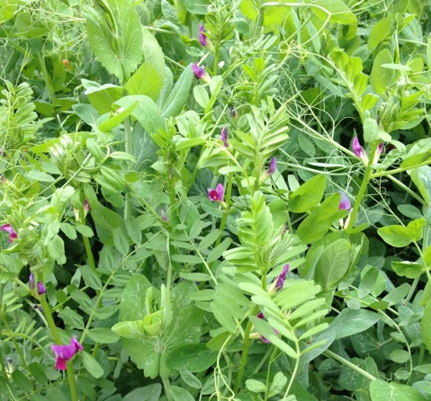
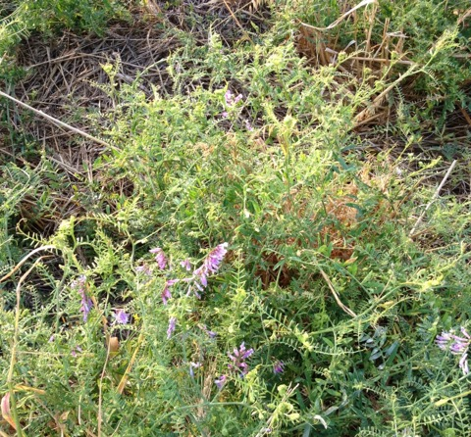
Cover Crops

Slide 49

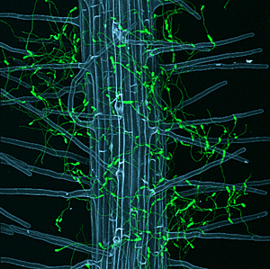
Plants fix dirt and make Soil

Slide 50
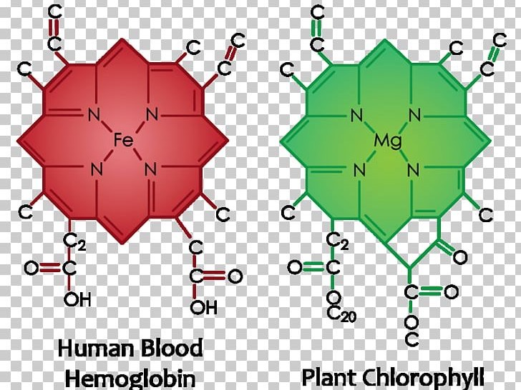

Slide 51
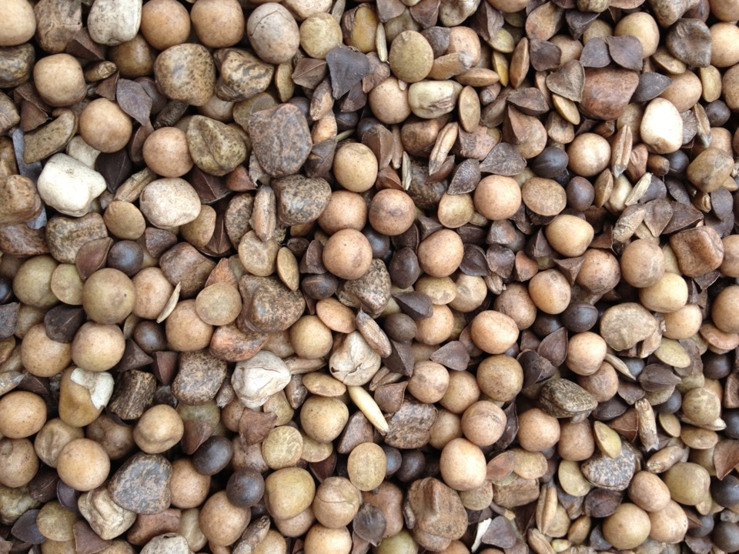
Give good feed to the soil Life, it will return good soil to you

Slide 52
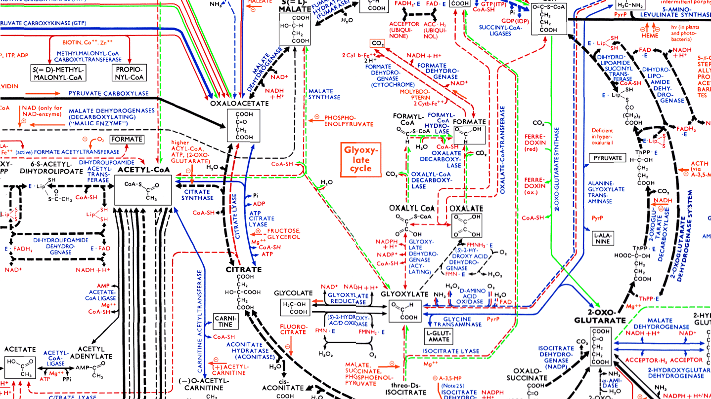
Capture Sunlight to Provide Energy for Soil Life

Slide 53

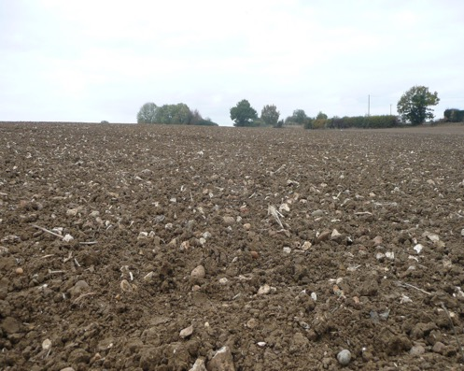

Which Field Captures Solar Energy?

Slide 54
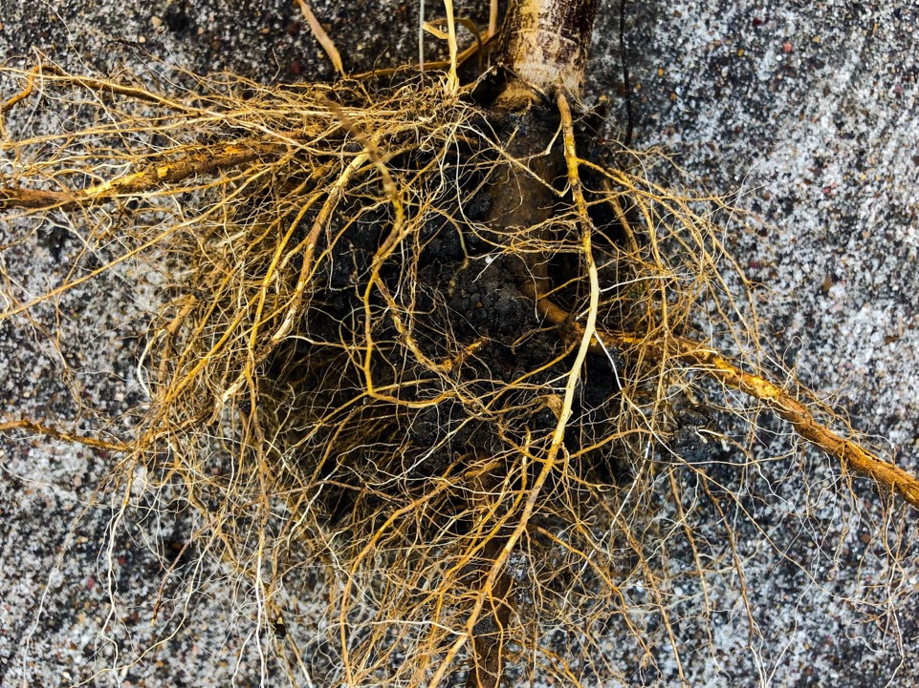
Sunflower Roots

Slide 55


Slide 56
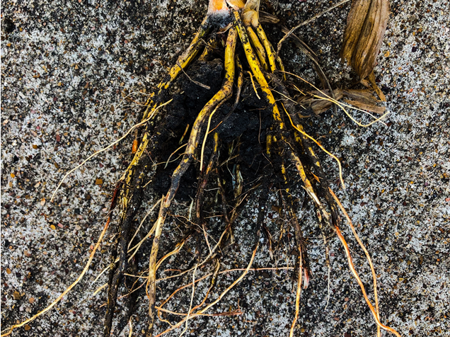
Sorghum Roots

Slide 59
What can we do?
Cover Crops
Increase Nutrient Cycling
Increase Water Conservation
Increase Organic Matter
Put the skin back on the soil using no-till and mixed species cover crops, which will decrease erosion and inputs
Be innovative and tenacious

Slide 60
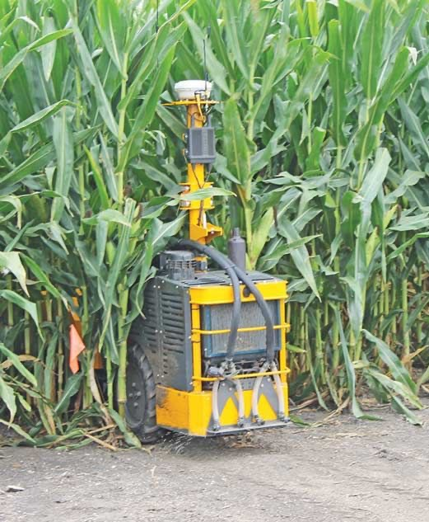
Innovation:
Cover crop planting in 30 inch rows

Slide 61


Innovation for soil respiration

Slide 62

Working with the Nature
Why mimic nature?
It has been doing R&D much, much longer than us
It fills niches
It creates balance
It recycles nutrients
It conserves water
It is tenacious

Slide 63
No-till or Conventional-till?
Plant the cover crops
You don’t need any test or research to tell you how to help your soil
Nature has been showing us the way all along
It is hard to stay excited about research or farming without innovation

Slide 64

Nature finds a way

Slide 65



The End

Slide 66


Contact
Rick Haney
Soil Scientist
USDA – ARS
Grassland, Soil & Water Research Laboratory
808 E. Blackland Road
Temple, TX 76502
(254) 770-6503
rick.haney@usda.gov

Slide 67


Left: Diatoms circa 1850. Right: Atomic Force Microscopy image of a nanographene molecule, the resolution is so high that for the first time, we can see the individual bonds between atoms, shown here as green lines.

Slide 68


Paradigm shift

Slide 69



Field Research
My Conventional-till research field

Slide 70


My No-till research field

Slide 73
Soil Respiration
Nitrogen Root Excretions
Organic Root Excretions
Legumes as Source of N
Stoklasa 1905, Lundergardh1924, Jensen 1934, Lees 1949, Makarov 1953, Bunt and Rovina 1955
Dyer 1894, Lemmerman 1907, Künze 1906, Schreiner and Reed 1907, Doyarenko 1909
Lyon and Wilson 1928, N excretions decrease with age of corn plant
Lipman 1912, cereals, oats and barley

Slide 74
Starkey (1929, 1934) showed that the roots of plants have a considerable influence on the accumulation of microorganisms in the soil
Rhizosphere of beets, (427 million bacteria per gram)
Control soil (only 8.2 million per gram)
In clover, he found 932 million per g and in the control soil only 6.6 million per g
In the rhizosphere of wheat, 653.4 million per g were found; and in the control soil, only 22.8 million bacteria per g

Slide 75

Research History - 1994

Slide 76

Research History 1995
1995: Haney’s first attempt at publishing using a technique involving drying and rewetting soil and recording the flush of CO₂ in 1 day to estimate N mineralization is rejected (finally published in 2000).
It’s deemed “too simplistic” by reviewers in spite of the data presented.
Haney becomes emotionally disturbed.

Slide 77

1996: CO₂ vs. 30 day CO₂

Slide 79


Soil Organic C vs. Water Extractable Organic C
  A soil with 2 % soil organic matter (SOM) would have 12,000 ppm C. When we analyze the water extract from the same soil, that number could be from 100-300 ppm C. The organic C in the soil water extract reflects the carbon in your soil that is highly related to the microbial activity. % SOM is about the quantity of organic C, water extractable organic C is about quality.

Slide 80

Soil Respiration and Nitrogen
1 day CO2-C of 50 ppm WEON of 40 ppm WEOC 400 ppm
Calculation 50/400=0.125
0.125*40=5 5*4 (rainfall events)=20 ppm
20*2 (0-6 inch sample)=40 lbs N
1 day CO2-C of 80 ppm
Calculation 60/400=0.2
0.2*40=8 ppm
8*4(rainfall event)=32 ppm 32*2=64l bs N
1 day CO2-C of 300 ppm
Calculation 300/400=0.75
0.75*40=30 ppm
30*4 (rainfall event)= 120 ppm 120*2=240 lbs N
BUT, we only measured 40 ppm WEON or 80 lbs of N
Therefore we will never credit more N from the WEON pool than we measure
AND whether the credit is 80 lbs, or 40 lbs, this is nitrogen we would have missed if we just measured nitrate

Slide 81

Soil Nitrogen
Soil-water Total N
(Pool 1)
Soil-water inorganic N (Pool 2)
Soil-water organic N
(Pool 3)
% of total N in each pool
(organic and inorganic)
Organic N

