Slide 1
OPENING KEYNOTE: Ray Archuleta
Agroecologist, founding partner of Understanding Ag
Regenerative Agriculture: Finding the WHY Before the HOW

Slide 2
Ecological Memory:
Allan Savory
Notes:
Ecosystem resilience is the magnitude of disturbance that can be absorbed by a system-before it shifts from one stable state (or stabilitydomain) to another (Holling 1973). Ecosystem resilience entails not only the capacity to reorganize and reestablish following disturbance, but also the ability of a system to renew itself through the maintenance of a diversity of options for development and evolution (Holling and others 1995).
These features, which determine the capacity of ecosystems to reestablish their
former functions and avoid phase shifts followingdisturbance (Scheffer and others 2001), have been termed “ecological memory”, which is the historical
component of resilience (Bengtsson and others forthcoming; Nystro¨m and Folke 2001). Following the disturbance of an ecosystem, biological legacies
(internal ecological memory) include surviving organisms (residuals), organic materials, and the organically generated environmental patterns that persist through a disturbance and serve as foci for regeneration and recolonization (T. Elmqvist and
others unpublished; Franklin and MacMahon 2000; Thompson and others 2001). External ecological memory is the availability of assemblages (refugia)of plants and animals outside the disturbed area that act as sources for its recolonization. The larger
a disturbance and the more damage it causes within an ecosystem, the greater its relative dependence on external ecological memory for the reestablish

Slide 3
Phase shift:

Slide 4
Phase shift: Nutrient and Water cycle is not functioning! Low internal ecological memory!

Slide 5
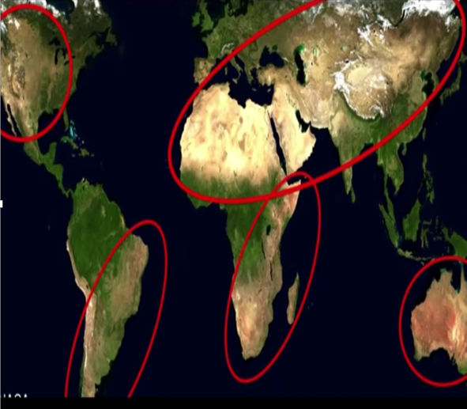

Slide 6
Coahoma, Texas June 2019

Slide 7
Phase shift:
self

Slide 8
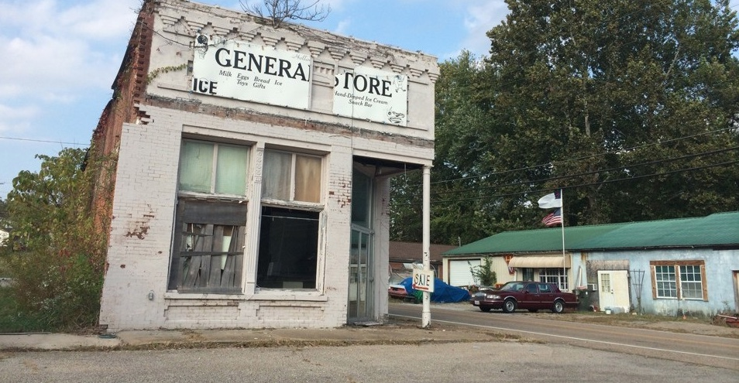
Dying of Rural America:

Slide 9
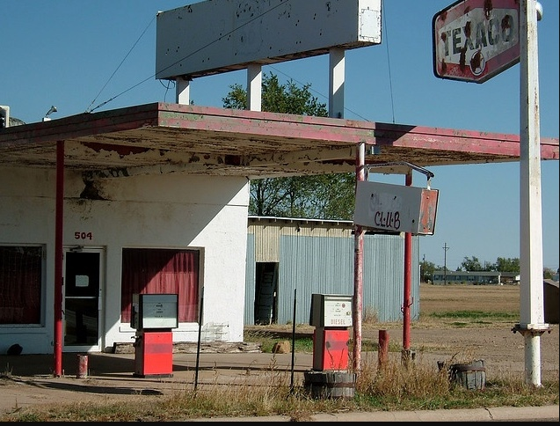
Death of Community!
Allan Savory

Slide 10
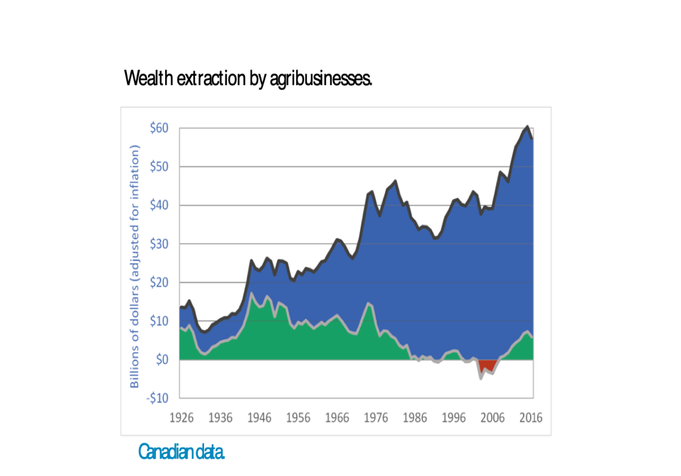
Phase shift:
Inputs
Income

Slide 11
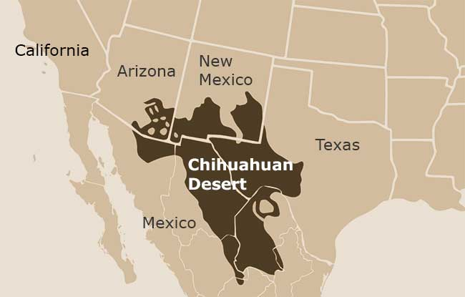
THE CHIHUAHUAN DESERT …
Las Damas Ranch-25,000 acres in Chihuahuan Desert
600 COW-CALF OPERATION
AVERAGE RAIN:
6-11 IN./YR.
4TH GENERATION RANCHING

Slide 12
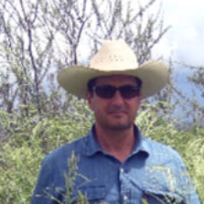
Ranchers from Mexico
Jesus Almeida
Alejandro Carrillo
“We need to mimic what nature does, not fight nature.”

Slide 13
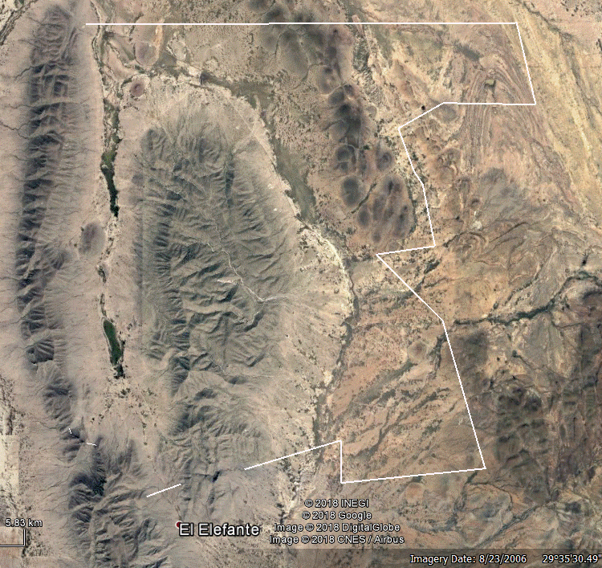
LAS DAMAS CATTLE RANCH

Slide 14
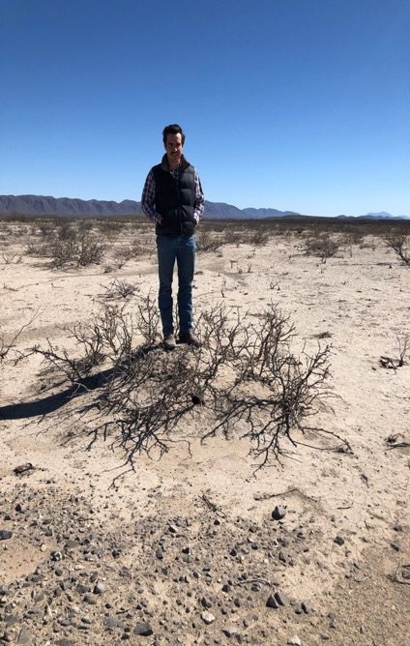
The Problem

Slide 15
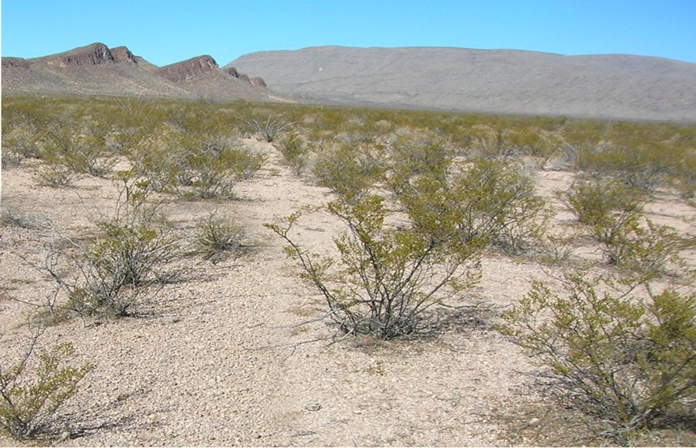
THIS IS THE TYPICAL VIEW OF THE CHIHUAHUAN DESERT …

Slide 16
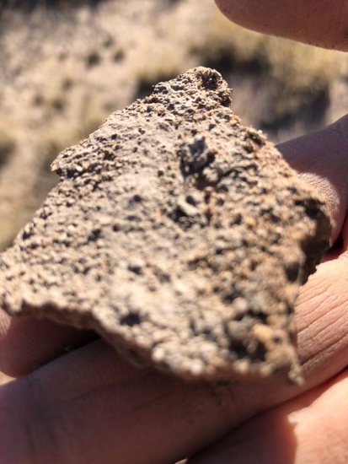
Solarized Soils

Slide 17
Solarization of the soil

Slide 18
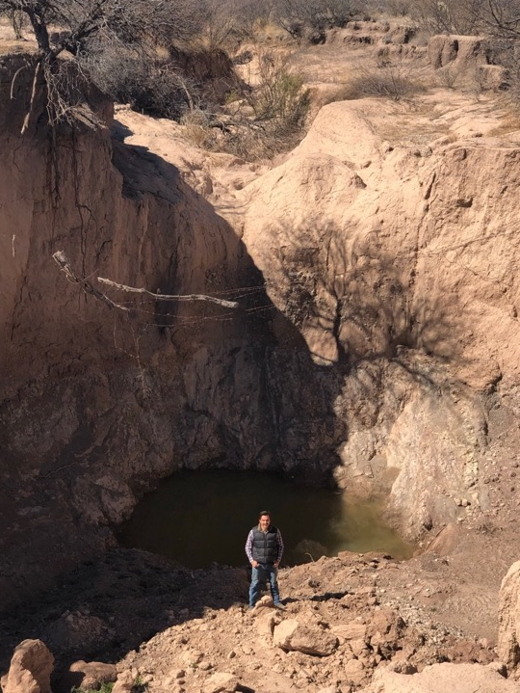

Slide 19
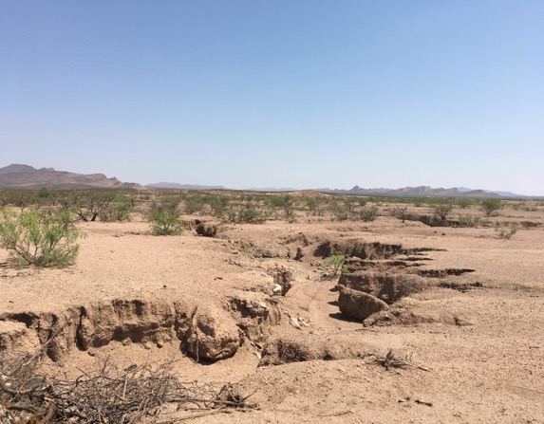
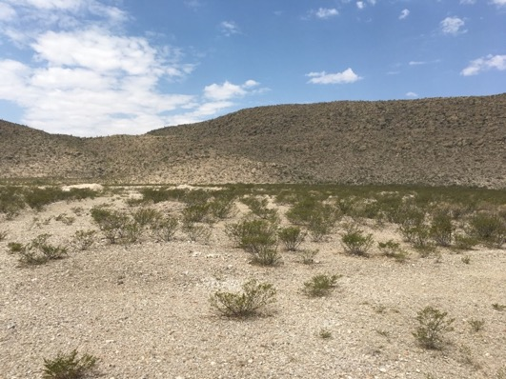
Conventionally Managed
(Chihuahuan Desert)
250 Acres to Support One Cow

Slide 20
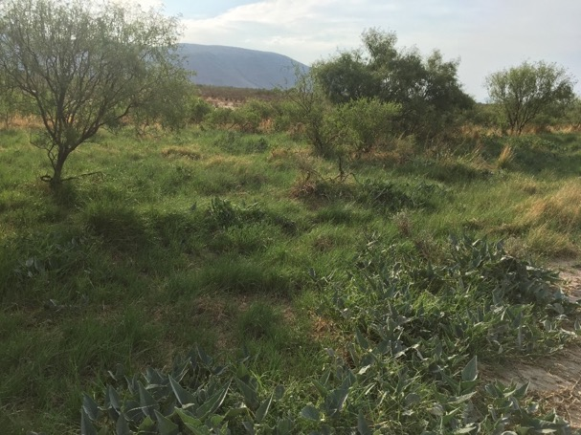
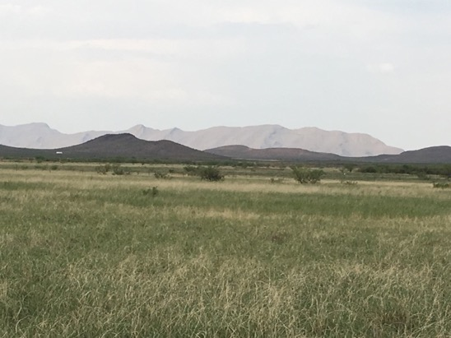
Adaptive Grazing
Management
20 Acres to Support One Cow

