Slide 1
Same Test Four Months Later with Corn or Beans growing
No-Till
No-Till
w/ cover
Tillage

Slide 2
Neighbors At The Coffee Shop!!

Slide 3
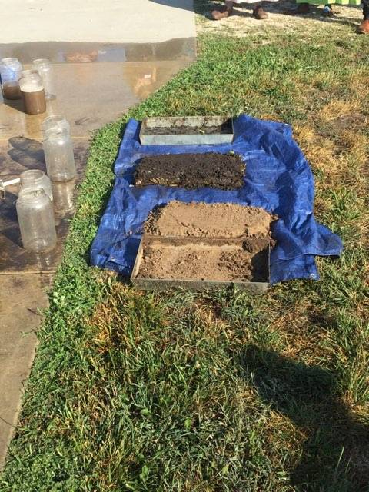
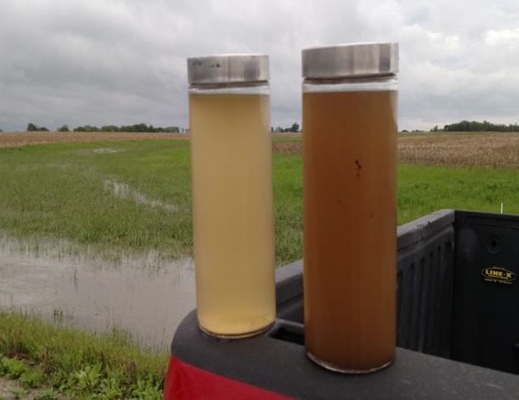
No till/cover crops vs. tillage
No-Till
w/ cover
Tillage

Slide 4
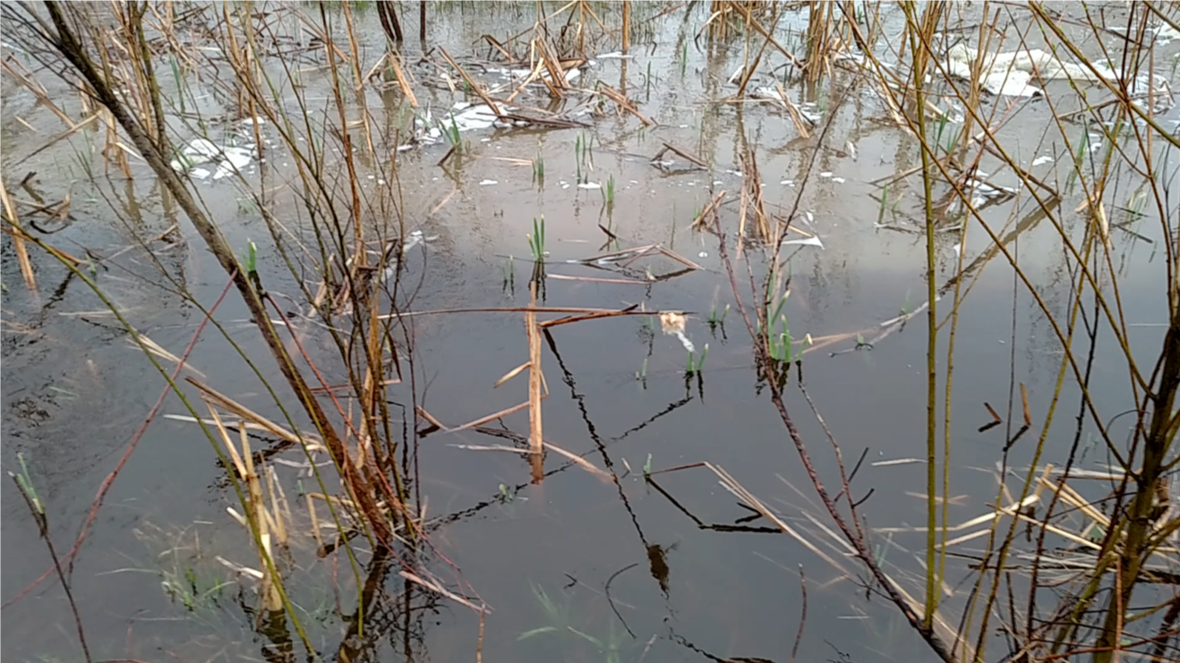
Can Cover Crops Make a Difference

Slide 5
4% vs. 2% organic material Infiltration vs. No infiltration
8961 Woodson Silt Loam
Coffey Co. Ks

Slide 6
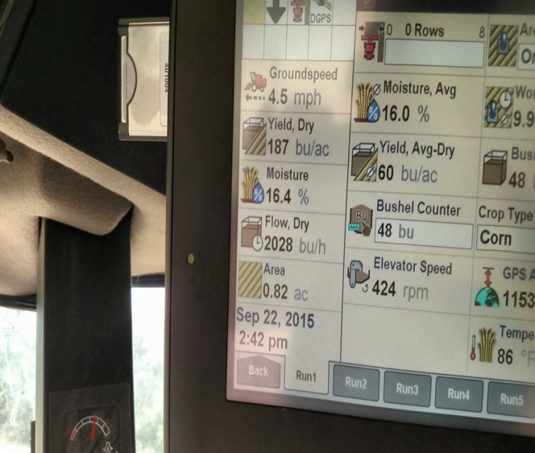
2% vs. 4% organic matter 100b/a

Slide 7
No Till Conventional Corn

Slide 8
Healthy Looking Ears of Corn with Good Yield Potential

Slide 9
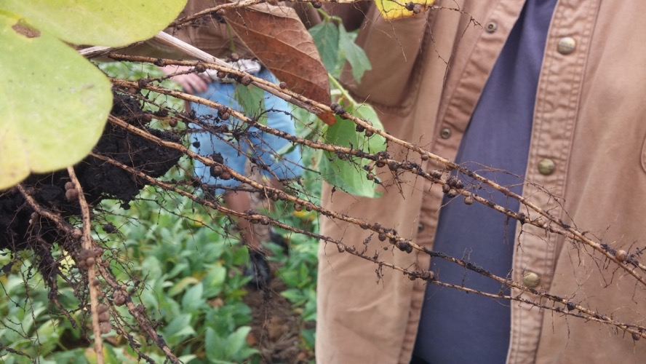
Healthy soils = healthy plants

Slide 10
Long Term Tillage vs. 7yr No-Till/Cover Crops Dicamba 4.9 vs. NA 5518 5.2

Slide 11
Dicamba 4.9-Williams 82 3.9-Na 5518 5.2 Tillage 4yr No Till 7yr No Till

Slide 12
Healthy Soil produces Healthy Roots

Slide 13
Loaded with pods because the root structure was loaded with potential!
NA 5518 #95 3/Bean Pods

Slide 14
Great Nodulation with No Seed Treatments!!

Slide 15
No Seed Treatment

Slide 16
Cover crops are the key to great Weed Control
Winter Barley
Mare’s-Tail

Slide 17
7.5” spacing with the Drill

Slide 18
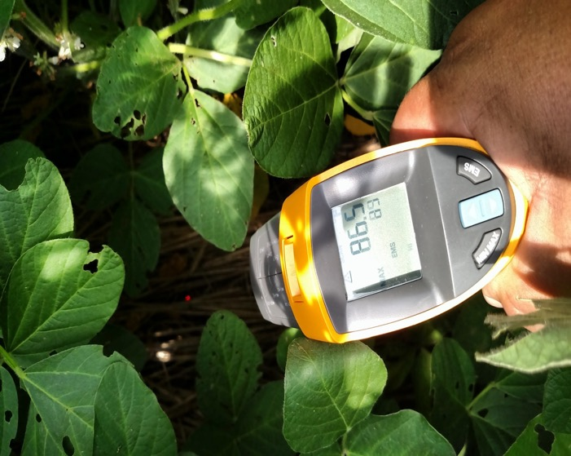
Huge difference in Soil Temps with Armor 35.2 difference
101 air temperature
121.7
86.5

Slide 19
Emerging at 5 days

Slide 20
2 weeks

Slide 21
No post spray 4 weeks

Slide 22
Non-GMO soybeans Clear Hilum No post spray of any kind
8775 Kenoma Silt Loam
3.2% OM Franklin Co. Ks

Slide 23
Healthy Plants=Profitability 9950 Willcross 2016 58b/a
8609 Aliceville Silty Clay 4% OM Coffey Co Ks

Slide 24
9950 Willcross 50b/a 2016 No post application of any kind

Slide 25
Evenly spread the residue out of the combine

Slide 26
Storage is a must to keep them pure! Premium Programs 98-99%

Slide 27
NA 5518 Grade 1 premium

Slide 28
5005 clear hilum no damage Grade 1 premium

Slide 29
Healthy Soil No Till vs. Degraded Tillage

Slide 30
2017 Customer Satisfaction 9950 110 3-bean pods 51b/a Allen Co. Ks

Slide 31
Na 5518 125 3/bean Pods 47b/a Coffey Co

Slide 33
Na 5518 Non-Gmo 5.2 47b/a 2018
8911 Summit Silty Clay
3% OM Coffey Co Ks

Slide 34
Healthy Soil 9 yr No-Till

Slide 36
5518 January 10th

Slide 37
2yr No-Till no Post Spray!!

Slide 38
Williams 82 Public 3.9 36b/a 2018
8609 Aliceville Silty Clay
3% OM Coffey Co Ks

Slide 39
Williams 82’s Drilled into Rye

Slide 40
Williams 82 Public Soybeans

Slide 41
Healthy Soils Lead to Opportunity Cost/Return/Acre $144 less input
Non Gmo Soybean Seed No Till/Cover | 29.00 | Dicamba Soybean Seed Tillage Full Input | 70.00
Cover Crop | 38.00 | 4 Tillage passes | 100.00
Chemical Pre/ | 23.00 | Chemical pre/post | 50.00
Trucking | .75 | Trucking | .75
Harvesting | 25.00 | Harvesting | 25.00
Planting | 17.00 | Planting | 17.00
Crop Insurance | 9.00 | Crop Insurance | 9.00
Land Rent | 75.00 | Land Rent | 75.00
Fertilizer | 45.00 | Fertilizer | 100.00
Input Expense | 232.75 | Input Expense | 376.75

Slide 42
2018 | Dicamba/ Tillage | RR1 7484 No Till 4.7 M | RR2 1st Year No Till/cover 4.7 | Williams 82 3.9M No Till/Cover | NAS 5518 No Till/Cover 5.0 M | NAS 5518 No Till/Cover 5.0 M 2019 | Dicamba No Till/Cover 4.9 M | 9950 No till/Cover 5.0 M
Total Input Cost | 376.75 | 232.75 | 267.75 | 212.75 Conv | 232.75 Conv | 212.75 Conv | 317.75 | 267.75 Conv
Actual Yield | 42 b/a | 42b/a | 40b/a | 36b/a | 47b/a | 50b/a | 63b/a | 65b/a
Coop price | 8.31* | 8.31 * | 8.31* | 8.31 | 8.31 | 8.60 | 8.31* | 8.31
Futures price | 9.16 | 9.16 | 9.16 | 9.16 * | 9.16* | 9.49* | 9.16 | 9.16*
Premium CBOT | 0.00 | 0.00 | 0.00 | 1.00 * | .75* | 1.00* | 0.00 | .50*
* Selling price | 8.31 | 8.31 | 8.31 | 10.16 | 9.91 | 10.49 | 8.31 | 9.66
Gross Profit | 349.02 | 349.02 | 332.40 | 365.76 | 465.77 | 524.50 | 523.53 | 627.9
Net Profit | -27.73 | +116.27 | +64.65 | +153.01 | +233.02 | +311.75 | +205.78 | +360.15
1.65 GOV. Help | +41.57 | +185.57 | +130.65 | +212.41 | +310.57 | (247.10) 2019 | +309.73 | +467.40

Slide 43
Dicamba Soybeans
42 Bu/ Ac
NET $-27.73
Williams 82 Soybeans
36 Bu/ Ac
Net $153.01
NA5518S Soybeans
47 Bu/ Ac
Net $233.02

Slide 44
Kansas State University Soybean Performance Trials, Ottawa, KS 2015
Brand | Variety | Bu/A | % of Mean | Ht. | Type
eMerge | e4993 | 65.0 | 119% | 33” | Conventional
Pioneer | 49T80R | 63.3 | 116% | 35” | RR
Bayer | HBK LL4950 | 62.4 | 114% | 36” | LL
Public | Experimental | 58.9 | 108% | 34” | Conventional
Asgrow | AG5335 | 58.3 | 107% | 33” | RR2Y
Bayer | HBK LL4953 | 56.1 | 103% | 31” | LL
Bayer | CZ 4818 LL | 53.9 | 99% | 36” | LL
Mean of Test |  | 54.5

Slide 45
Chief Operations Officer for Green Pastures LLC.

Slide 46
Caos garden no tilled into Rye

Slide 47
Great Variety of Vegetables

Slide 48
Variety of Healthy Food from Healthy Soil Farm to Table

Slide 49
Healthy Food=Healthy Soil

Slide 50
#230 pie pumpkins=345 pies give or take!

Slide 51
2nd Trailer Load of Vegetables

Slide 52
Sweetest, Best tasting Watermelon

Slide 53
British Whites

Slide 54
September 1, 2-3lb gains can be had

Slide 55
Finishing on the Warm Season Mix Early Fall

Slide 56
883 Hanging Weight Plenty of Fat Cover

Slide 57
Lamb Steaks Home Grown

Slide 58
Smoked to Perfection!!!

Slide 59
Quality of Life Do we have time to have fun!

Slide 60
Diversity in the deer plot

Slide 61
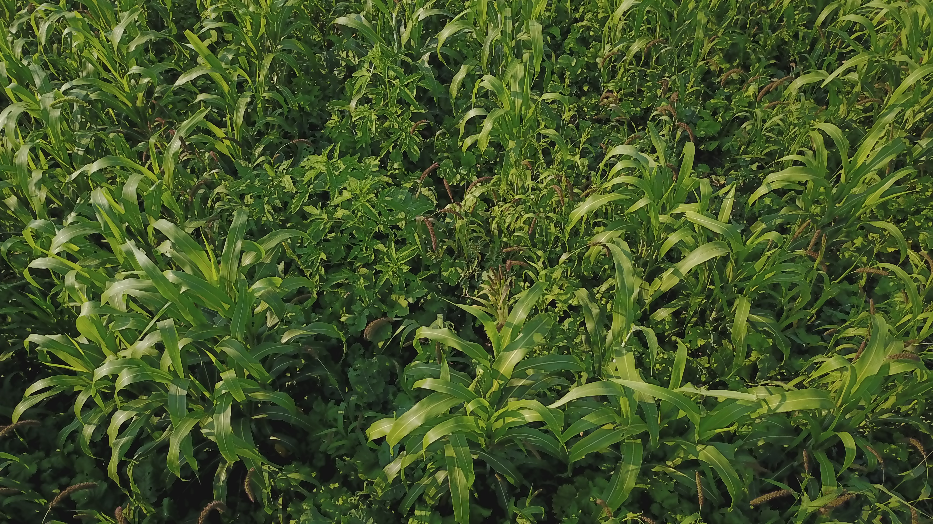

Slide 62
Quality bucks started showing up after planting cover crops

Slide 63
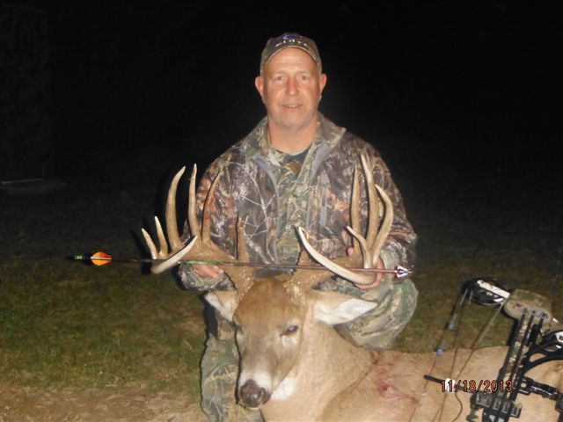
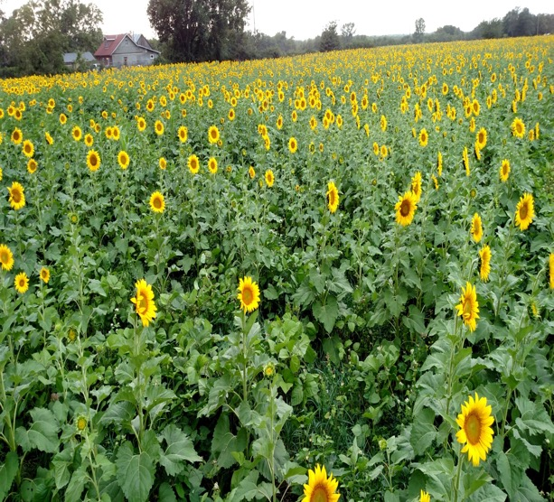
Healthy Soil = Healthy Deer Connecting Landowners to Healthy Soil
185 4/8 14pt.

Slide 64
Making the Most of what you have to Hunt
300 acres Bedding Area
Deer Blind
Deer Plot
Brome Hay Field

Slide 65
Making a plot when no habitat exists!
Bedding Area
CRP
Soybean/Turnips
Sorghum Sudan

Slide 66
Security Cover to get to the Blind!

Slide 67
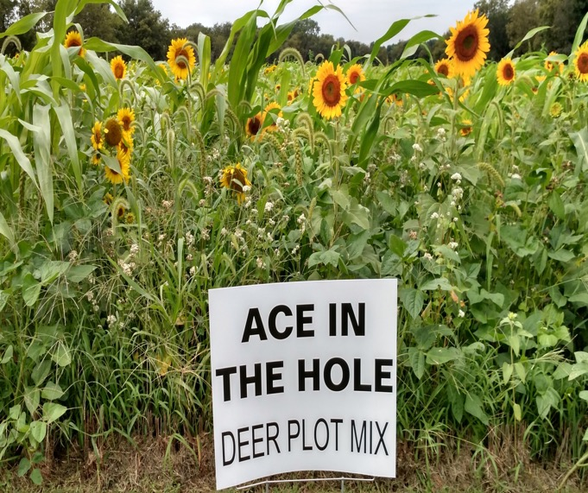
2014 rifle season Kansas Ace in the Hole Plot

Slide 68
2016 Rifle Buck Ace in the Hole Plot
8609 Aliceville Silty Clay 2% to 3% OM

Slide 69
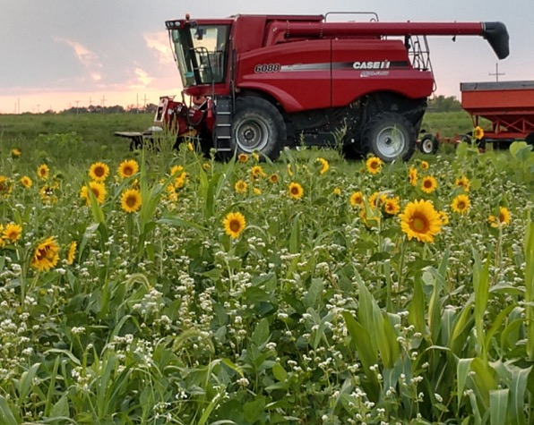
Definition of Luck: A point in time where Opportunity and Preparation Intersect

Slide 70
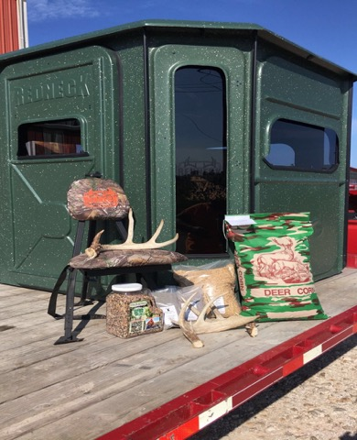
Helping Farmers, Ranchers and Hunters

Slide 71
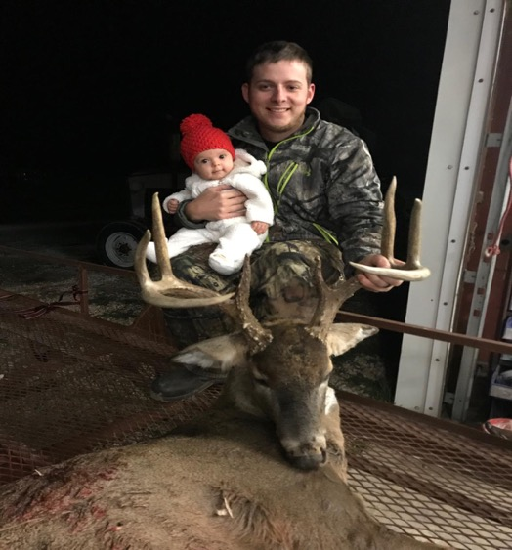
Natural Ag Solutions LLC. Growing Crops isn’t all we do! Good Luck in 2020!!

