Slide 1
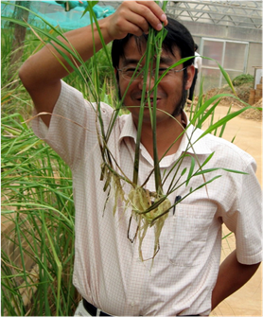
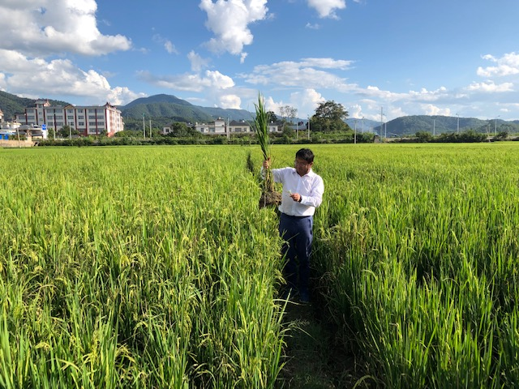
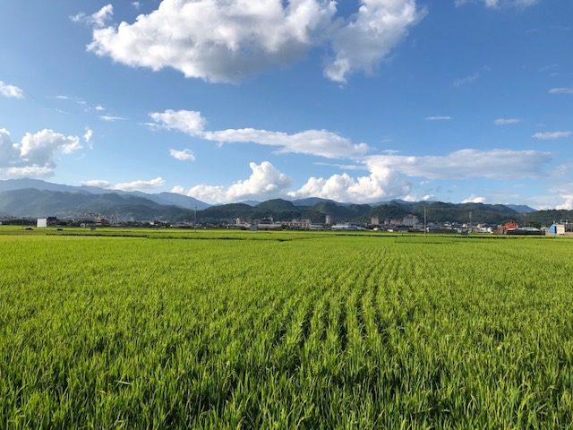
Perennial Rice
Wide hybridization

Slide 2
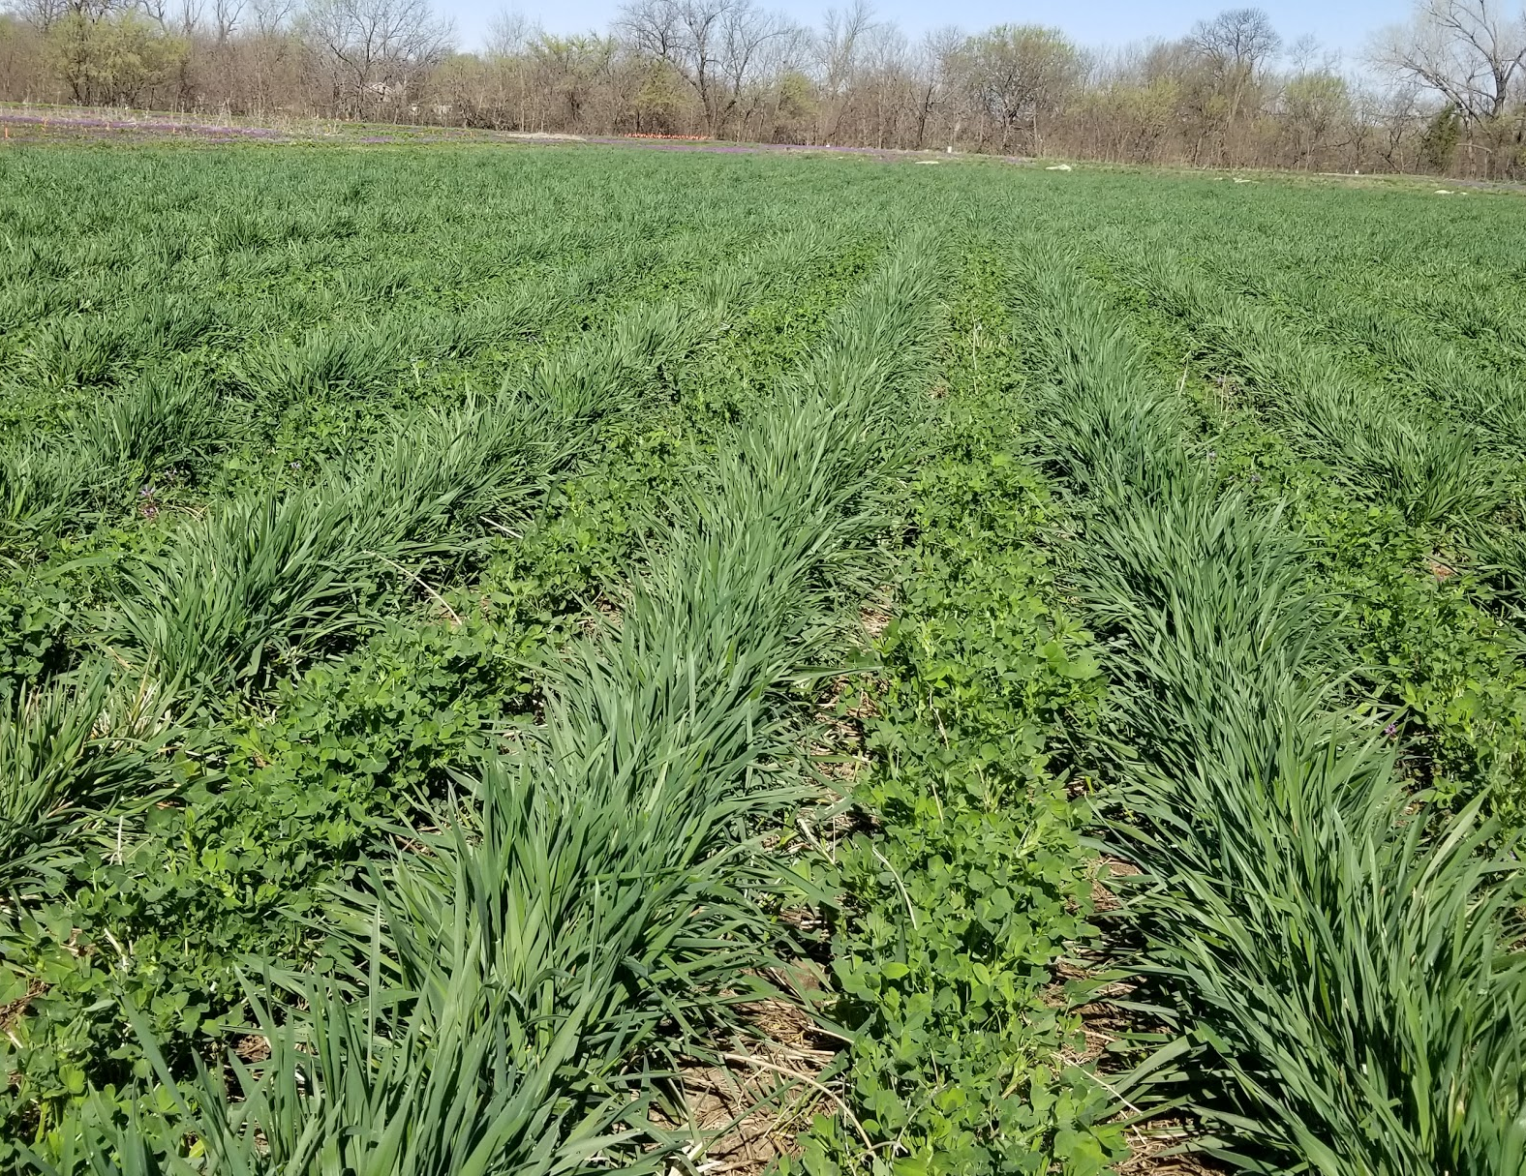
Phase 5: Perennial grain crops with perennial covers

Slide 3
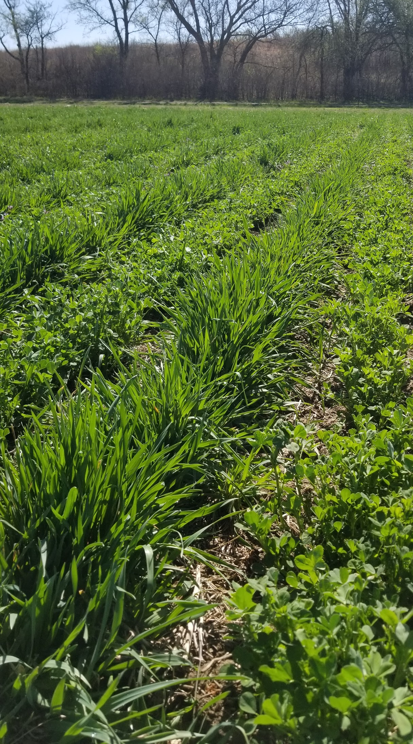
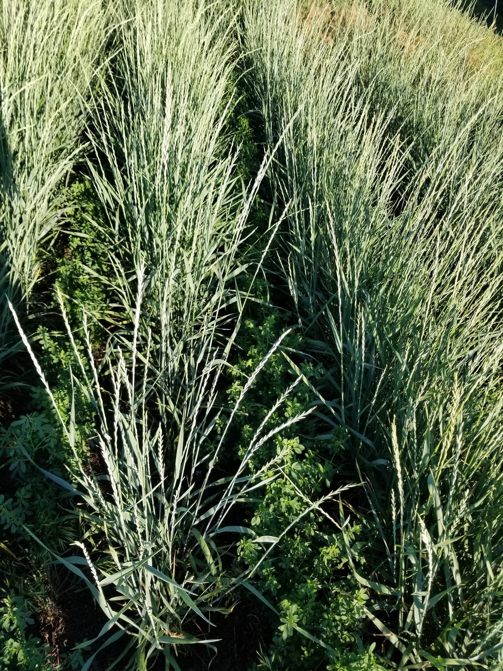
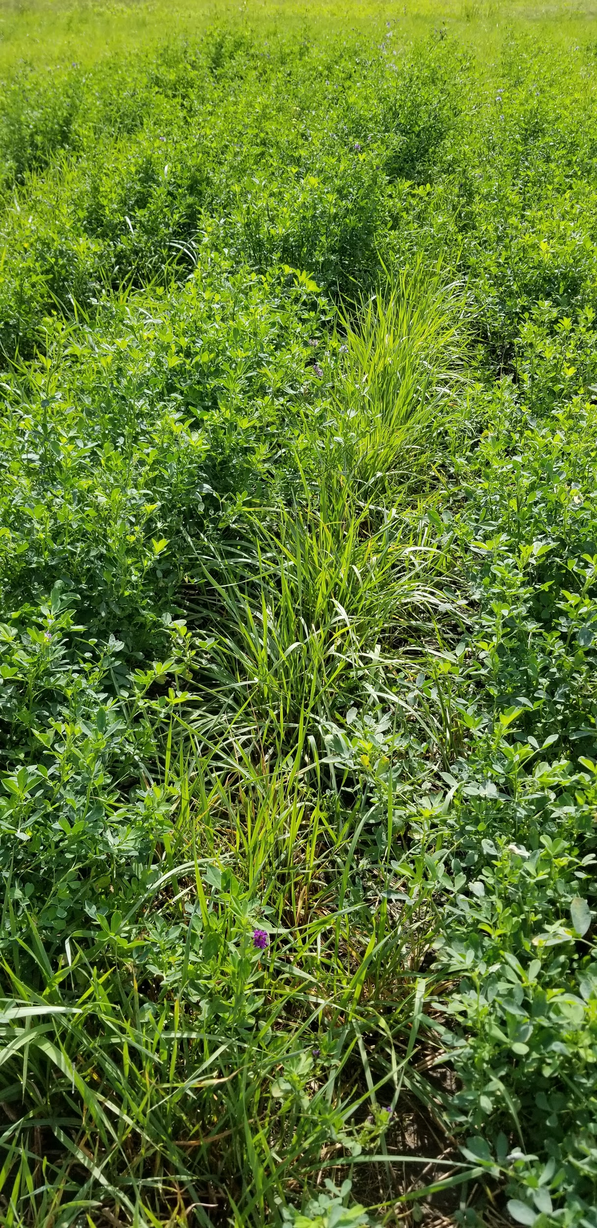
Designing an intermediate wheatgrass (Kernza) + alfalfa cropping system
April 8, 2019
June 10, 2019
August 29, 2019

Slide 4
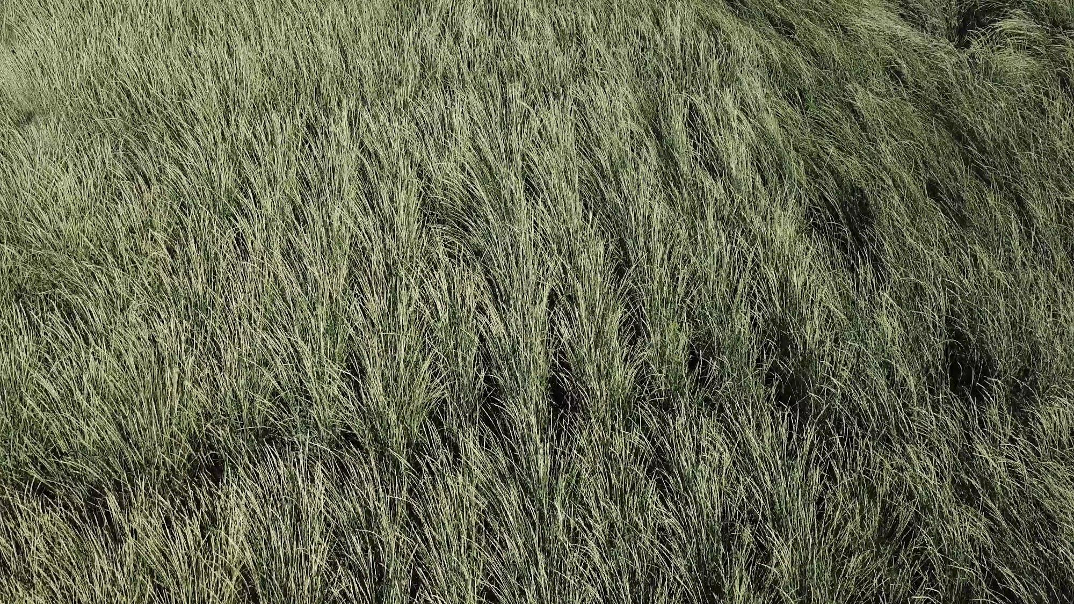
Kernza + Alfalfa (July)

Slide 5
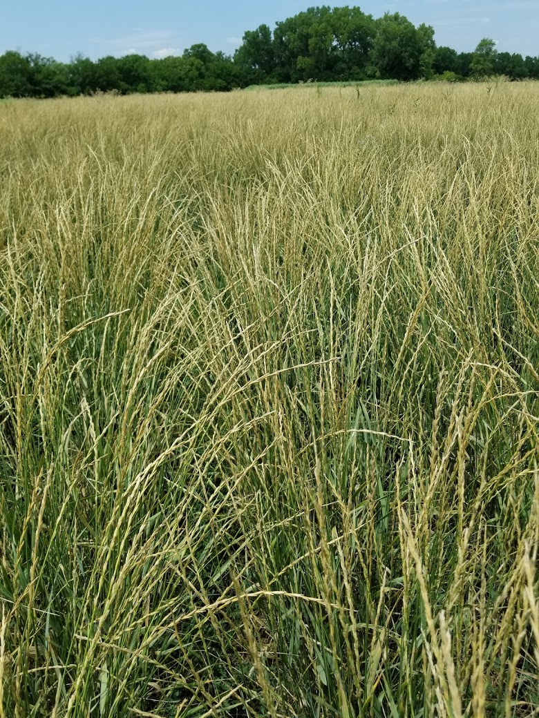
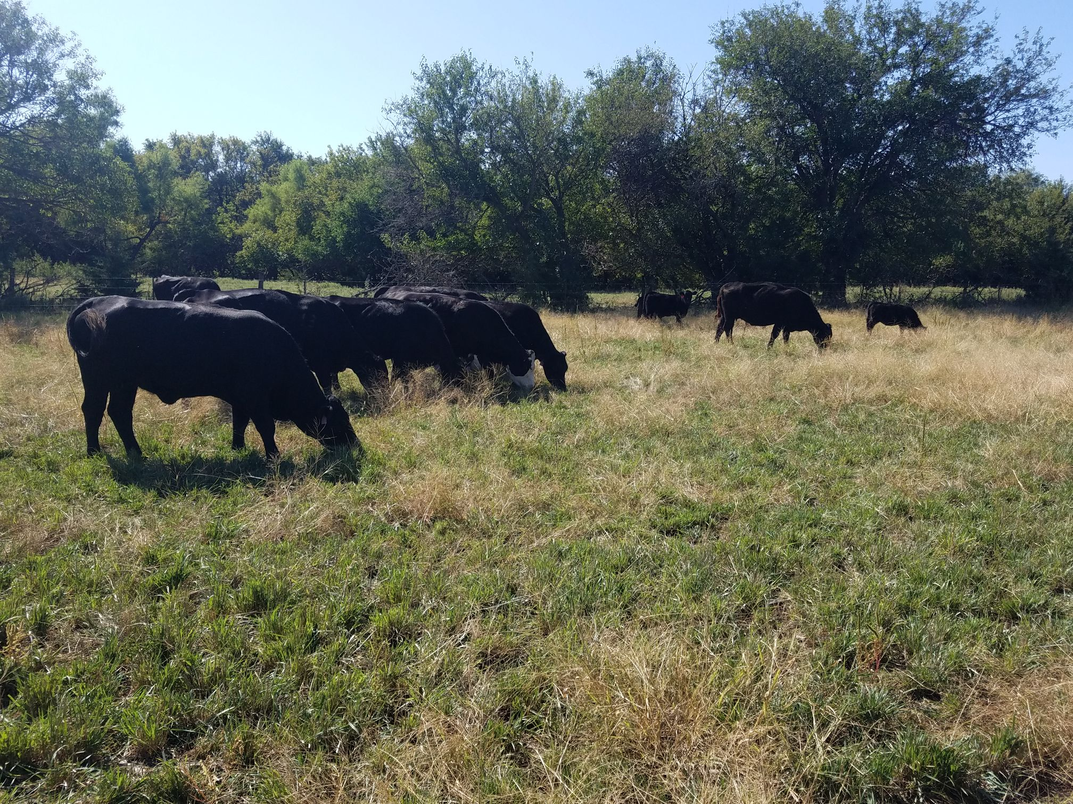
Kernza and Kernza+Alfalfa economics 101:
treat your field as a pasture/hay meadow
Spring grazing
(Until late April)
Summer hay/residue
(Mid-July)
Fall/Winter grazing
(Late Sept - winter)

Slide 6
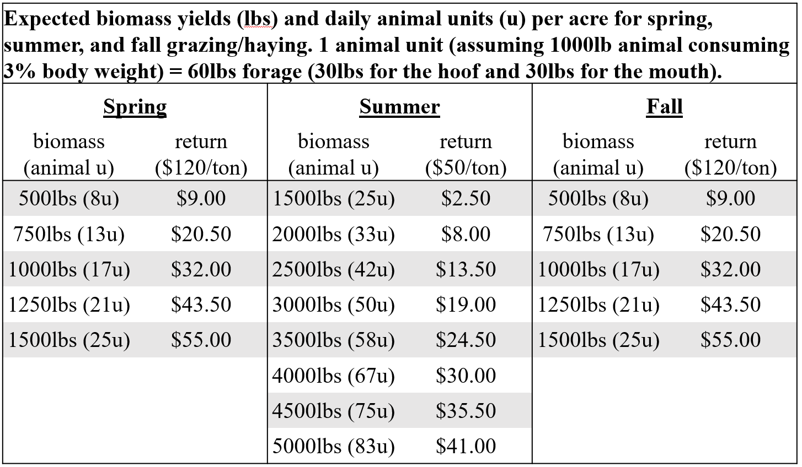
Kernza and Kernza+Alfalfa economics 101:
treat your field as a pasture/hay meadow
I am assuming $14/acre swath + $14 per large round bale

Slide 7
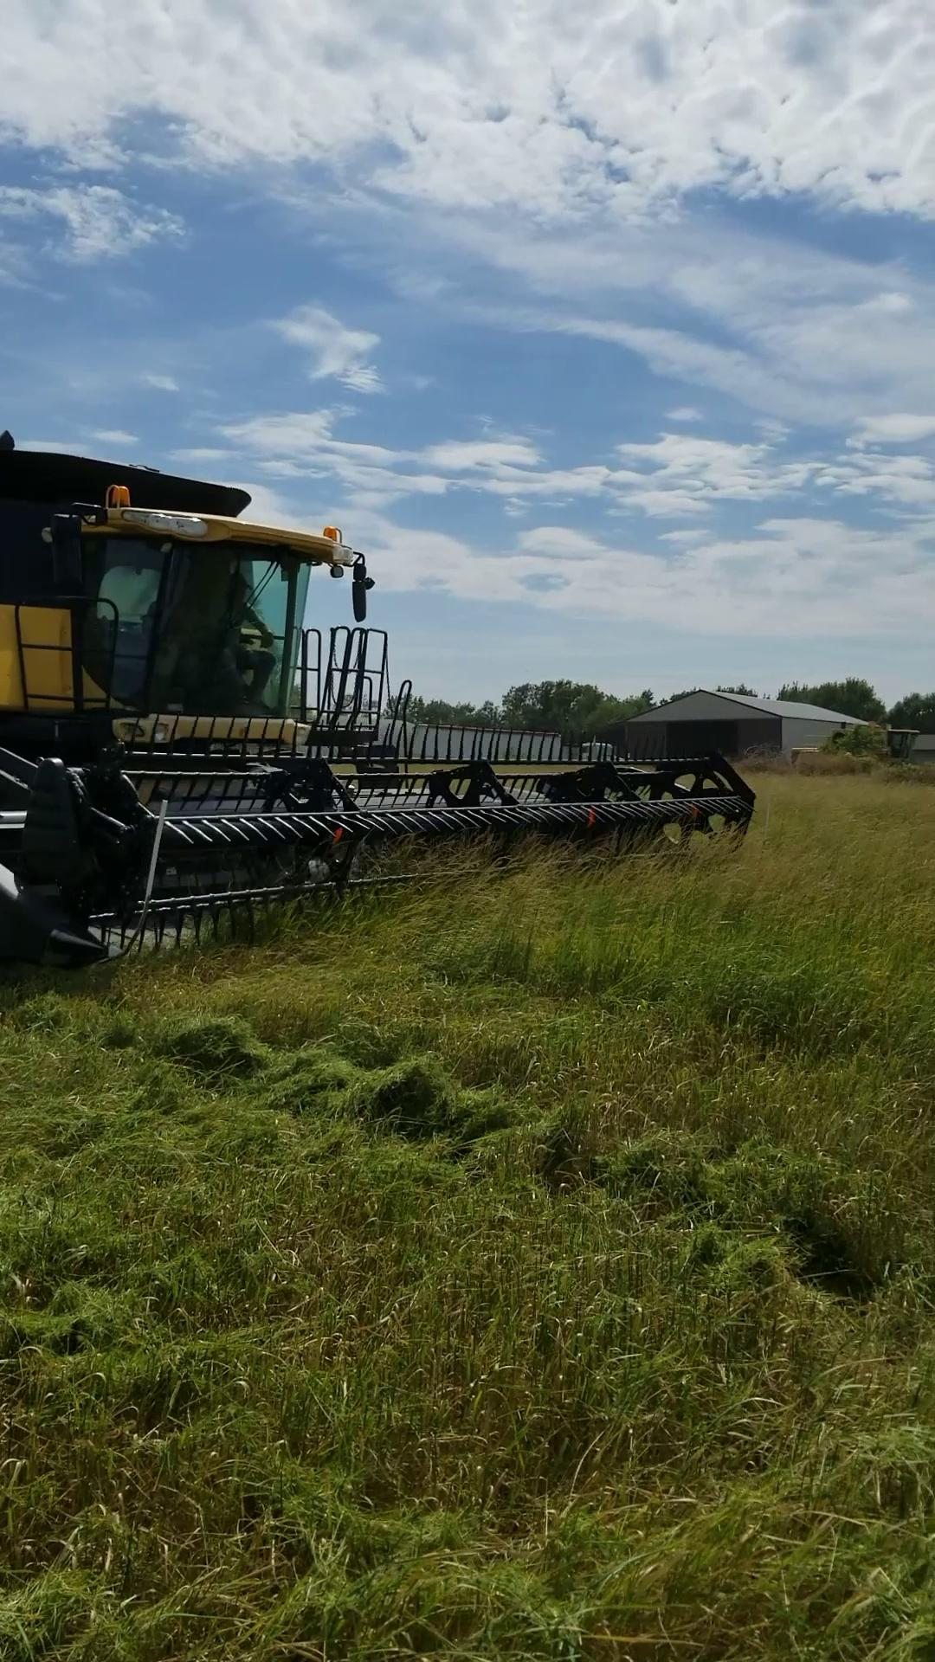

Slide 8
Kernza and Kernza+Alfalfa economics 101:
treat your field as a pasture/hay meadow
$60.00/acre
or
76 animal u per acre

Slide 9
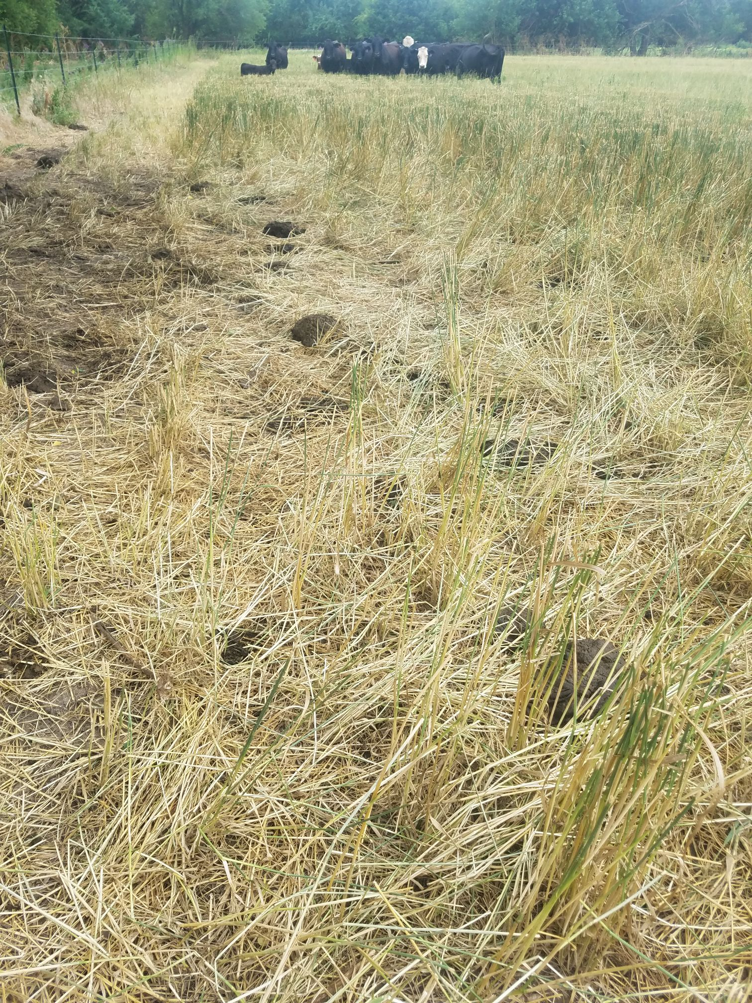
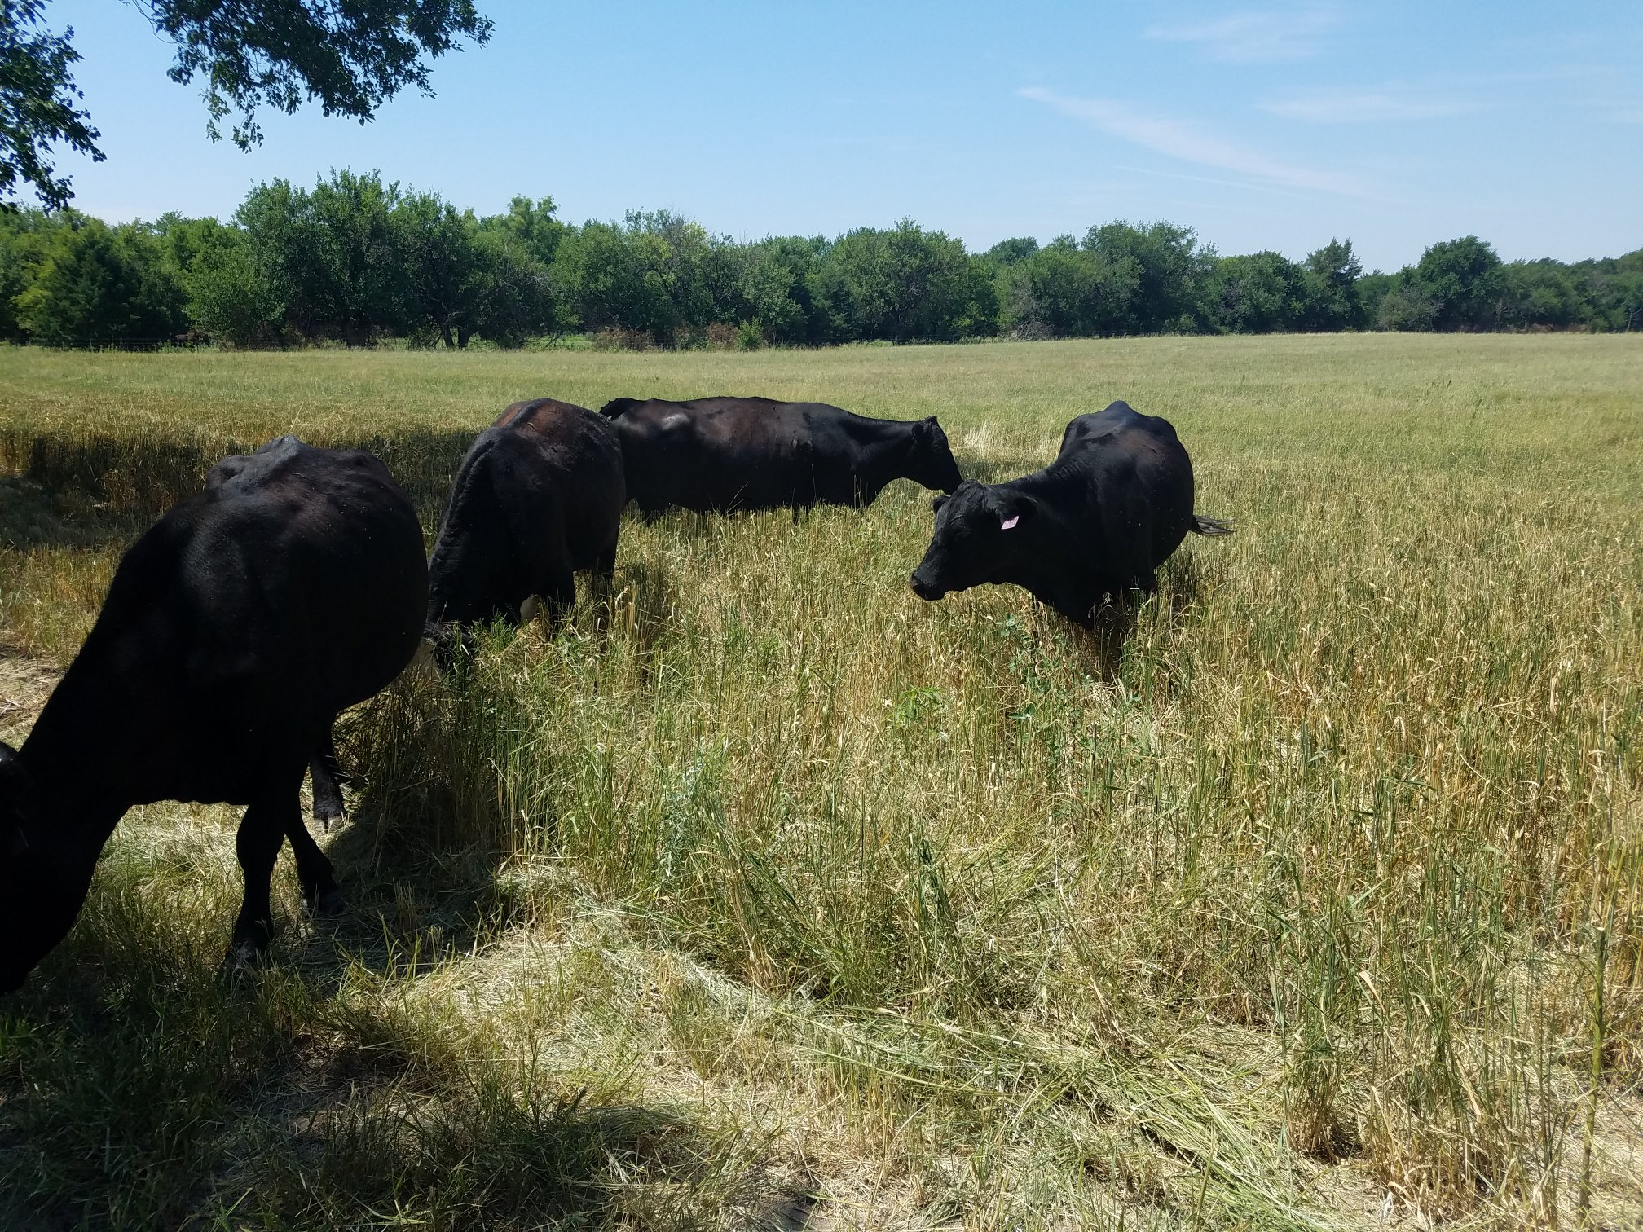
September 9, 2019

Slide 10
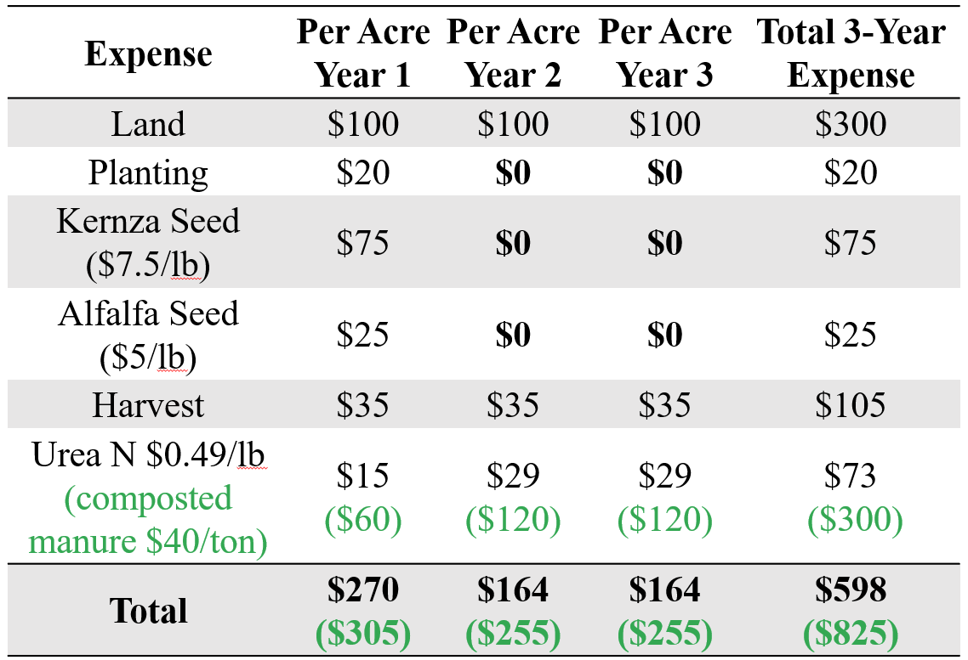
Kernza and Kernza+Alfalfa economics 101:
Establishment, Fertility, Harvest
Notes:
7.5 tons compost * 33% *$15 ton = $50

Slide 11
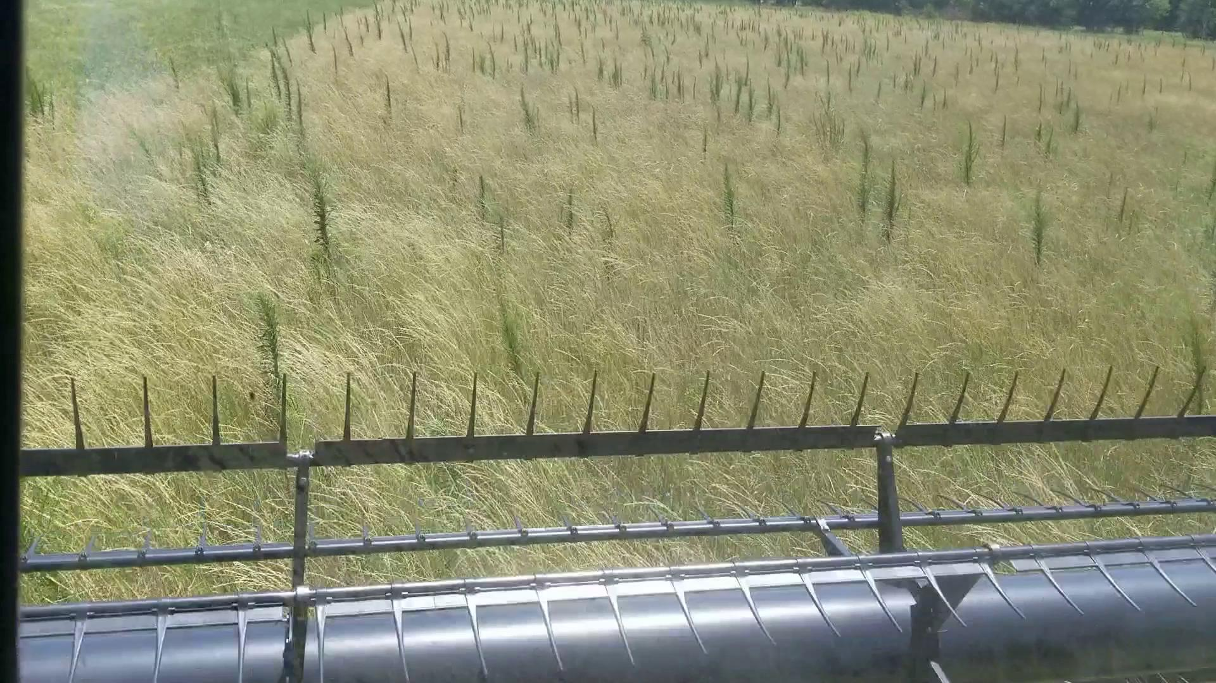

Slide 12
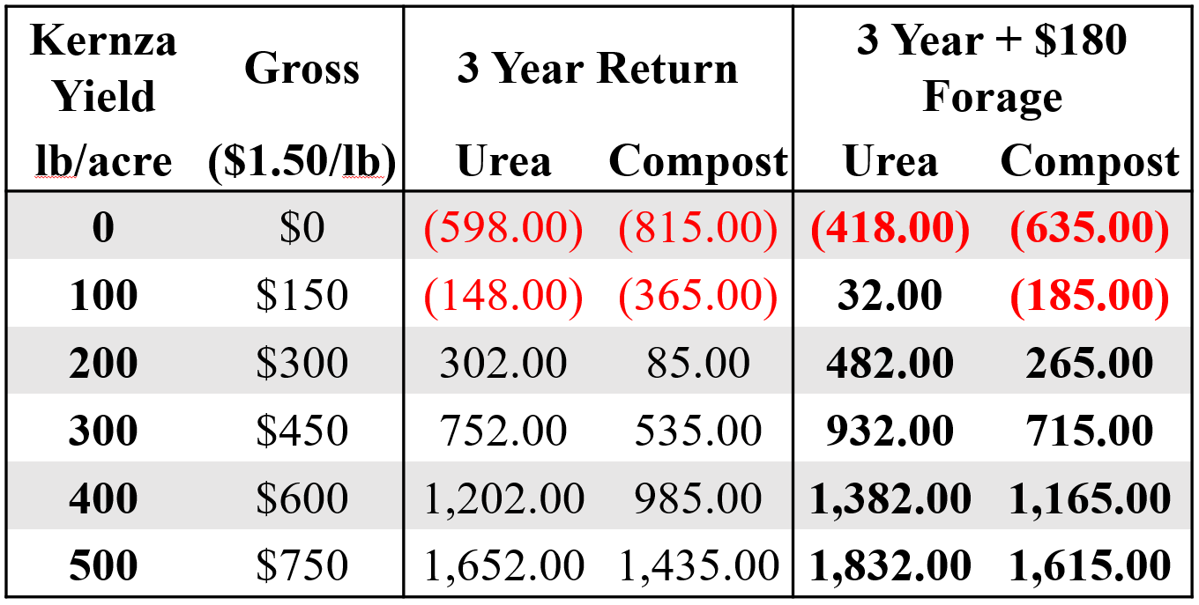
Kernza Grain:
A bonus cash crop

Slide 13
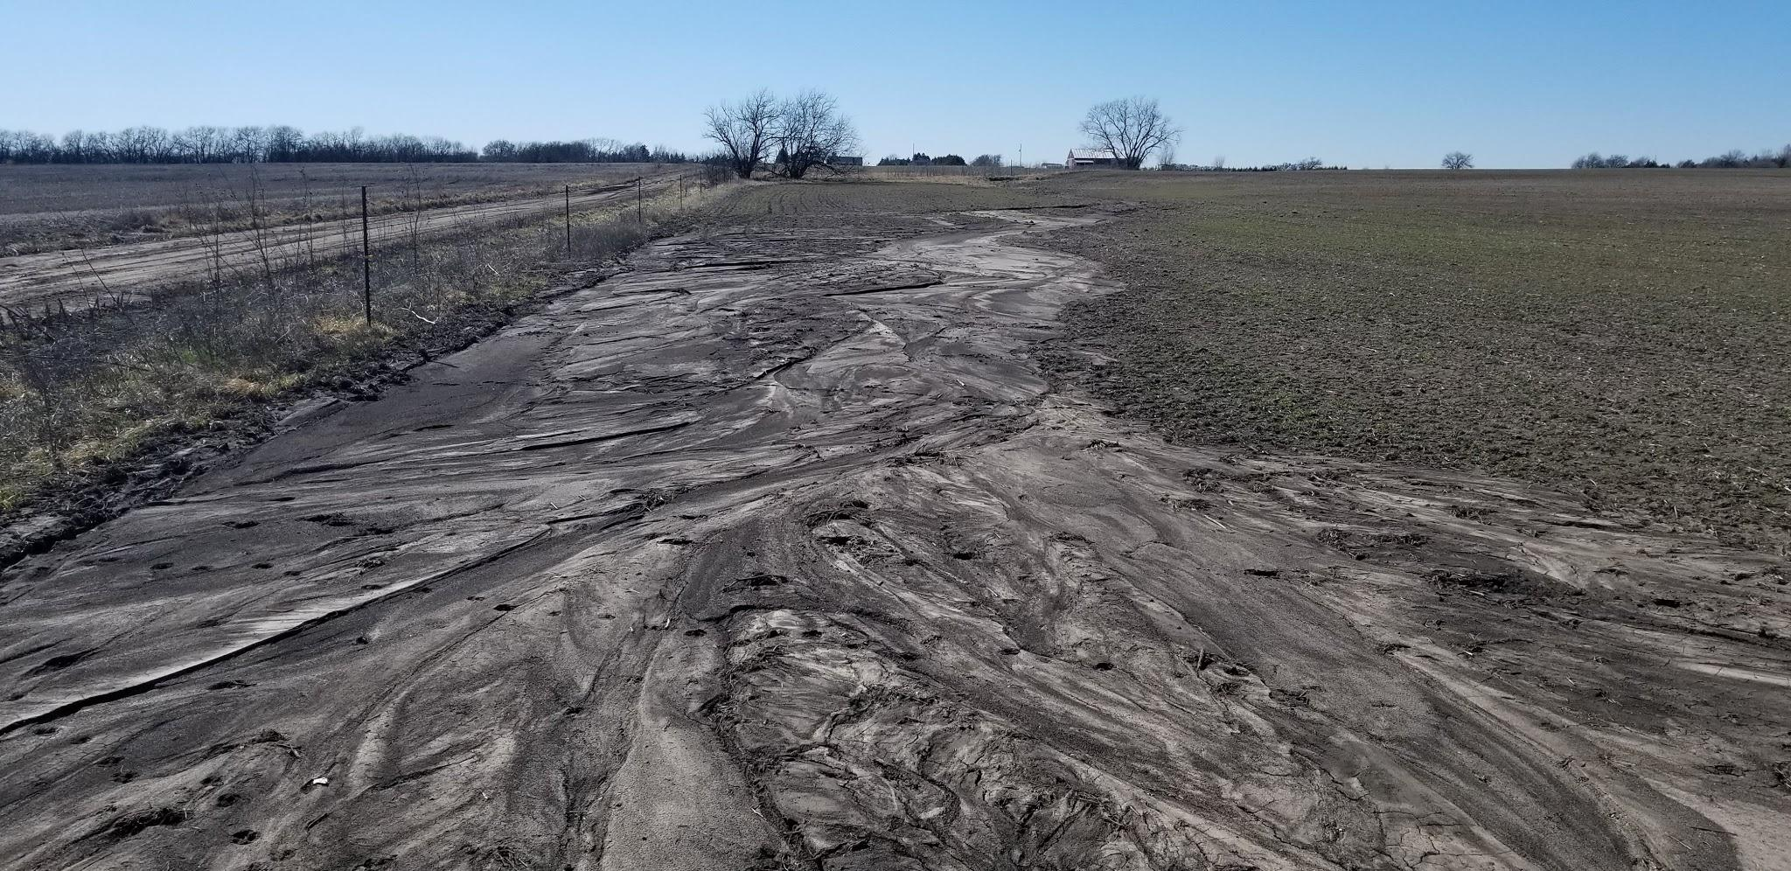
Organic Kernza + alfalfa:
tillage prior to establishment

Slide 14
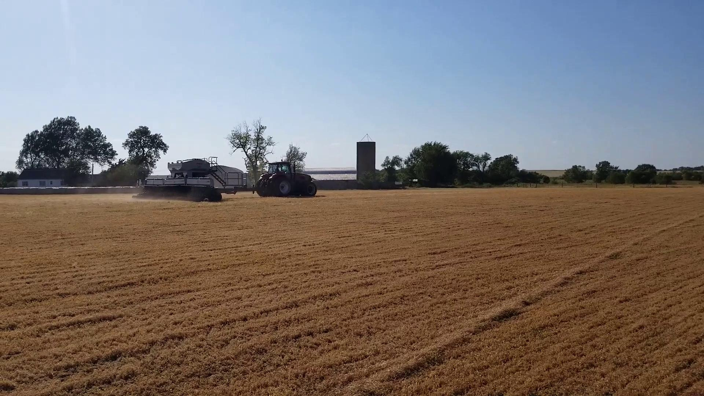
Kernza planted with a no-till drill

Slide 15
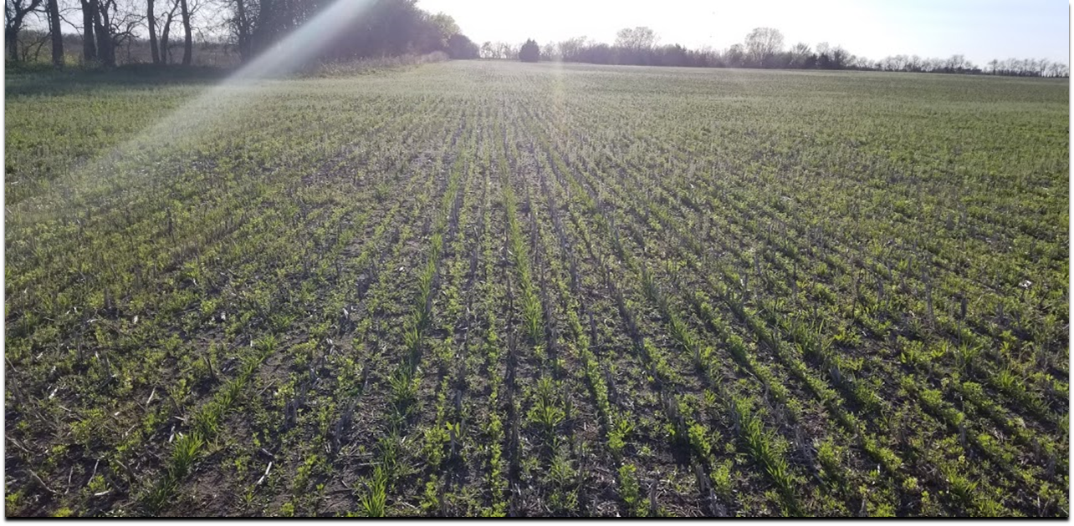
Kernza + alfalfa planted with a no-till drill:
30 inch Kernza rows (grain box) and 10 inch alfalfa rows (small seed box)

Slide 16
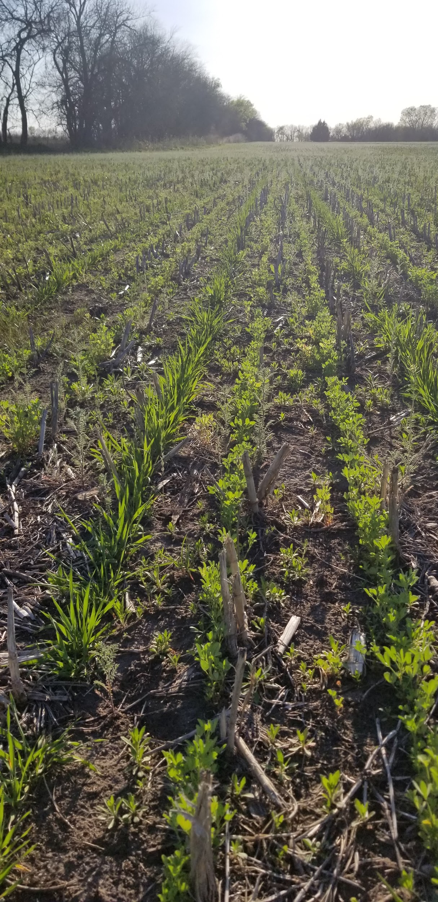
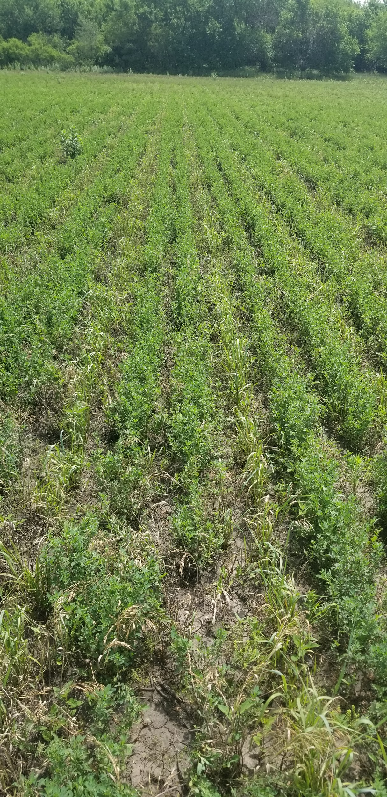
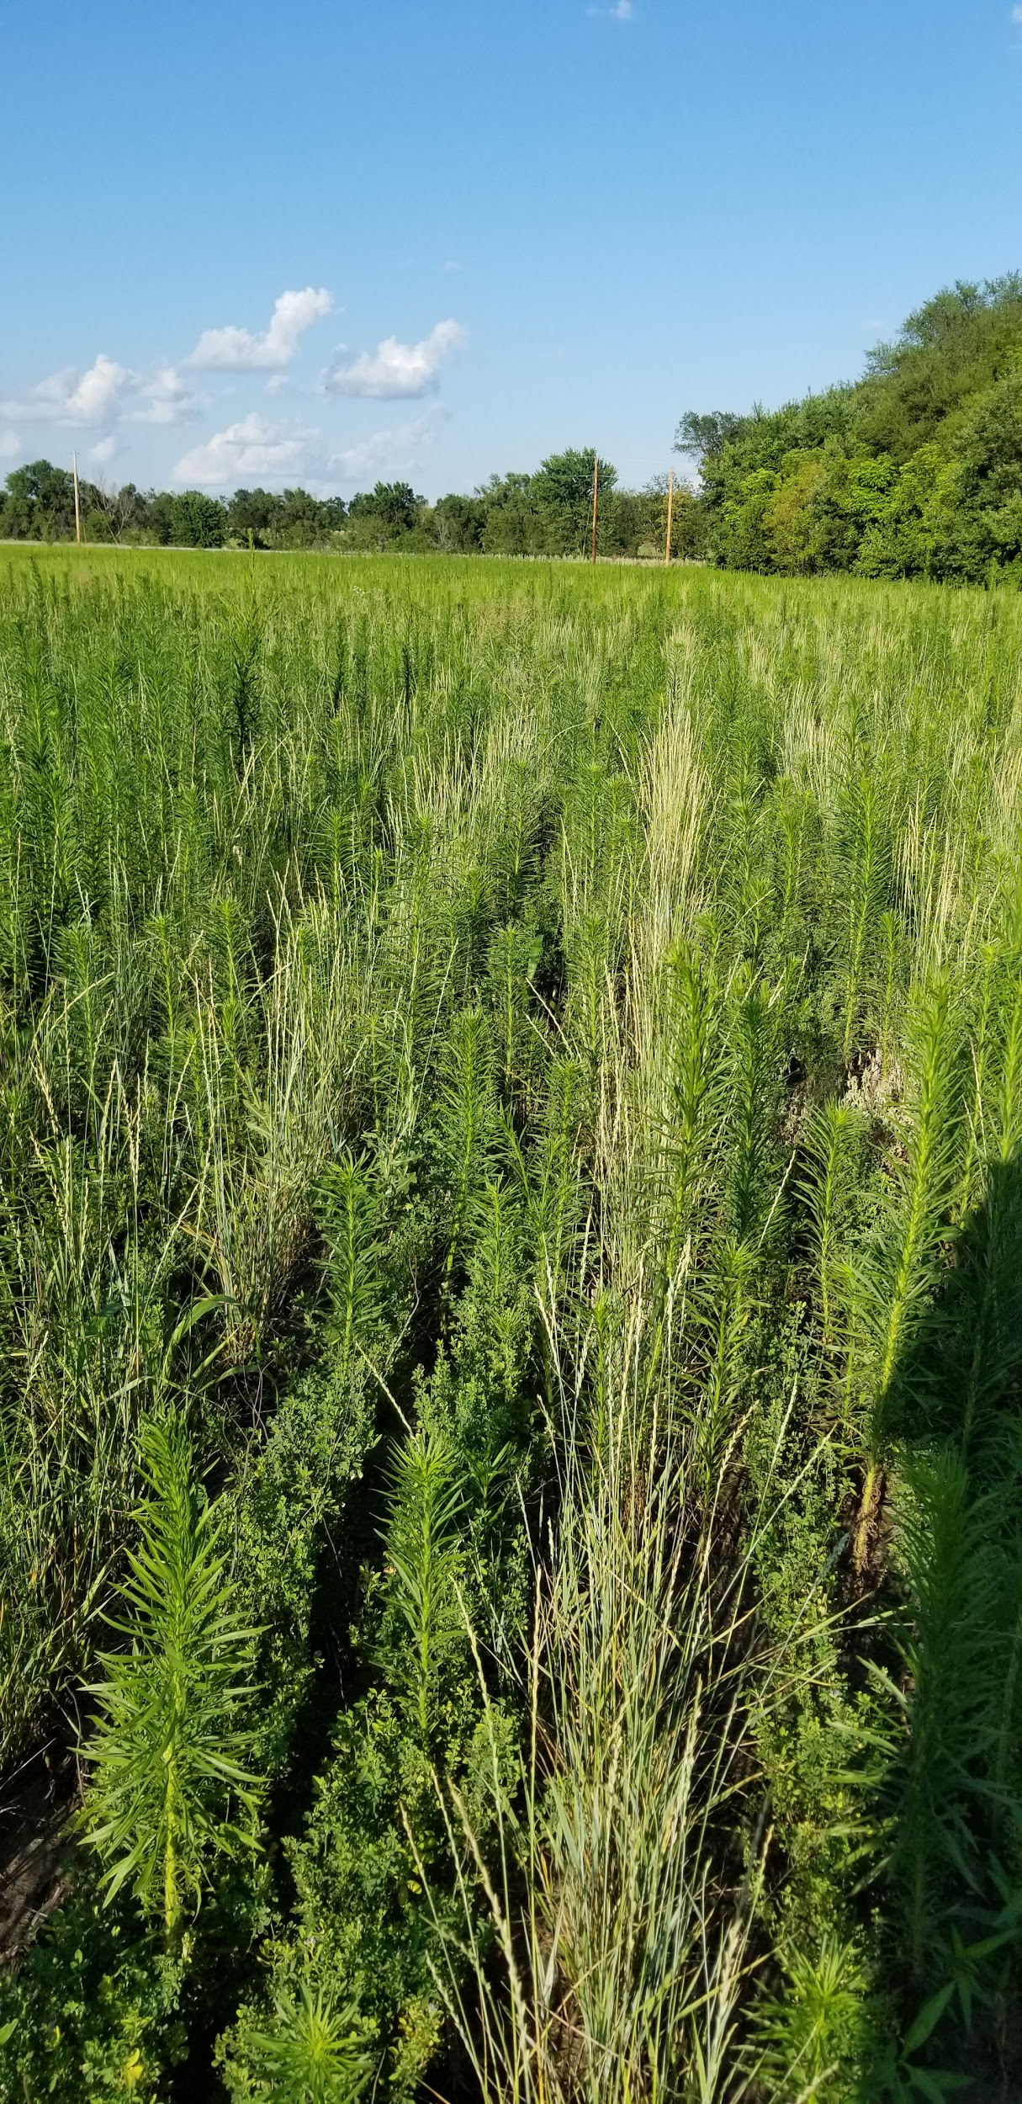

Slide 17
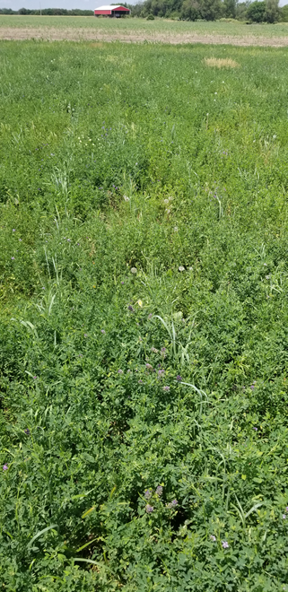
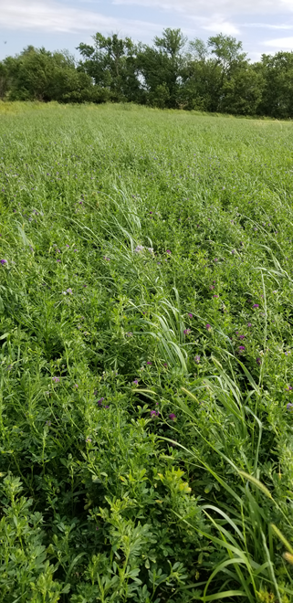
No-till establishment of Kernza into existing alfalfa stand?

Slide 18
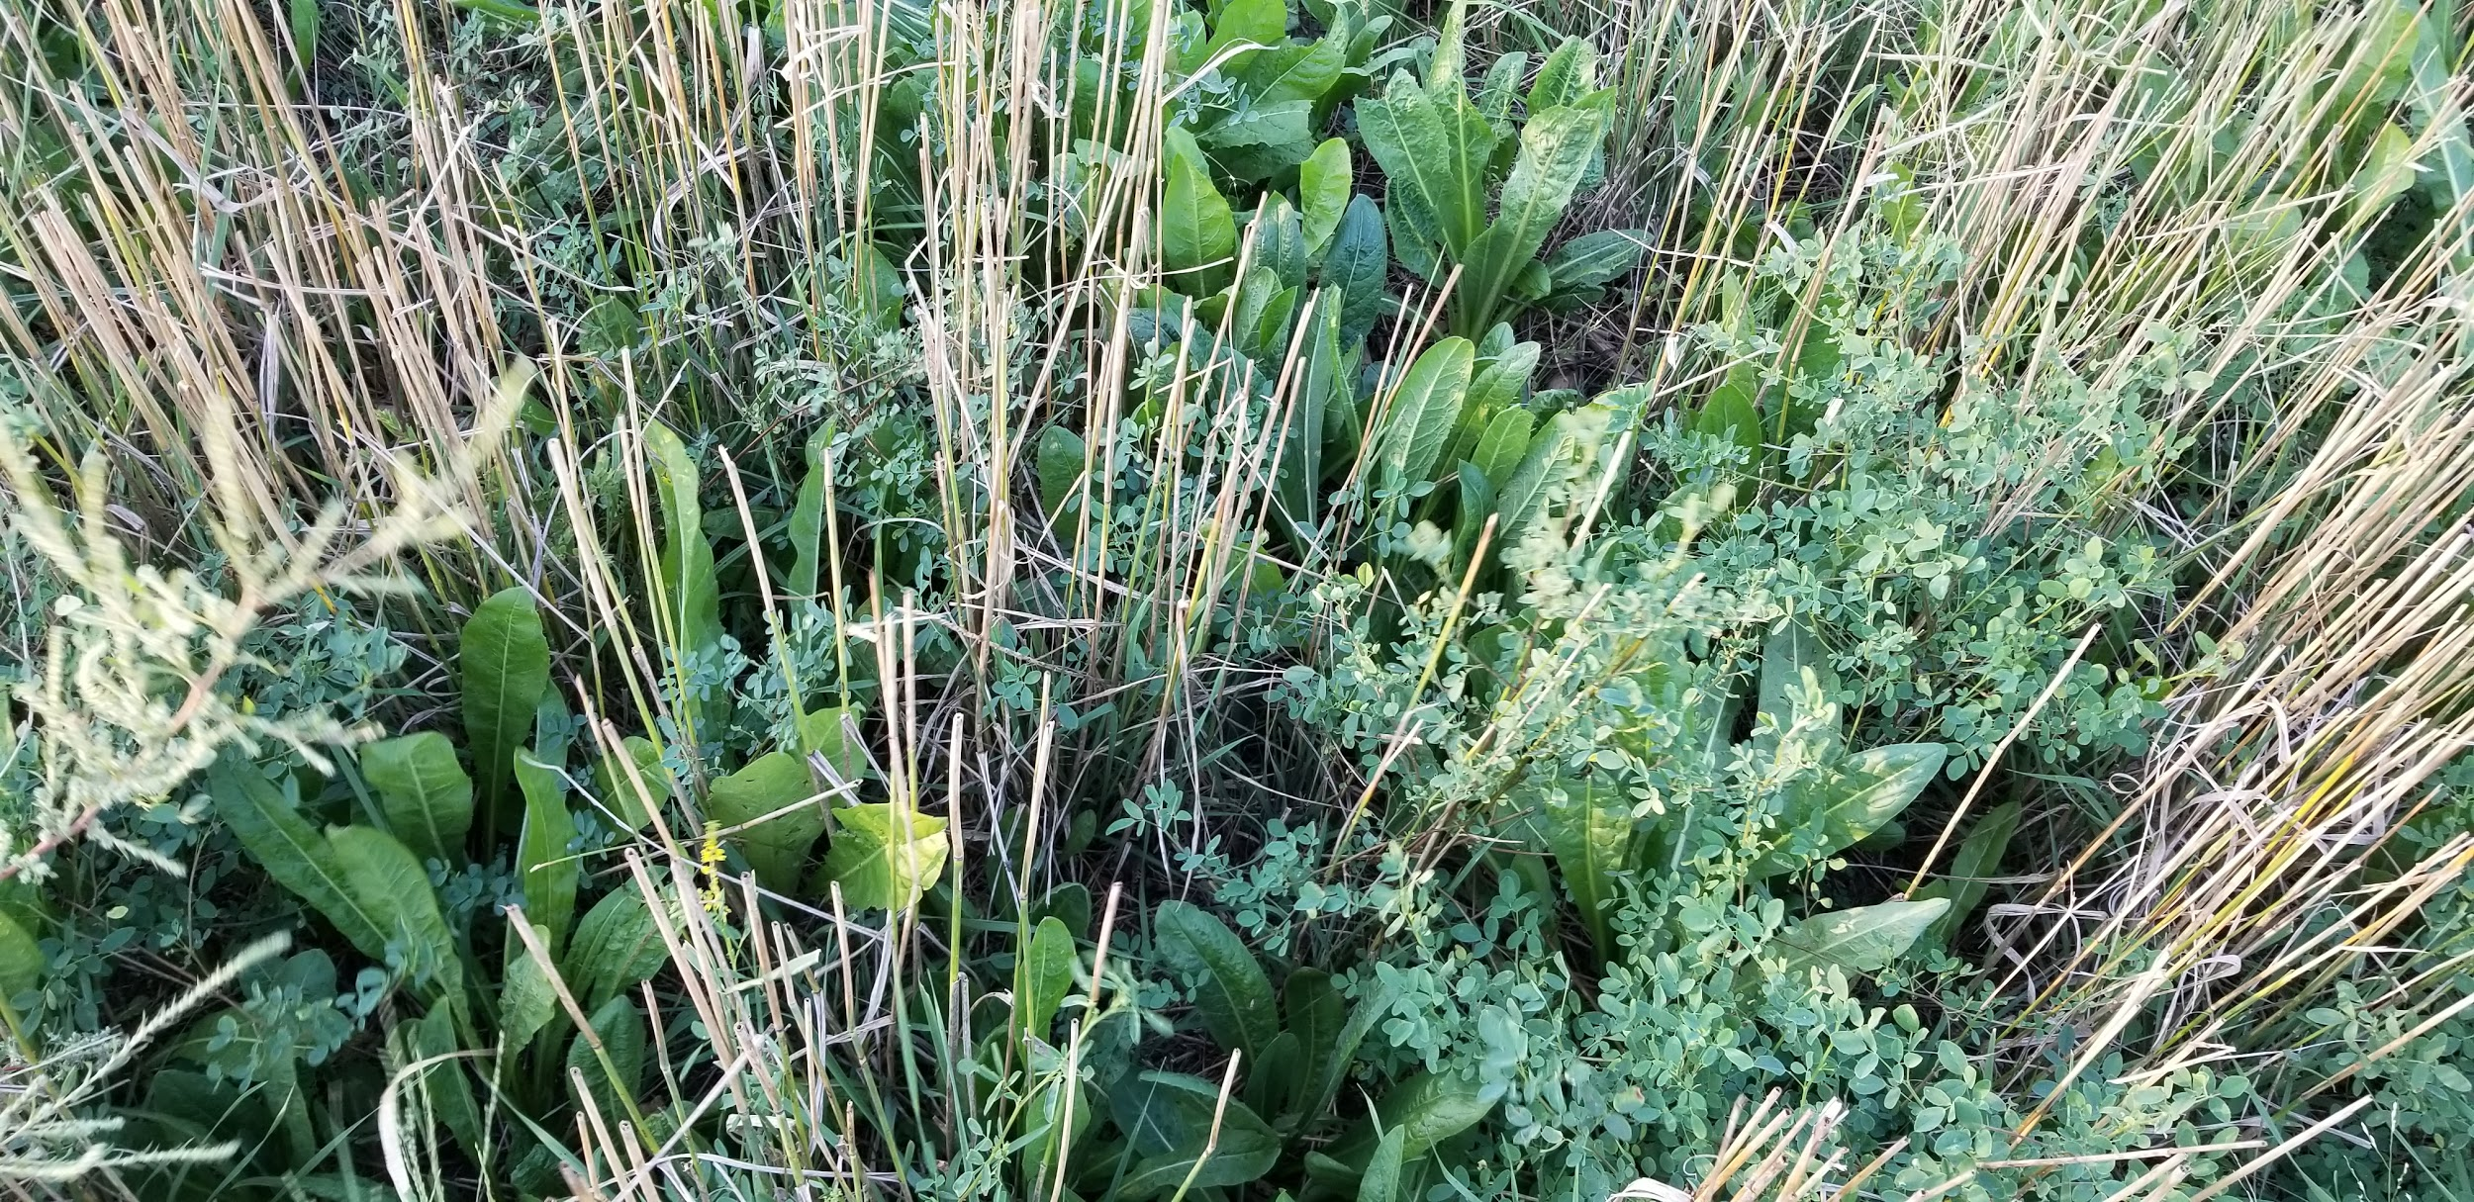
Kernza + alfalfa + yellow sweetclover + chicory
September 14, 2019

Slide 19
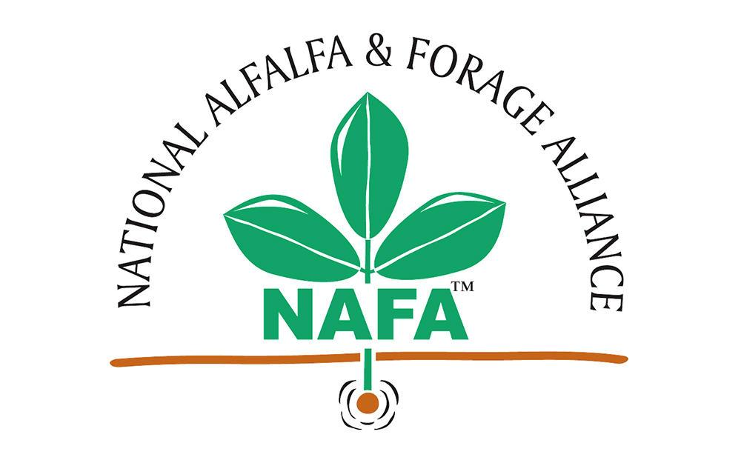
A company is an association or collection of individuals, whether natural persons, legal persons, or a
Thank You:
MORE AT landinstitute.org

